Slide 1
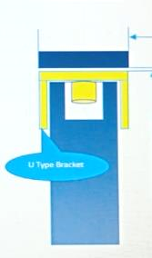
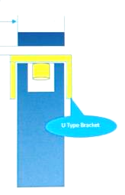
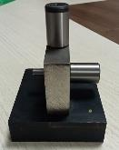
ACTIONS FOR U TYPE BRACKET HONDA BEAT CARBURATOR
Supplier: Saptagiri Industries.
Operation: U TYPE BRACKET - HONDA BEAT CARBURATOR
Implementation Date: 19.01.2023
While threading operation u type bracket not align with the tap (Not perpendicular to flat ) While thread formation, cross threading form due to misalignment More gap in-between top resting plate and parts ( Gap 2.5 mm ) | Reduce the gap in between Top resting plate and parts ( 0.2 mm )
BEFORE
AFTER
Defects Details : NOT AS PER SPECIFICATION-SQUARNESS UP TO 0.8 AGAINST 0.1 ( QTY – 15 NOS )
Material flow
Material flow
RM inspection
RM inspection
Sheet sharing
Sheet sharing
While threading operation u type bracket not align with the tap (Not perpendicular to flat )
Blanking
Blanking
Two side chamfer
Two side chamfer
First Forming
First Forming
While thread formation, cross threading form due to misalignment
U Forming
Reduce the gap in between Top resting plate and parts ( 0.2 mm )
U Forming
Piercing first Hole
Piercing first Hole
Piercing Second Hole
Piercing Second Hole
More gap in-between top resting plate and parts ( Gap 2.5 mm )
Extrusion & Chamfer
Special gauge provided to verify concentricity
Extrusion & Chamfer
Chamfer fer
Chamfer fer
Tapping fer
Tapping fer
Cleaning fer
Cleaning fer
Final Inspection fer
Final Inspection fer
Packing/storing fer
Packing/storing fer

Slide 2
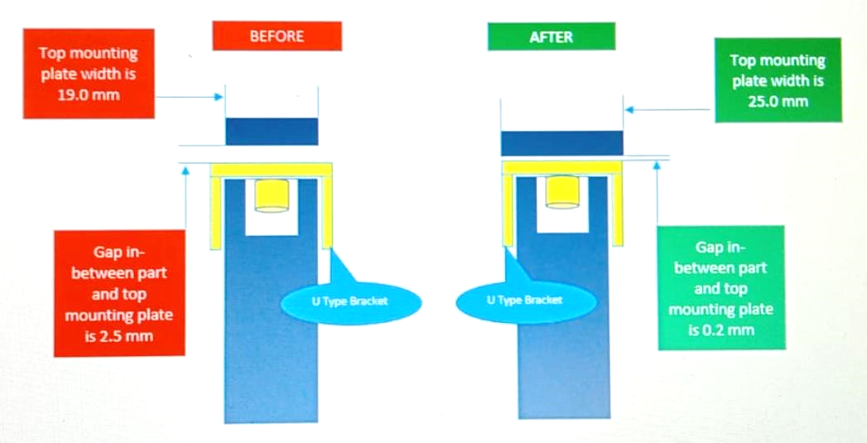
ACTIONS FOR U TYPE BRACKET HONDA BEAT CARBURATOR
Supplier: Saptagiri Industries.
Operation: U TYPE BRACKET - HONDA BEAT CARBURATOR
Implementation Date: 19.01.2023
BEFORE
AFTER

