Slide 1
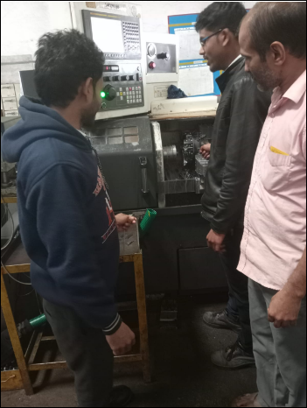
Training Evidence for Customer Complaint found at ETL in Fork Bolt KOPG
Defect - Groove OD 22.45 – 0.1 Under Size
Training Topic – How to change Insert, how to take offset, & Job check

