Slide 1
MAP ALLOYS

Slide 2
Customer Complaint :
Customer : ETL –k226, Waluj, A’bad
Complaint Reported on : 07.01.23
Part Name : Integral Caliper
Part No : 520BK01573
Defect : Leakage
Qty : 01 Nos Cavity –A28
Batch No : 32J49

Slide 3
Customer Communication:

Slide 4
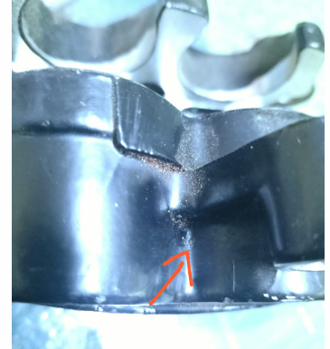
Defective Part Image :
Leakage Location

Slide 5
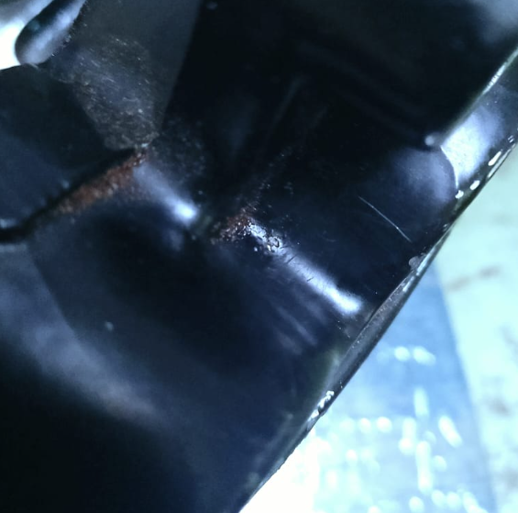
1. Visual Appearance
Pin hole /deep mark observed
Result : Minor deep mark /pin hole observed at leakage location
X

Slide 6
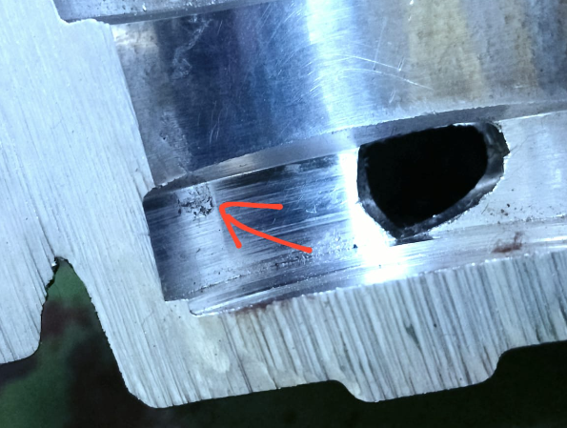
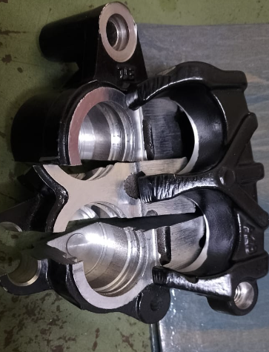
2. Visual Appearance –Cut Section At leakage location
Oxide /inclusion observed
Result : Oxide/inclusion observed at leakage location inside piston bore .
X

Slide 7
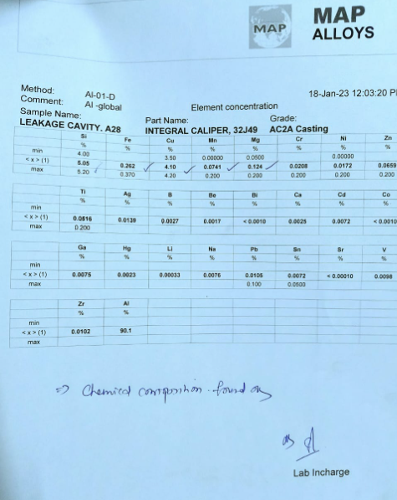
3 . Chemical Test-
Result : Chemical composition confirms to the spec AC2A–Found Ok

Slide 8
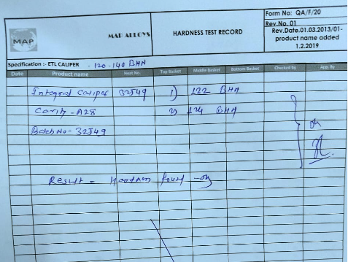
4. Hardness Test
Hardness Spec -120-140 BHN
Observed -122 ,124 BHN
Result : Hardness Test confirms to the specification –Found Ok

Slide 9
Mail Communication dtd 17.01.23 - Caliper Leakage Cavity A22 & A29

Slide 10
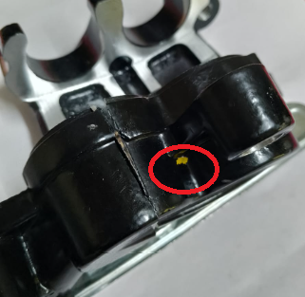
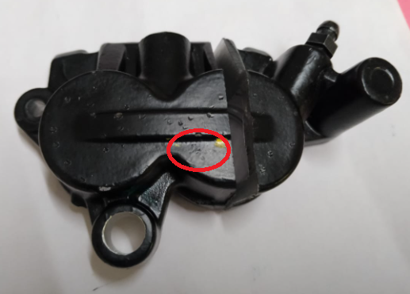
Defective Part : Leakage location
Cavity –A22 | Cavity -29
Leakage location marked by red circle | Leakage location marked by red circle

Slide 11
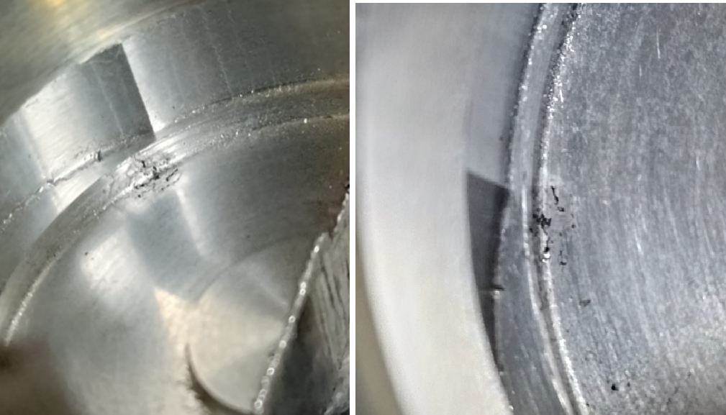
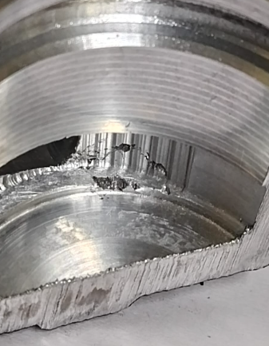
Defective Part : Cut section visual inspection
Cavity –A22 | Cavity -29
Oxide –inclusion observed at piston bore | Oxide –inclusion observed at piston bore

Slide 12
MAP Alloys Observation/Findings as below :
Defect Conclusion :
Sr No | Cavity No | Analysis –Visual observation | Remark
01 | A-28 | Oxide inclusion observed at leakage location | Not Ok
02 | A-22 | Oxide inclusion observed at leakage location | Not Ok
03 | A-29 | Oxide inclusion observed at leakage location | Not Ok

Slide 13
Why Why Analysis :
Why 1 : Leakage through piston bore area
Why 2 : Oxide/inclusion observed at leakage location
Why 3 : Oxide /inclusion flow out in cavity from molten metal .
Why 4 : Presence of Oxide inclusion in molten metal bath
Why 5 : Metal cleaning process inadequate
Root Cause : Metal cleaning process inadequate

Slide 14
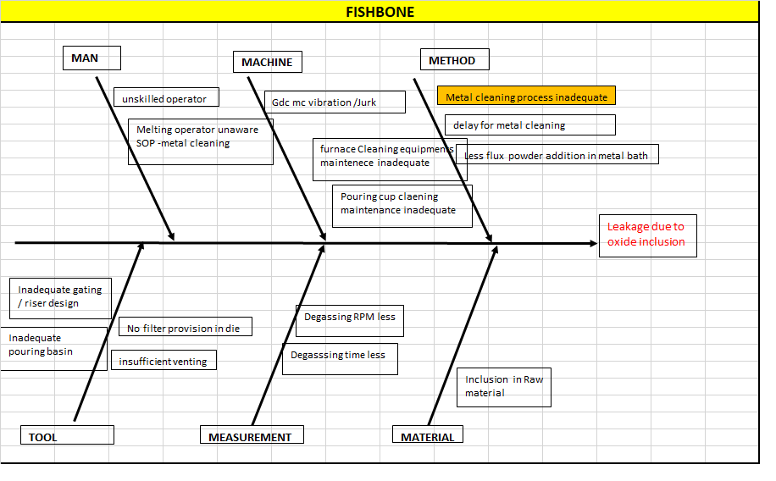
Fishbone :

Slide 15
Action Plan :
Sr No | Defect | Action Plan | Resp | Target Date | Status
1 | Leakage | Occurrence Side : 1. Alarm/buzzer with 10 min frequency provided at melting furnace for metal cleaning. 2. Poka-yoke to be implement – Auto pourer will pick up metal after metal cleaning and buzzer accept by operator 3. Auto skimmer provision to furnace bath, feasibility to be check and confirm. | Milind Narkhede | 23.01.23 15.02.23 05.02.23 | Completed In process In process
2 |  | Detection Side : 1. 100% dot mark will be provided for leakage location inspection. (WIP parts) 2. QA alert displayed at final inspection stage | R. Pandey | 18.01.23 08.01.23 | Completed
3 |  | System side : 1. Buzzer alarm provision check point will be updated in Poka-yoke check sheet. | Milind Narkhede | 24.01.23 | Completed

Slide 16
Thank You

