Slide 1
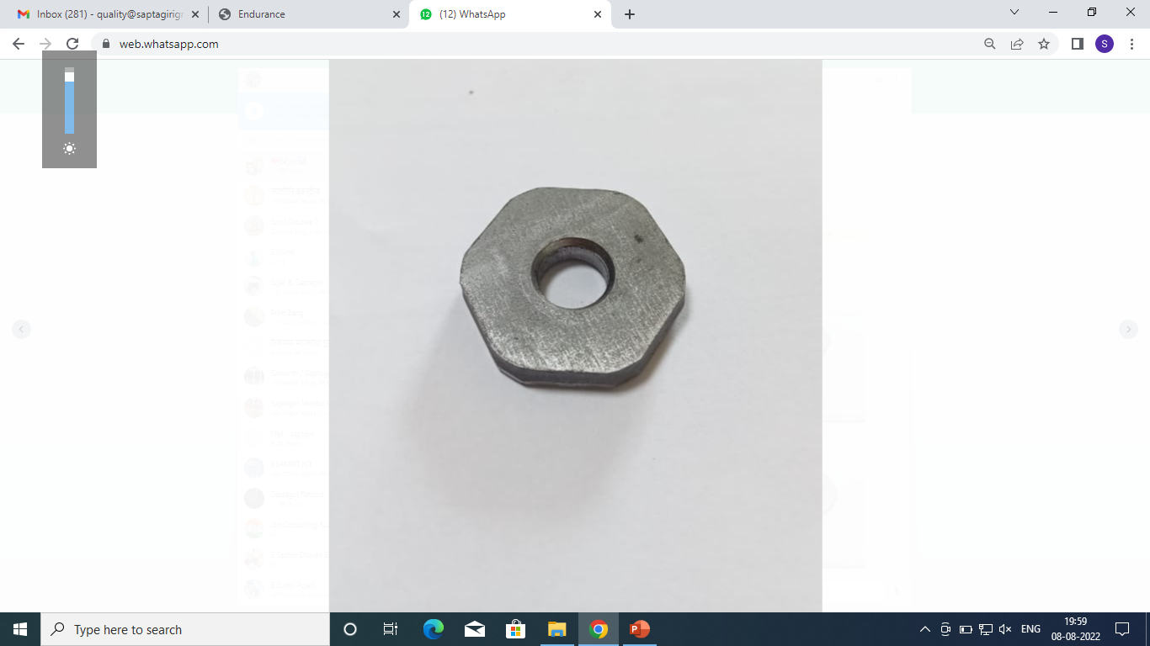
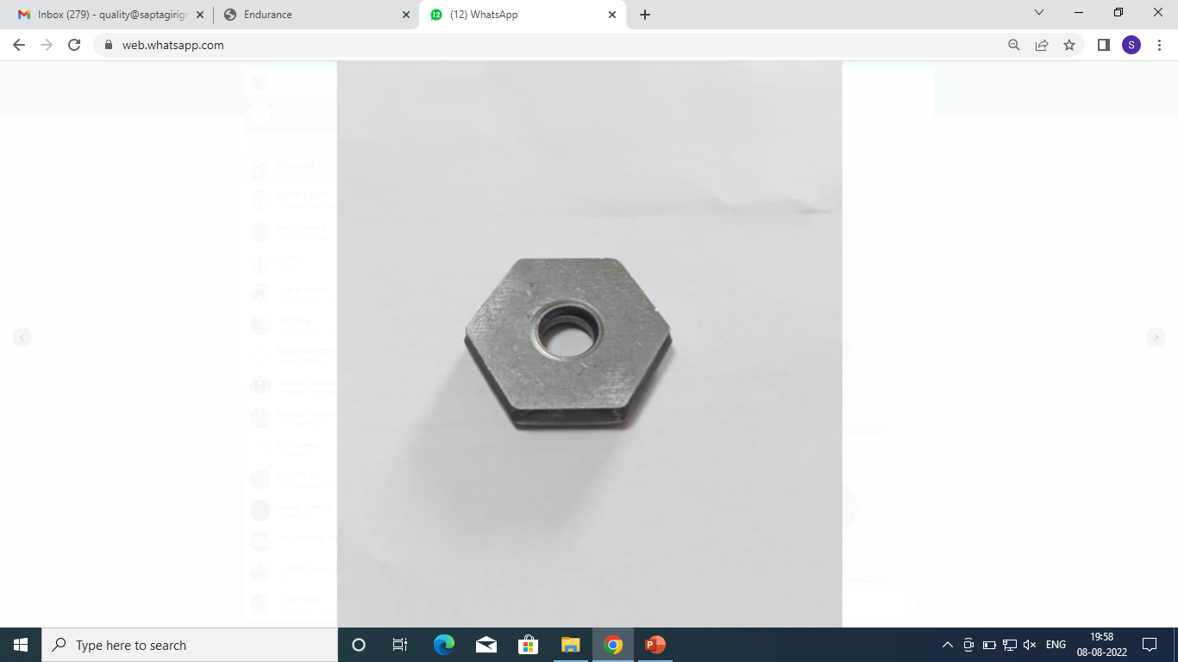
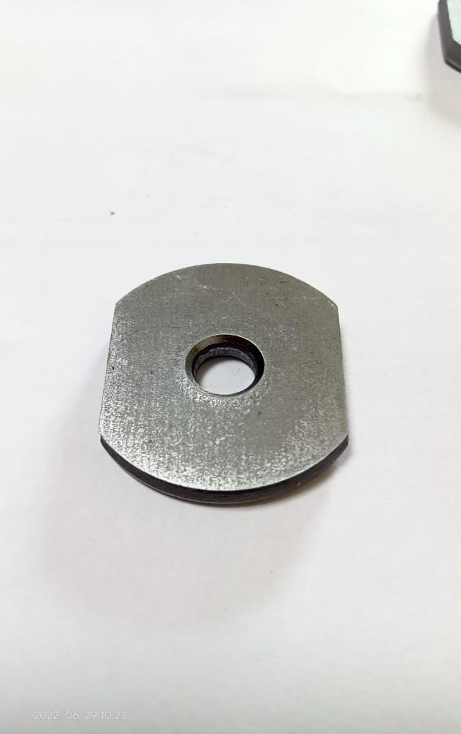
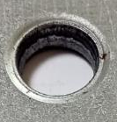
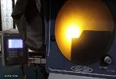


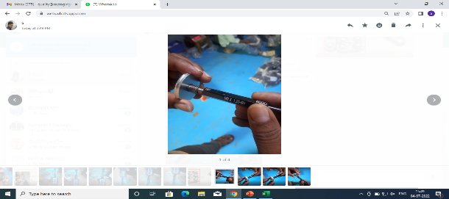
ACTIONS FOR NG THREADING (Hex NUT 520FL03012 )
Burr observed at ending of thread Step mark on chamfer Chamfer angle more that is 55 degree against 45 degree Chamfer tool warn out | No burr on chamfer No Step mark on chamfer angle . Chamfer angle corrected as require 45 degree . Chamfer angle verified on profile projector Started 100% tapping inspection by TPG.
Supplier: Saptagiri Industries.
Operation: Press shop / Machine shop
Implementation Date: 30.01.2023
BEFORE
AFTER
Problem/Present Status: GO not passing through out into the thread
No burr on chamfer
Material flow
Material flow
Burr observed at ending of thread
No Step mark on chamfer angle .
RM RECEIPT
RM RECEIPT
RM Inspection
RM Inspection
Step mark on chamfer
Blanking
Chamfer angle corrected as require 45 degree
Blanking
Chamfer angle more that is 55 degree against 45 degree
Pressing
‘’ Chamfer tool replace with new one and started
Pressing
Both side chamfer
Both side chamfer
Chamfer tool warn out
Threading
Threading
Chamfer angle verified on profile projector
Plating
Plating
Started 100% tapping inspection by TPG.
Final Inspection
Final Inspection
Packing
Packing

