Slide 1
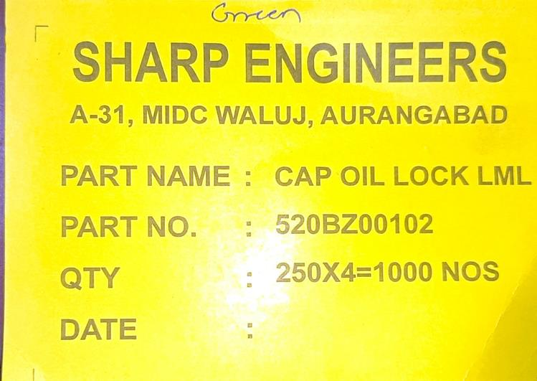
Improvement in Inspection/Packing stage

