Slide 1
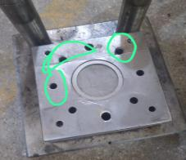
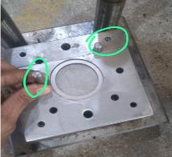
Action and Implementation
Before
After
Stopper pin not provide
Stopper pin not provide
Part Name | Part No | Supplier | Defect | Actions | T. Date | Status
Washer Seal | 550PL01712 | SAPATGIRI INDUSTRIES | Defect Phenomenon – Punching shift from side (cut mark observed on the outer side) – 23.01.2023 Why 1 : Raw material strip shift, While production and strip forwarding to another part by manual :Why 2: Stopper or guide pin not provided Why 3: Root Cause: Stopper or guide pin not provided | Containment action: 100 % material verified at ETL and Saptagiri End and observed 12 nos at Saptagiri end Inspection side action: 1- 100% Inspection started along with identification mark on the bag. Cause Side Action: 1- Two guide pin or stopper provided. 2- Additionally die plate guide bush replace with new one Sustenance : Verify guide pin by daily check sheet : Die plate guide bush will change after the 200000 nos or any damages before tool life. | 27-01-2023 | Completed

