Slide 1
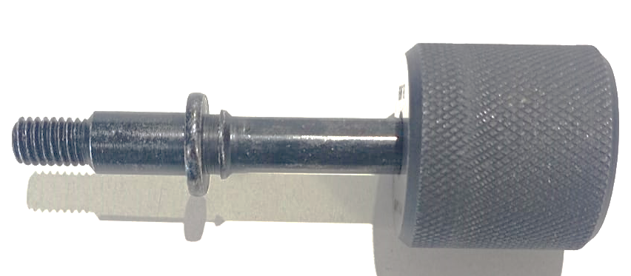
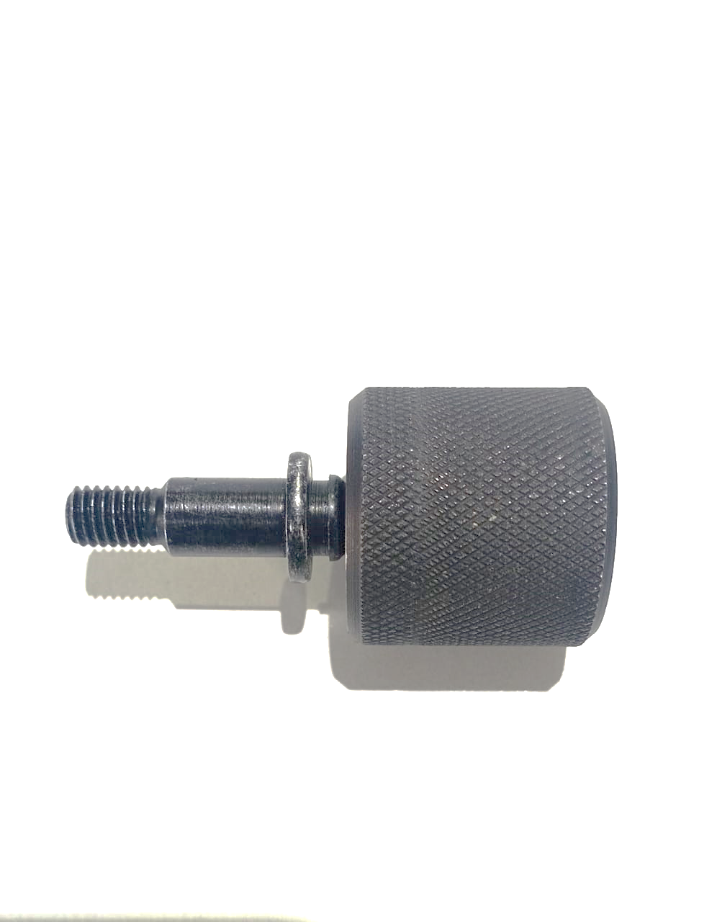
Action plan
Before
After
Part Name | Model | Supplier | Defect | Actions | T. Date | Status
9 mm anchor pin B2TD00626O | REML | Metaforge | Defect Phenomenon – 8.90-8.97 OD O/S Why 1: Straightness gauge not pass Why 2: 8.90-8.97 OD oversize Why-3- Some top coat flakes seen on OD Why 3: During top coat (Pigment Base) application after plating equally not distributed Why 4: Manual drying time is 12-15 minutes Root Cause: | Containment action: 100% inspection done from Total Segregation = 8000 nos. Ok = 6238 nos. N/Ok = 1762 nos Inspection side action: Straightness 8.90-8.97 mm gauge provided for plating stage Cause Side Action: Increase manual drying process time 20-25 minutes Sustenance – SOP revise Manual top coat drying time | 19.11.2022 20.11.2022 22.11.2022 22.11.2022 | C C C C

Slide 2
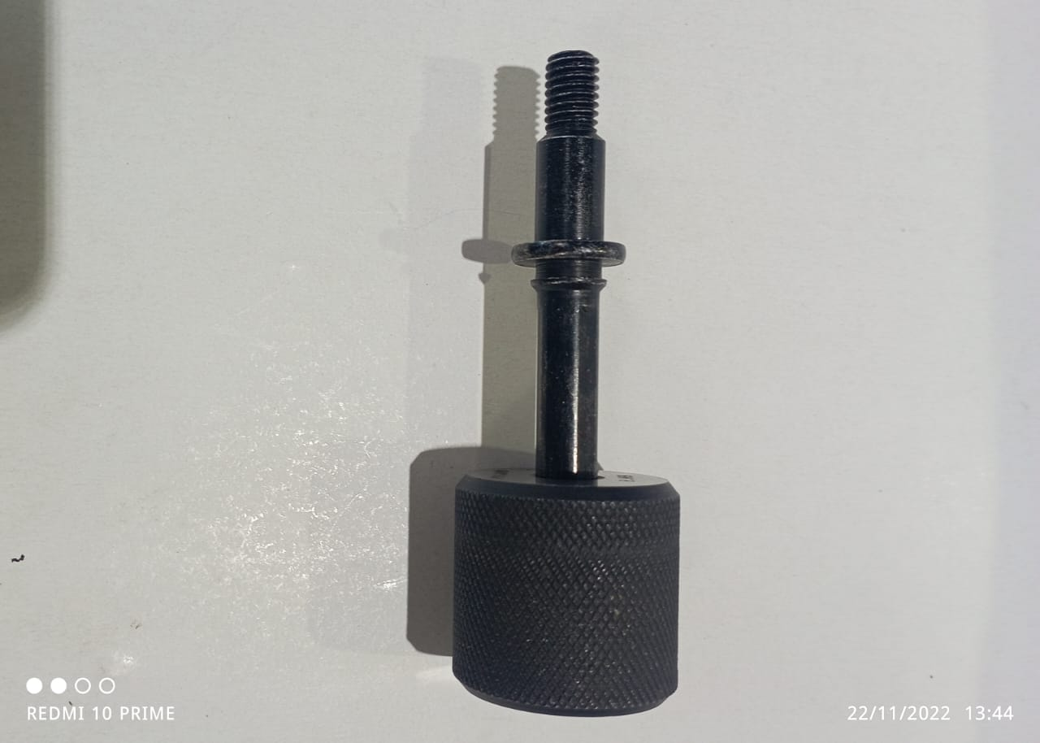
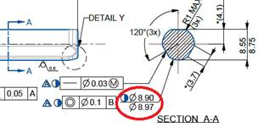
Quality Alert
8.90-8.97 mm OD O/S

Slide 3
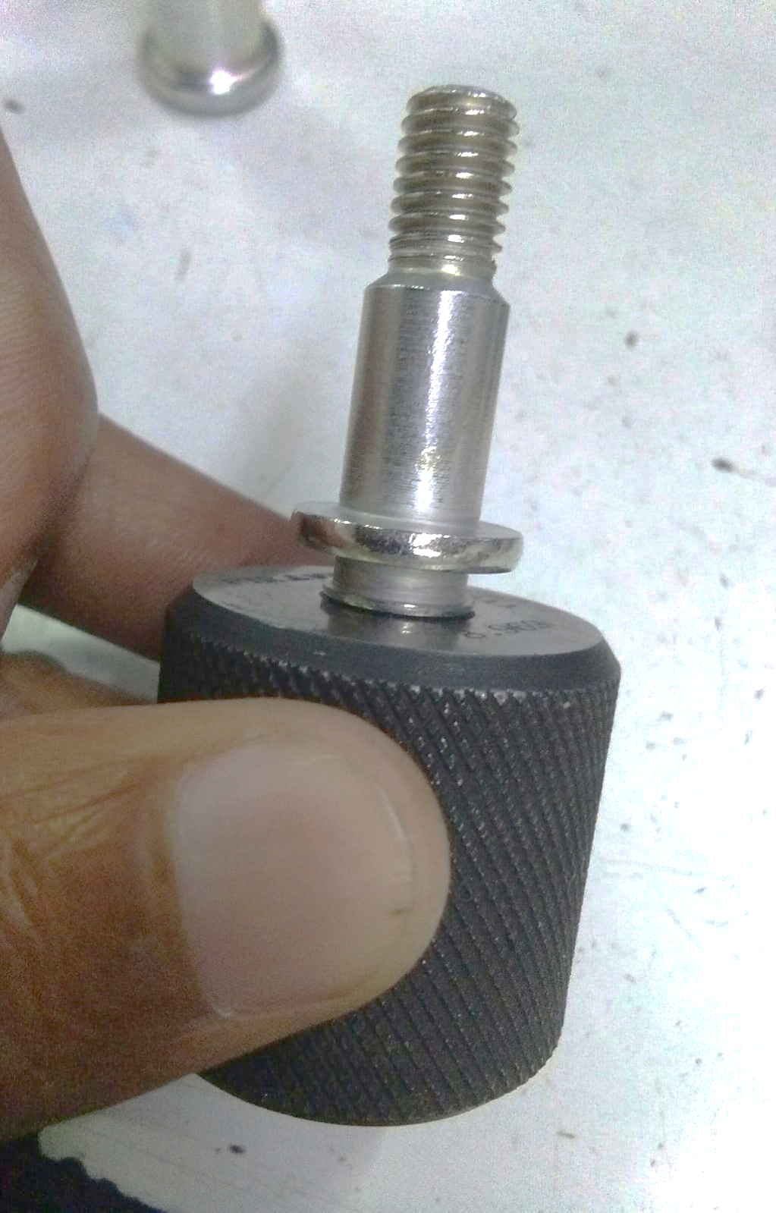
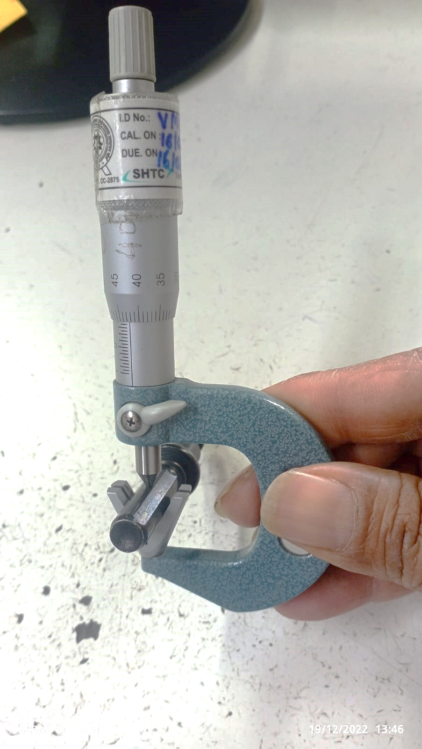
Improvement in Inspection
Straightness 8.90-8.97 mm gauge provided for plating stage
Inspection by V micrometer and Straightness Gauge

Slide 4
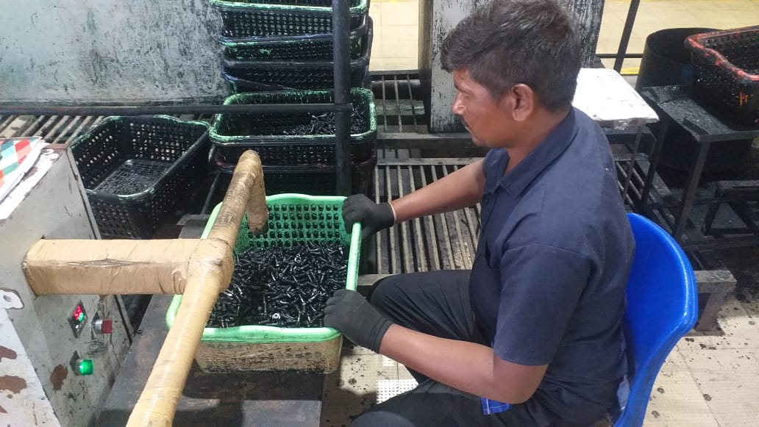
Manual hot air-drying process

Slide 5
THANK YOU

