Slide 1
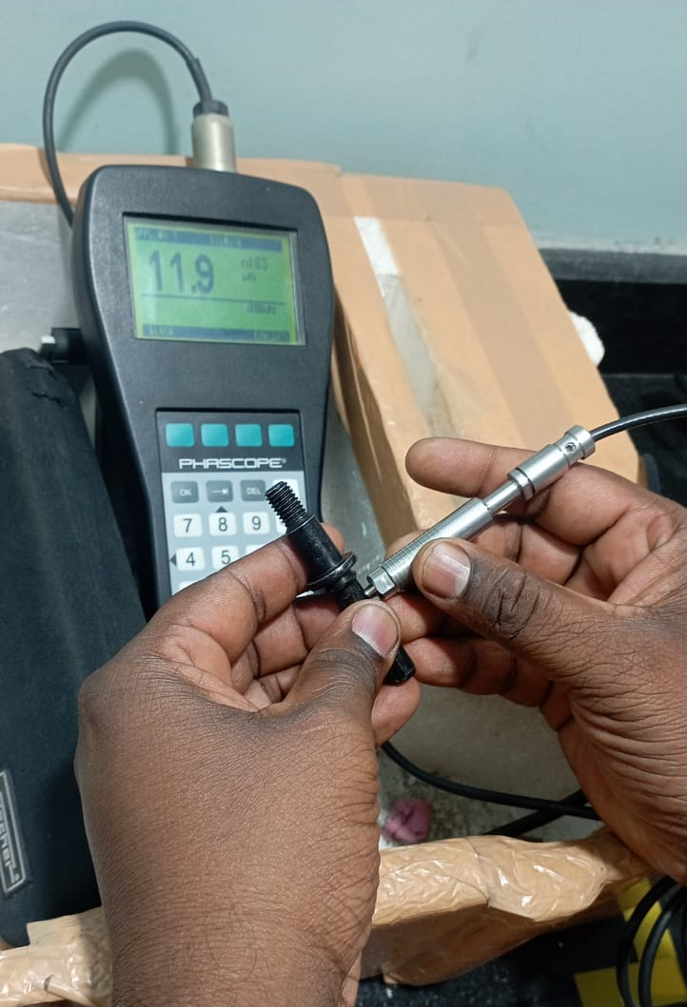
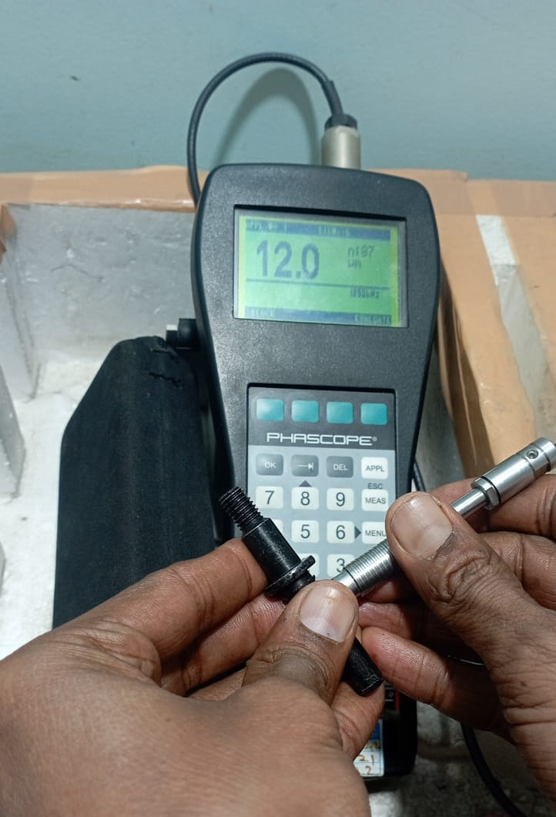
9 MM ANHCOR PIN STRAIGHNESS COMPLAINT
PLATING AT HIGHER SIDE 11-12 MICRONS STRAIGHTNESS GAUGE NOT PASS
AFTER REMOVING THE PLATING GAUGE PASS

Slide 2
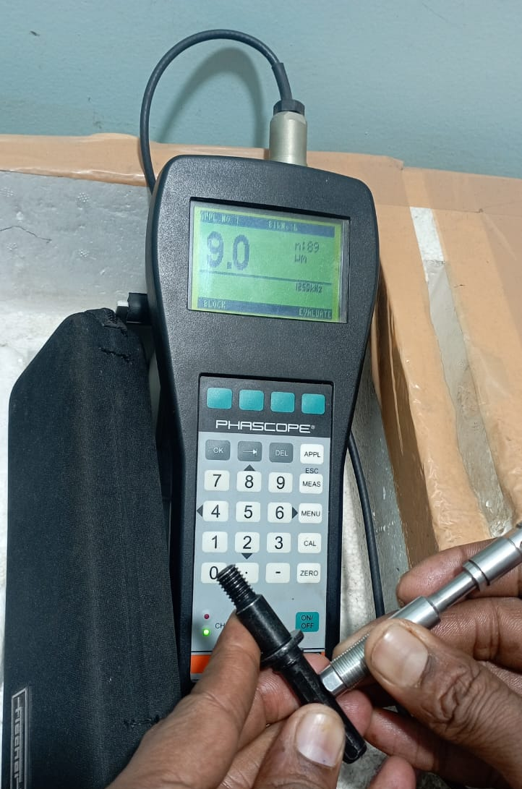
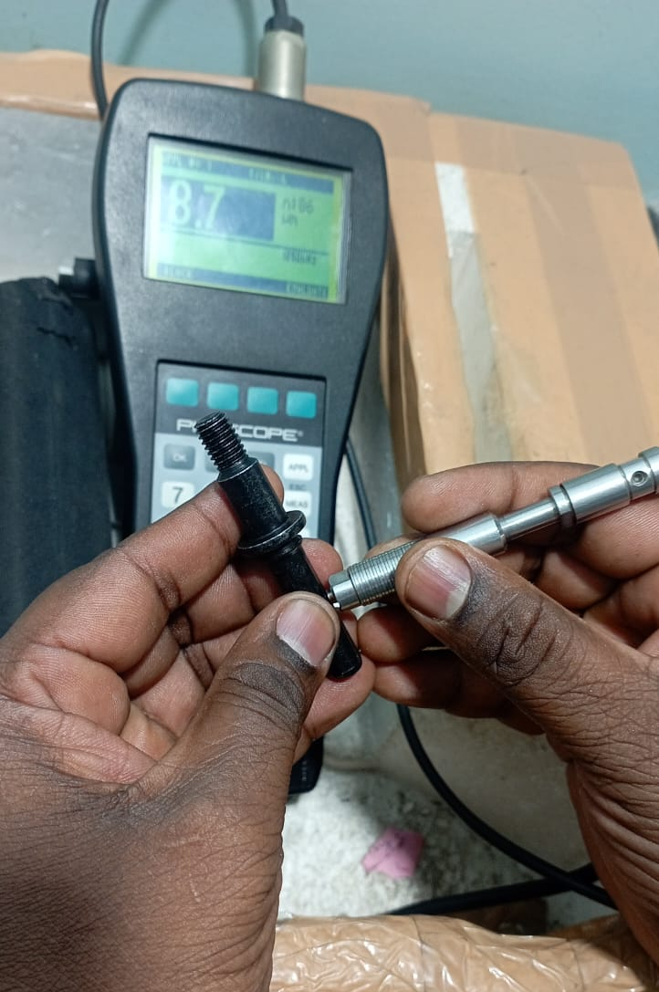
9 MM ANHCOR PIN STRAIGHNESS COMPLAINT
PLATING AT LOWER SIDE 8-9 MICRONS STRAIGHTNESS GAUGE PASS

