Slide 1
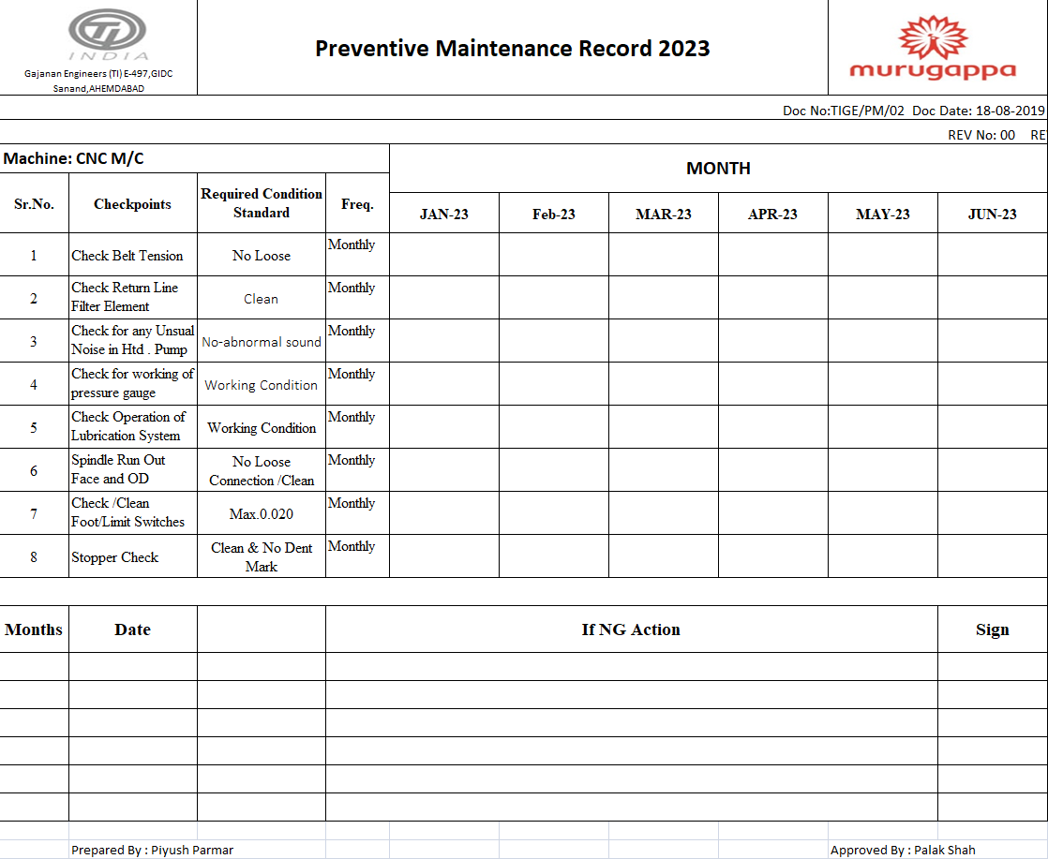
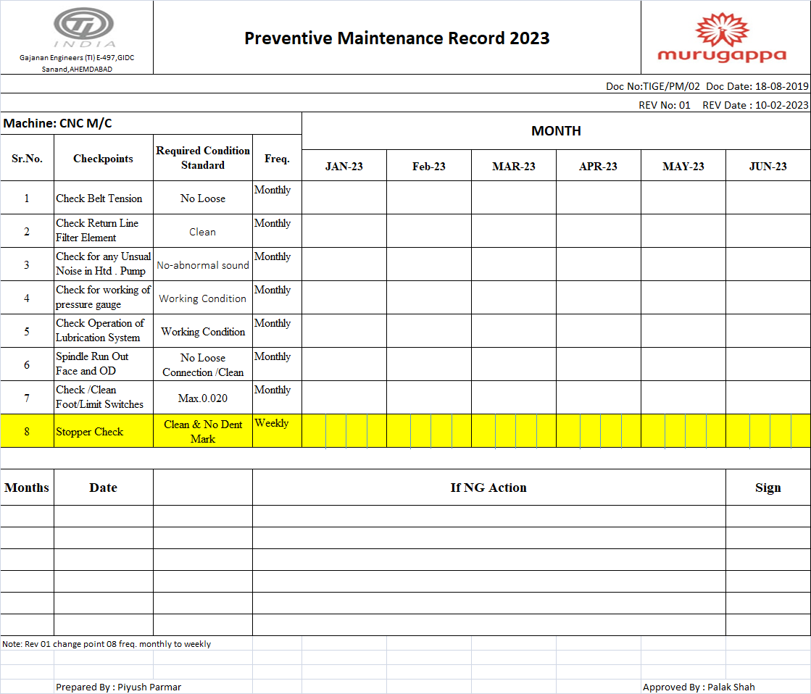
Before & After Comparison of Actions
Before
After
Description :-
Machine maintenance plan frequency one month.
Description :-
Machine maintenance plan frequency change one month to weekly bases

Slide 2
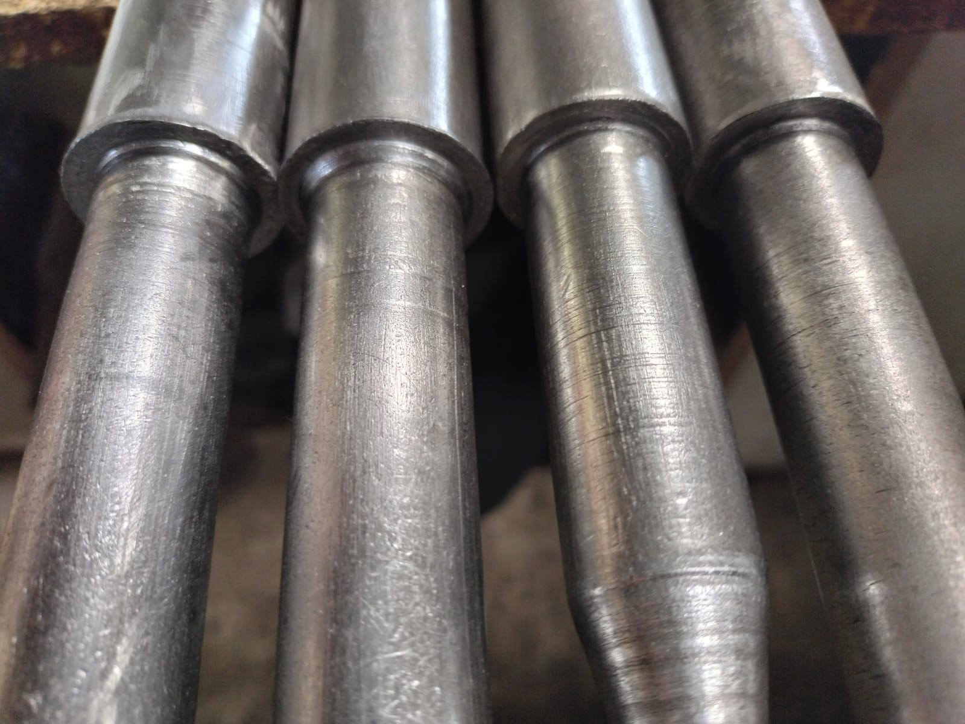
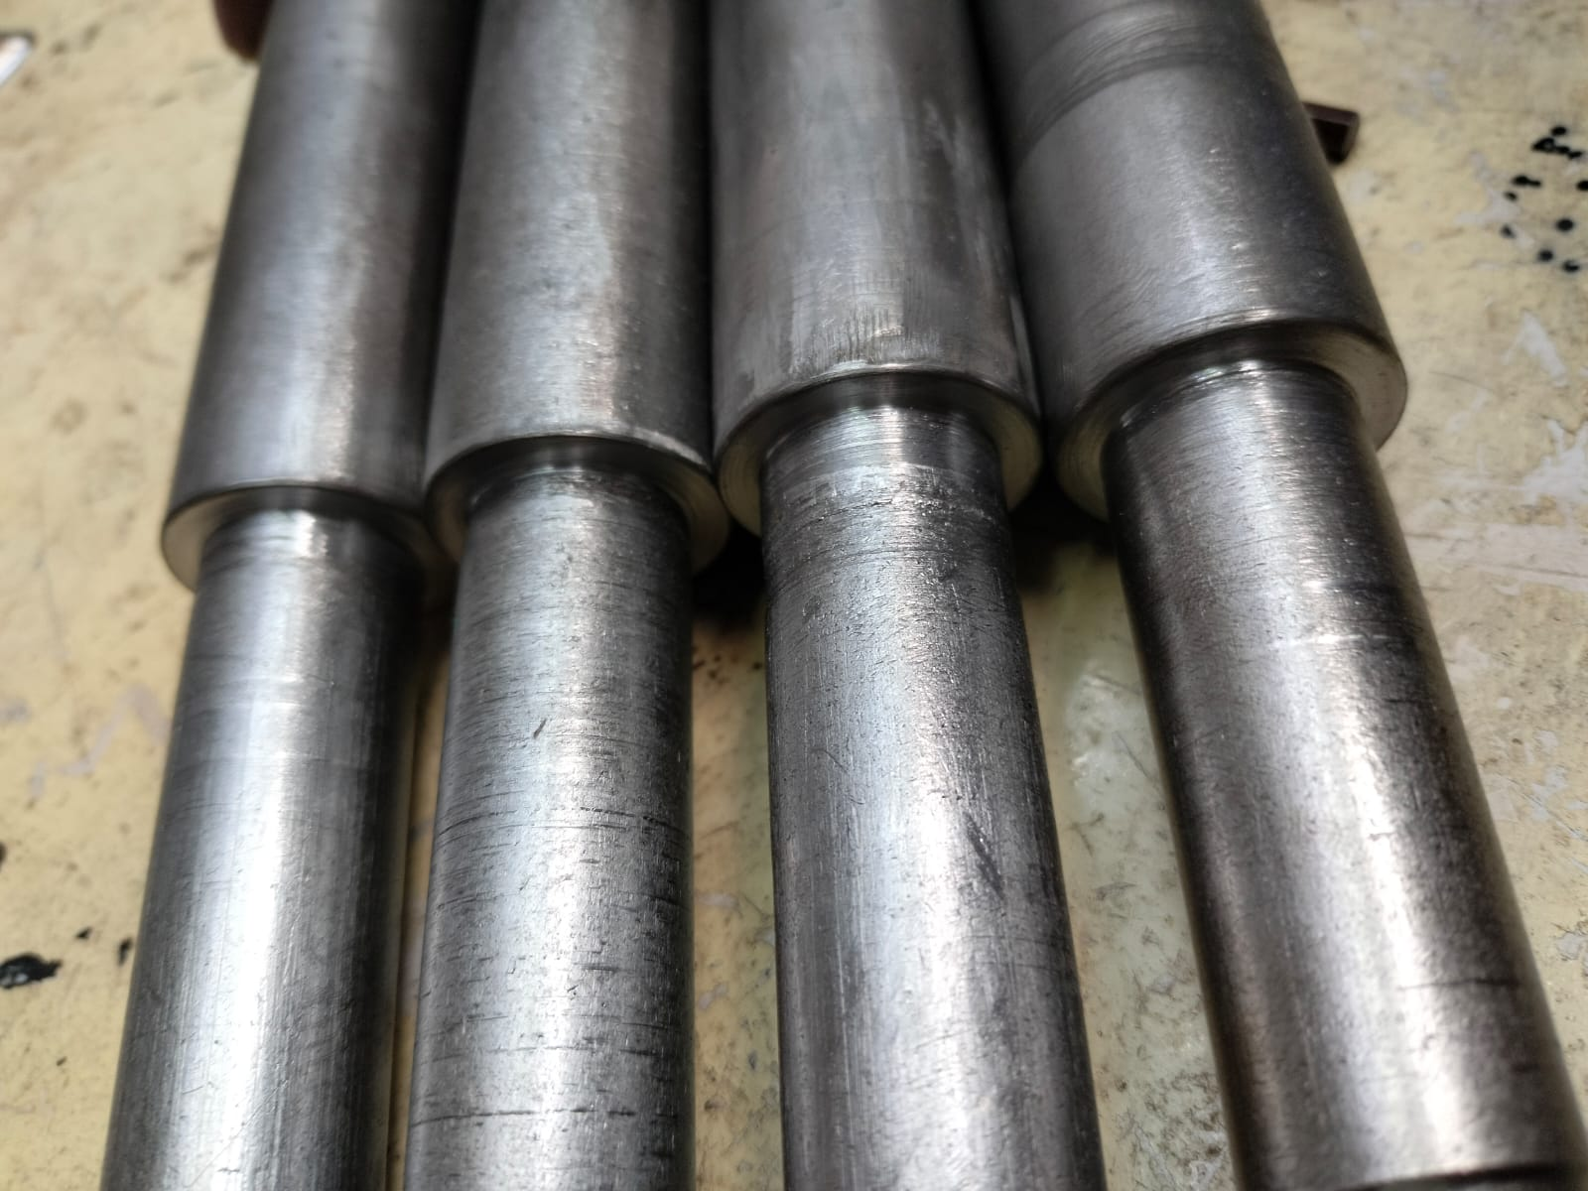
Before & After Comparison of Actions
Before
After
Description :- Stopper Cut Damage Found
Description :- Stopper Cut clean & OK

Slide 3
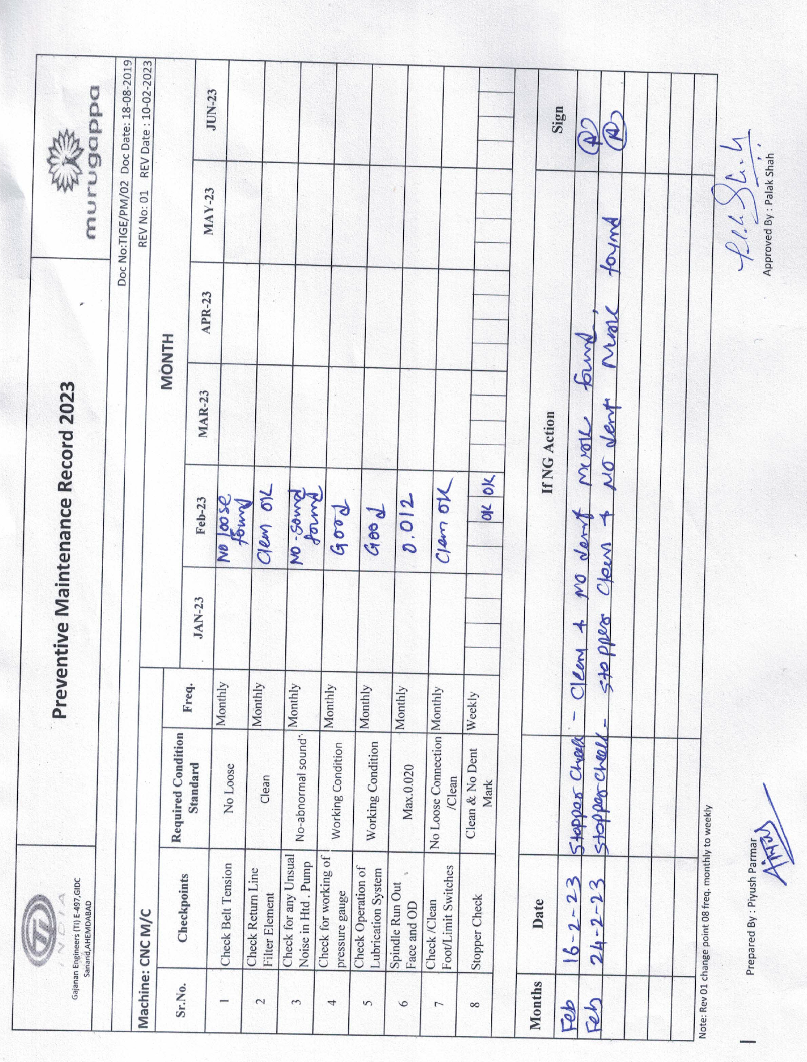
PM Check sheet
Description :-
Machine Stopper Check frequency change from one month to weekly bases & monitoring for Stopper Condition to eliminate the Dent Mark generation due to stopper damage.

