Slide 1
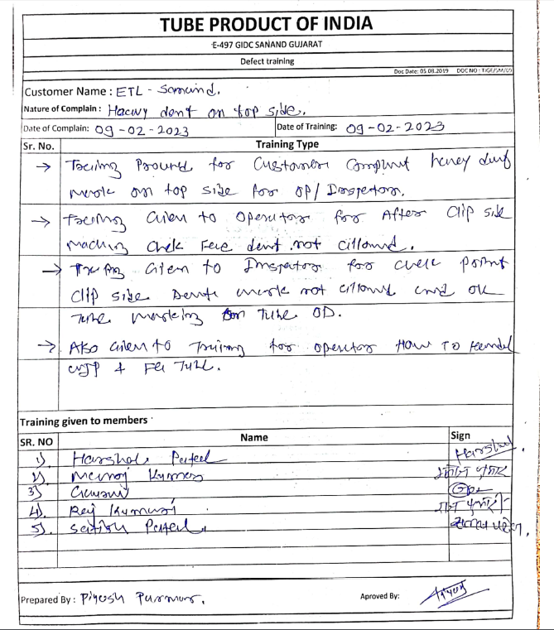
Training Sheet

Slide 2
Final Inspection check points

