Slide 1
Action plan
Dt.: 13 Feb 2023

Slide 2
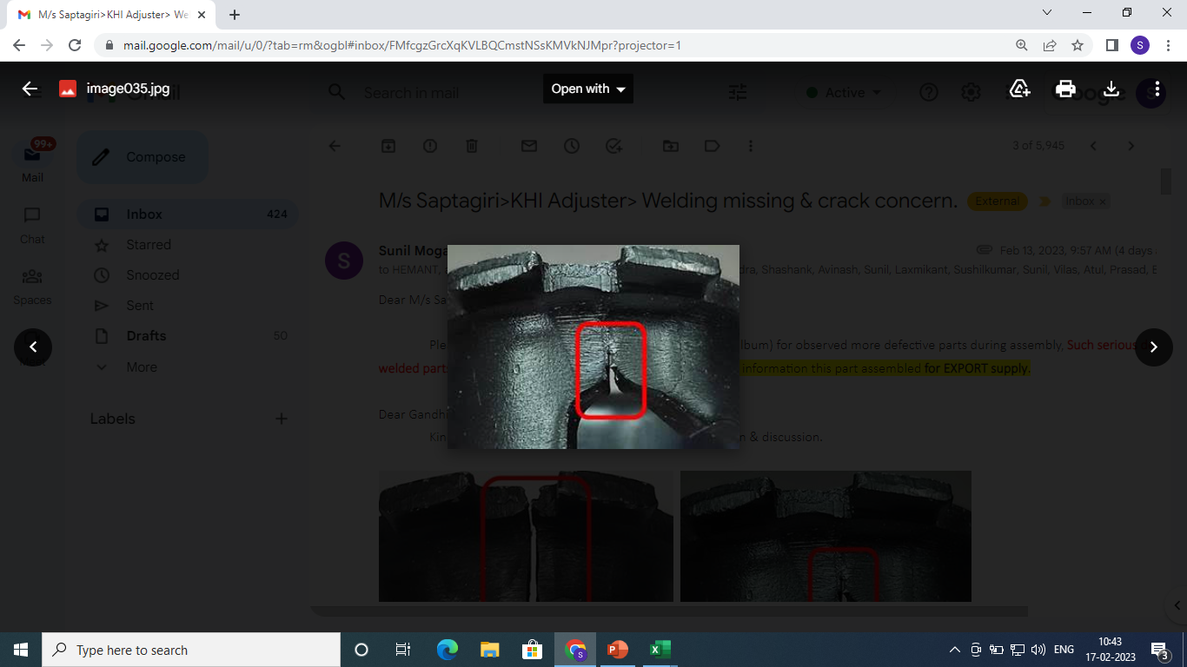
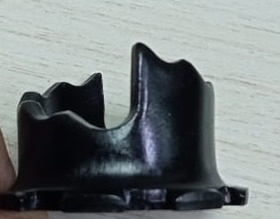
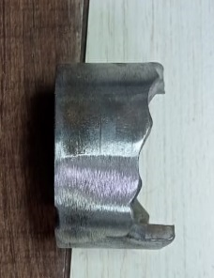
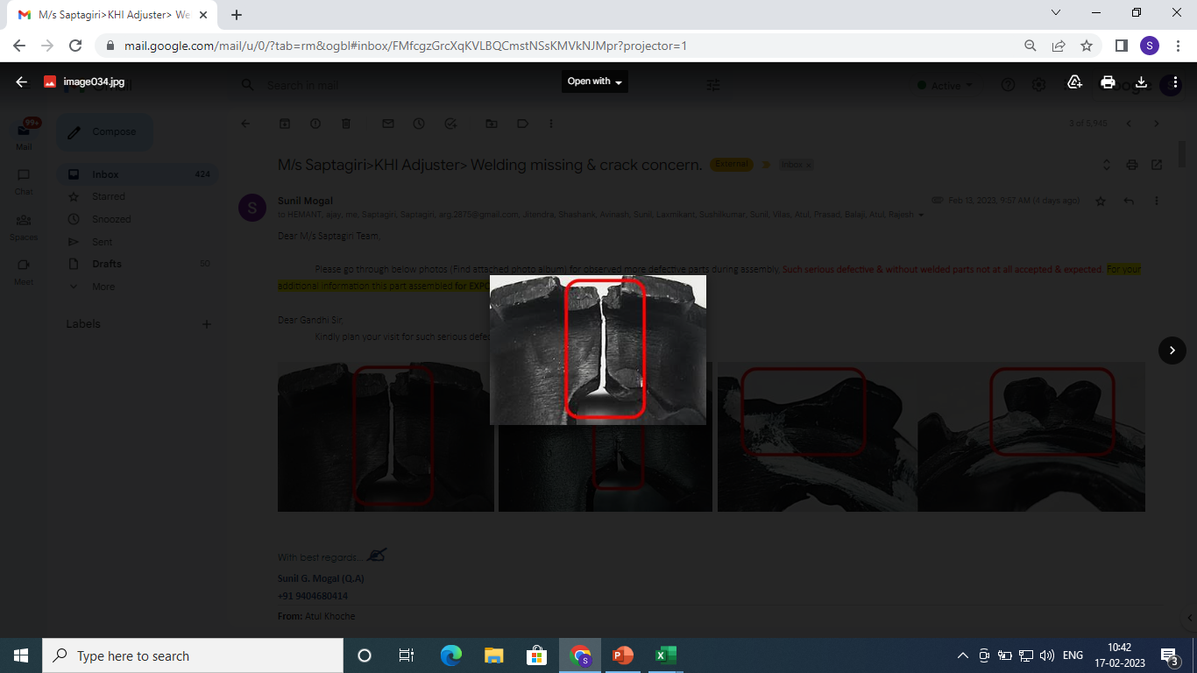
CONDITIONS FOR OCCURRENCE
● Phenomenon: Welding line open parts.
Trouble content
・Supplier: Endurance tech.
・Model: Kawasaki
・Parts name: Adjuster
・Part No.: S2AB04412O
・Date of Occurrence: 13.02.2023
・Qty NG: 4000 Nos.
NG Part | OK Part
●Parts Stock check results
Welding line Open
No weld line open
Action
Area | Total Stock | Checked | Checking Method | NG Qty | Status
ETL – K120 | 4000 | 4000 | Visual check | 4000 | All available stock qty. Rejected

Slide 3
UNDERSTANDING OF ACTUAL CONDITION AND CONTROL
Process Flow
Possible defect occurrence area.
Raw Material Inward
Sheet Shearing
Blanking
U Bending
First Rounding
Second Rounding
CO2 Welding
(Single Spot)
First Flaring
Single Notch
Parting & ID Chamfer
Buffing
Weld Bead Turning & Grinding
Co2 Welding
(Full Run)
Second Flaring
Restracking
OD Trimming & 8 nos Notching
Face Deburring
Buffing
Packing/storing
Final Inspection
Fe Zn Plating

Slide 4
UNDERSTANDING OF ACTUAL CONDITION
● Understanding the actual cause – (Factor analysis)
Man
Machine
Uneven welding
Round Bending Gap More
Round Bending not uniform (Circular
Less Awareness
Excess welding outside the Gap
Uneven Round Bending
Gap not filled by welding
Round Bending Gap uneven
Excess Buffing on welding area
Welding Open after buffing operation
Sample Basis Inspection
Method
Material

Slide 5
FACTS VERIFICATION
# | 3M | PROBABLE CAUSES | FACTS VERIFICATION | Jud.
1 | MAN | Less Awareness | Operator and inspector not aware about the weld line open | O
2 | MACHINE | Round Bending not uniform (Circular) | Round bending observe uniform ( Circular ) | O
 |  | Uneven round bending | Height variation in both side as well as uneven gap | ❒
 |  | Round bending gap uneven | In a few part observed uneven gap at top side less ( 0.54 mm ) and bottom side more (1.44 mm ) | ❒
 |  | Excess welding outside the gap | No Excess buffing observed | O
 |  | Gap not filled by welding | Gap fully filled by welding operation | O
 |  | Gap not filled by welding | Gap fully filled by welding operation | O
 |  | Excess buffing on welding bead area | No Excess buffing on welding line | O
 |  | Excess buffing on welding bead area | No Excess buffing on welding line | O
 |  | Uneven Welding | Welding run verified and observed evenly ( In straight line ) | O
4 | METHOD | Sample basis Inspection | While welding and buffing operation only do the sample basis inspection | ❒

Slide 6
ROOT CAUSE ESTABLISHMENT
(WHY-WHY ANALYSIS)
● Root cause establishment (Why-Why Analysis)
 | WHY – 1 | WHY- 2 | WHY -3 | WHY-4 | Why-5 | Why-6
Occurrence | Welding Open after buffing operation | Uneven round bending / Round bending gap uneven | Ram entry less or raw material spring back
Outflow | Welding Open after buffing operation | No Inspection after the buffing operation
Conclusion
Uneven round bending / Round bending gap uneven
Ram entry less or raw material spring back
No Inspection after the buffing operation
Inspection after the buffing operation

Slide 7
COUNTERMEASURES
 | Cause | Countermeasure | Tgt. Dt. | Status
Supplier End | <Occurrence > | Before Welding operation 100% inspection starts for uneven round bend. 100% inspection starts after welding operation. Draw route process to be introduce instead of welding process. | 14-03-2023 14-03-2023 14-03-2023 | Completed Completed Draw operation completed it’s working on notching operation
Supplier / ETL End | <Outflow> | 200% Inspection started along with marking at inner side at Final Inspection. Q-Alert display at Final inspection and welding stage. Training given concern operator and inspector for uneven bending and welding open after the buffing process. | 14-03-2023 14-03-2023 14-03-2023 | Completed Completed Completed

Slide 8
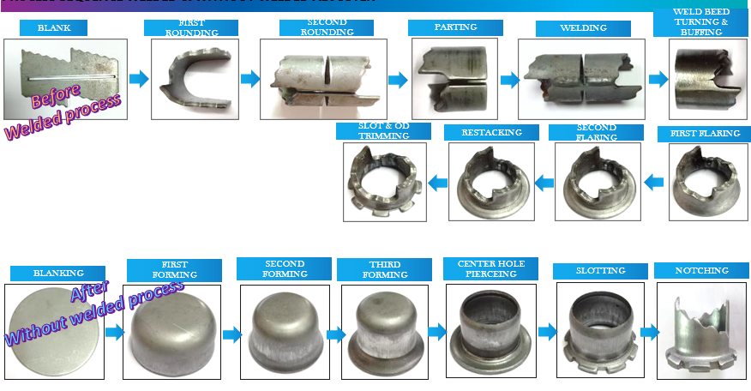
Welding process and draw route process :
Draw operation completed it’s working on notching operation

Slide 9
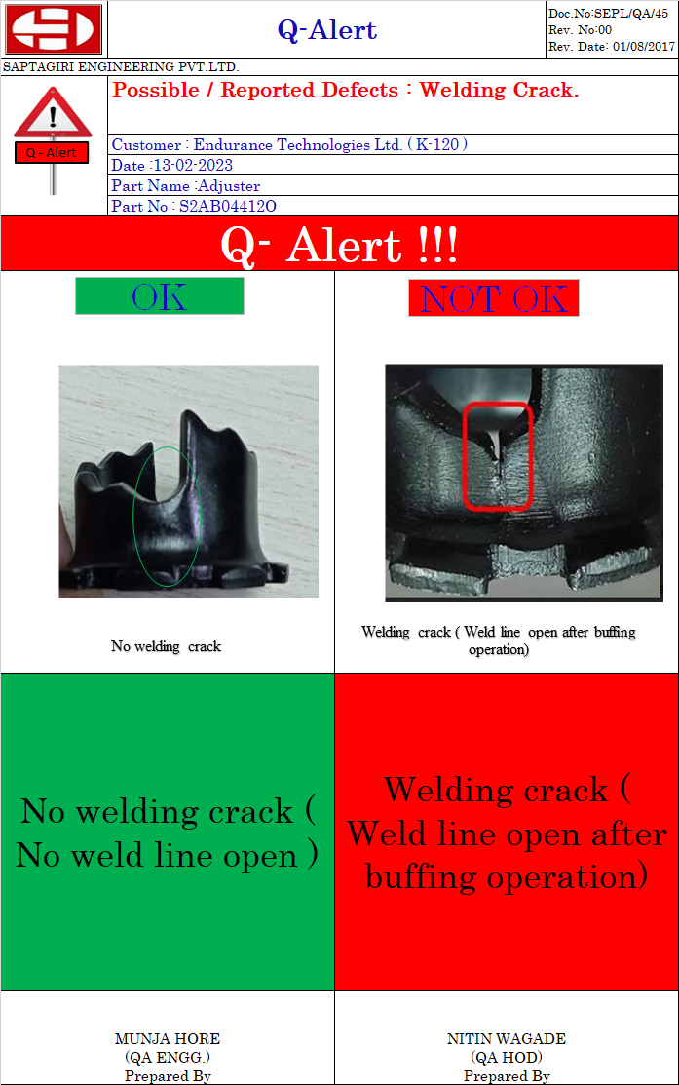
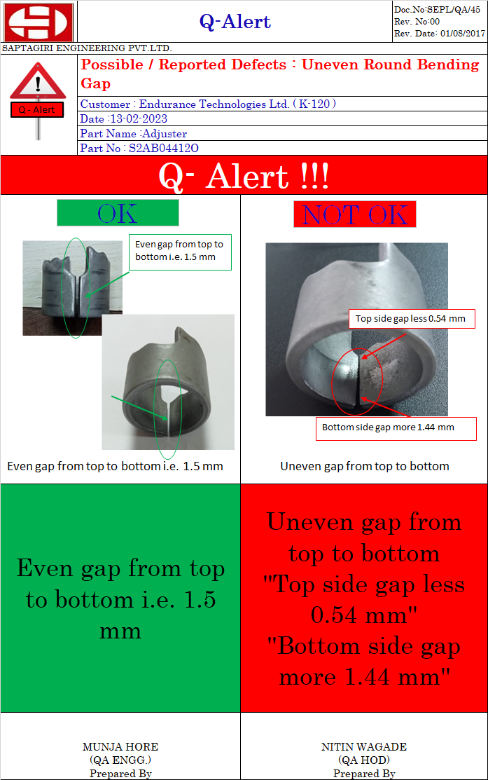
Q–Alert display at work places :

Slide 10
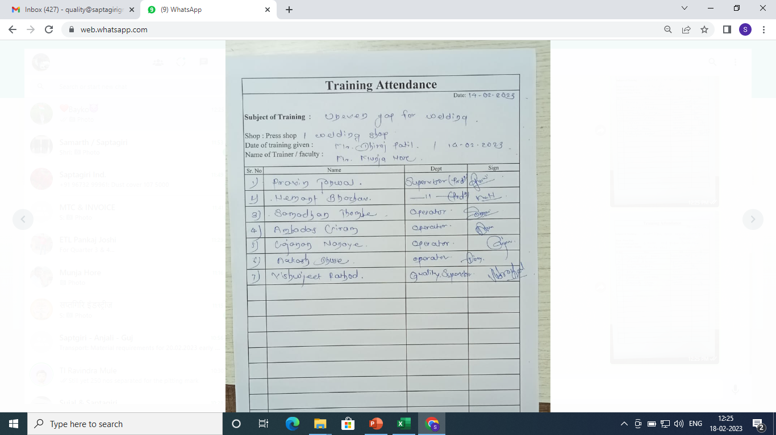
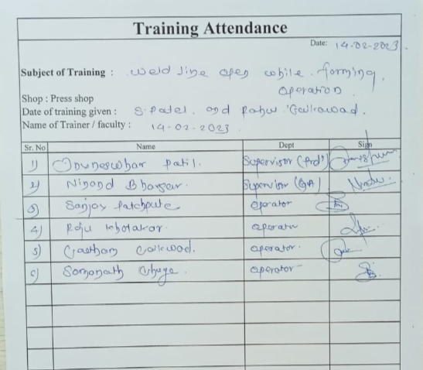
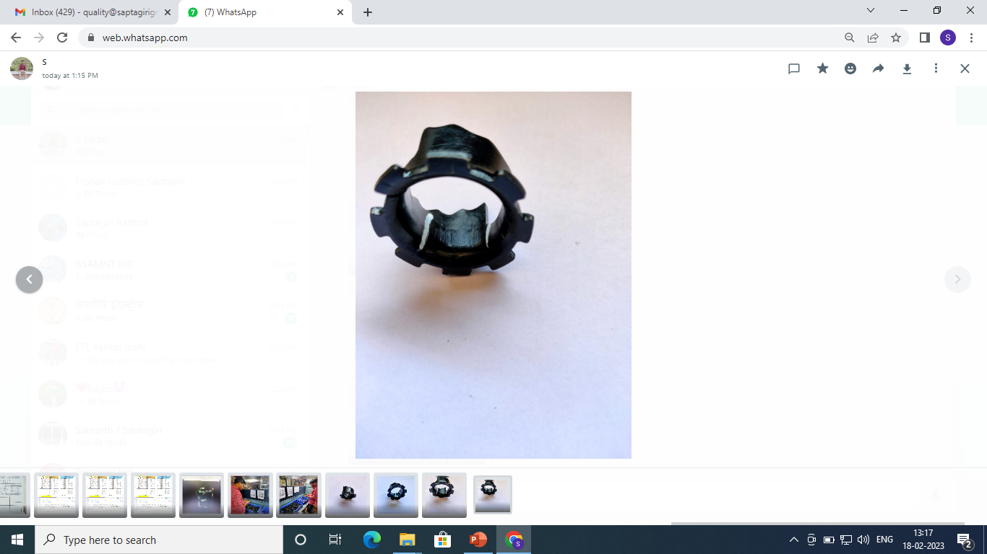
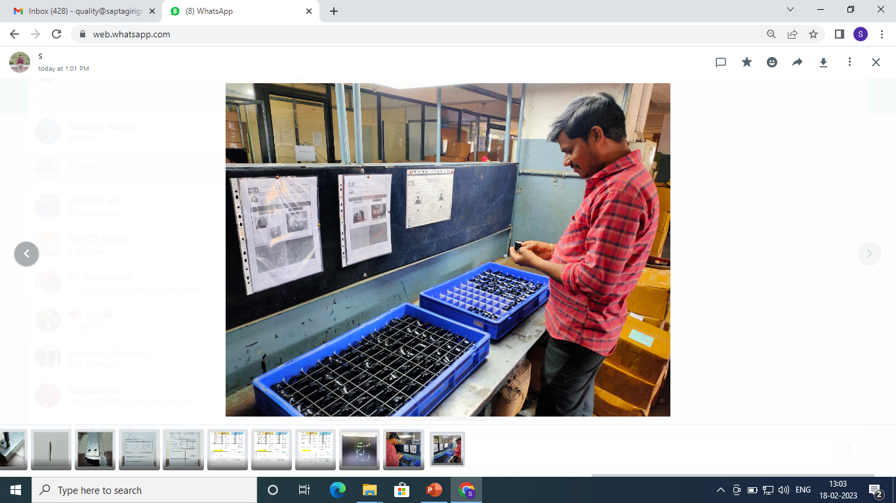
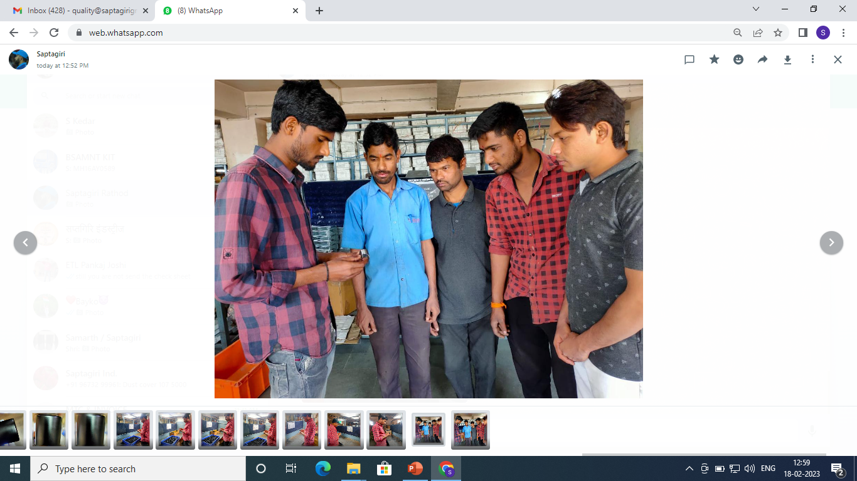
Training record :
Awareness training for weld line open after forming operation
Awareness training for uneven gap for welding
100% Inspection Identification mark
200 % Inspection weld crack ( Weld line open )

Slide 11
THANK YOU

