Slide 1
ACTION PLAN
FOR
QUALITY ISSUE
Supplier Name:
M/S Sharp Engg
Date:20.02.2023

Slide 2
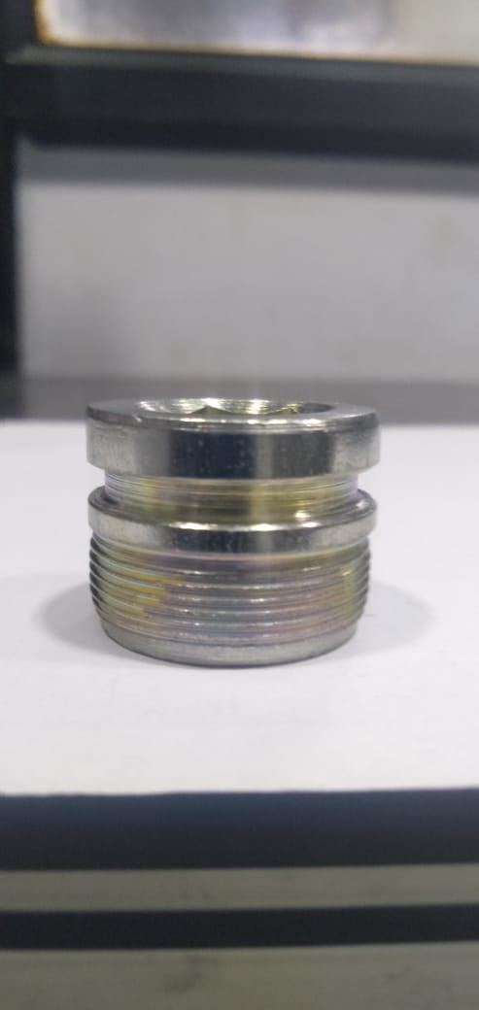
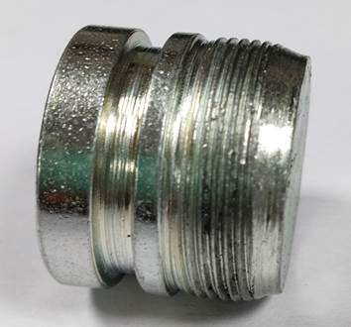
DEFECT PHENOMENA DETAILS
● Phenomenon:
・Supplier: SHARP ENGINEERS
・Model:- BAL
Ok Parts | NG Parts
Photo | Photo
・Parts No.:550DZ4702
・Parts name: FORK BOLT
・Date of Occurrence: 16/02/2023
●Parts Stock check results
Spec-M26X1-6g(Sharp Thread) Observed- NG (Flat/Cross Thread)
Area | Total Stock | Checked | NG | Status
ETL end | 1980 | 1980 | 108 | Rejected
Warehouse | NA | - | - | -
Transit | 1980 | 1980 | 97 | Rejected
Sharp Engineers End finish | 990 | 990 | 27 | Rejected
WIP | NA | - | - | -

Slide 3
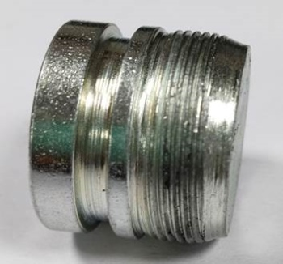
ACTION PLAN FOR
Problem: M26X1-6g NG (FLAT/Cross Thread)
Part Name: FORK BOLT K-2
Process Flow:
Defect Photo / Sketch
Type Of Phenomena | New/Repeated
If Repeated No. Of Occurrence | New
1- Forming, Parting & Drilling
2- Ø25.30 Checking
3-Tip Grinding
4- Hex A/F 14.0 punching
5-Ø25.30 grinding
6-M26X1P-6g Threading
7-Plating as per ABS00010 Std.
8-Final Inspection
9) Pre-dispatch inspection
10-Packing & Dispatch.
Total Qty. | Ok Qty. | NG Qty.
- | - | 108
Cause Verification & Fact Analysis:
Man
Method
Parameter | Specification | Act. Observation | Jud.
THREADING | M26X1-6g (Sharp Threading) | FLAT/CROSS THREADING | NOT OK
Observed OK
Observed OK
FLAT THREADING M26X1 6g NG
Problem Analysis:
M/c
Material
 | Why-1 | Why-2 | Why-3 | Why-4
Occurrence Side | FLAT/Cross THREADING M26X1 6g NG | Hydraulic pressure dropped | O ring broken inside cylinder | Check point not added in PM check sheet
Detection Side | Fitment issue in Fork Bolt K2 at Assembly | Observed Cross Threading in part M26X1 6g NG | Not detected in visual inspection | Sample basis inspection in pipe
Hydraulic pressure dropped.
Observed OK
Sr. No | Possibilities Causes | Verification | Result
1 | Material hardness fluctuation | Observed | OK
2 | Pre-thread role diameter 25.16-25.20 | Observed | OK
3 | Thread role life monitoring | Not evident | X
4 | Hydraulic Pressure 14-16 KG | Not ok | X
C’ Measure:-
Detection Side Countermeasure | Occurrence side countermeasure
100% Inspection checkpoint for thread M26X1 6g with matching part. Freq. revised in control plan, Q alert & OPLdisplyed on machine and FI stage. | O ring changing frequency defined for yearly basis., Check point added in PM check sheet. As per F/MNT/02.
Conclusion: O ring changing frequency defined for cylinder on yearly basis.

Slide 4

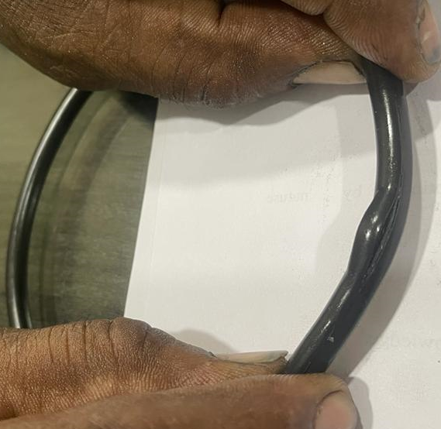
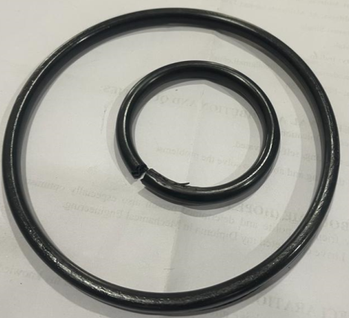
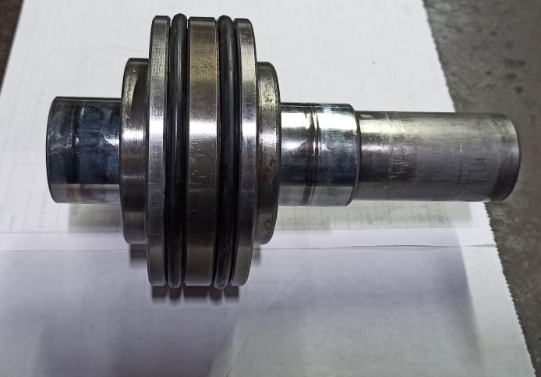
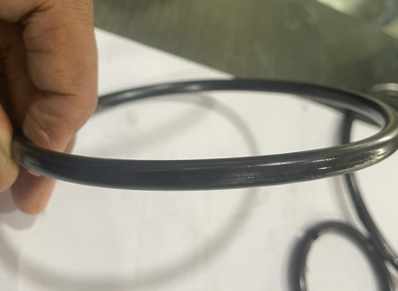
Sustenance action: FORK BOLT K-2
DRILL MACHINE :- SE/TR/01 Date: 22/02/2023
BEFORE
AFTER
Problem/Present Status:
Hydraulic cylinder O ring broken, Hy. pressure not getting as per defined requirement (i.e. 14-16 Kg)
Countermeasure:
Both side O ring has been changed for hydraulic cylinder and check point added in preventive maintenance check sheet.
Benefits :- Rejection reduced for FLAT/CROSS thread defect phenomena.

Slide 5
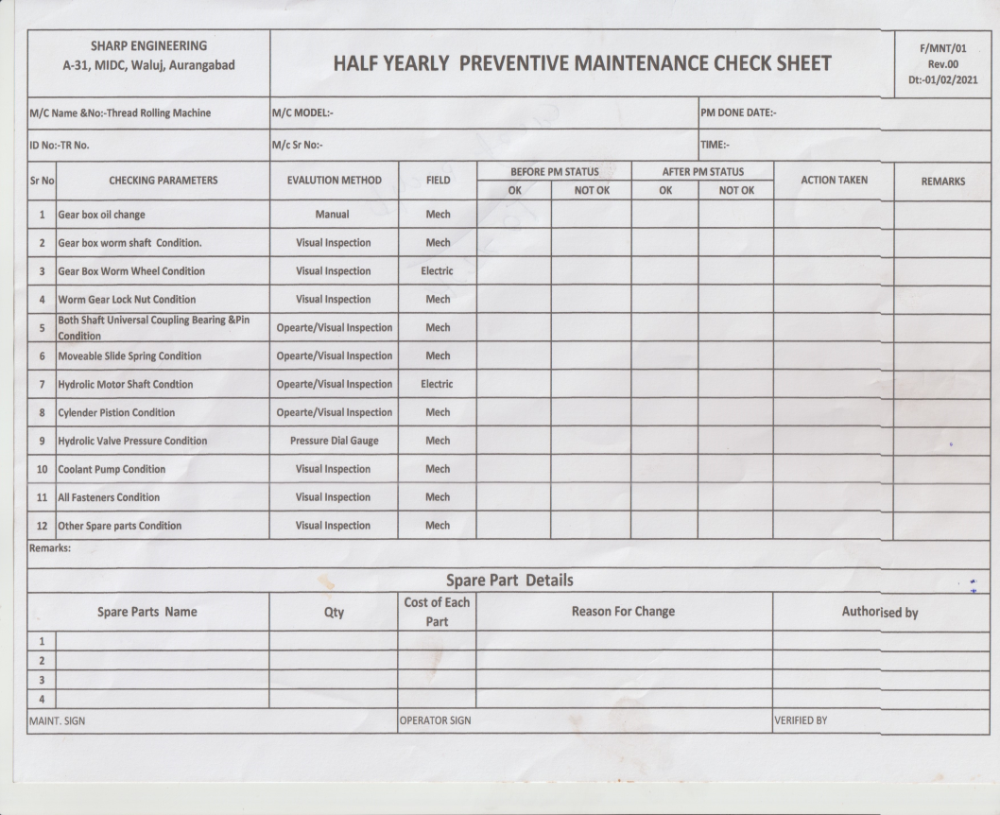
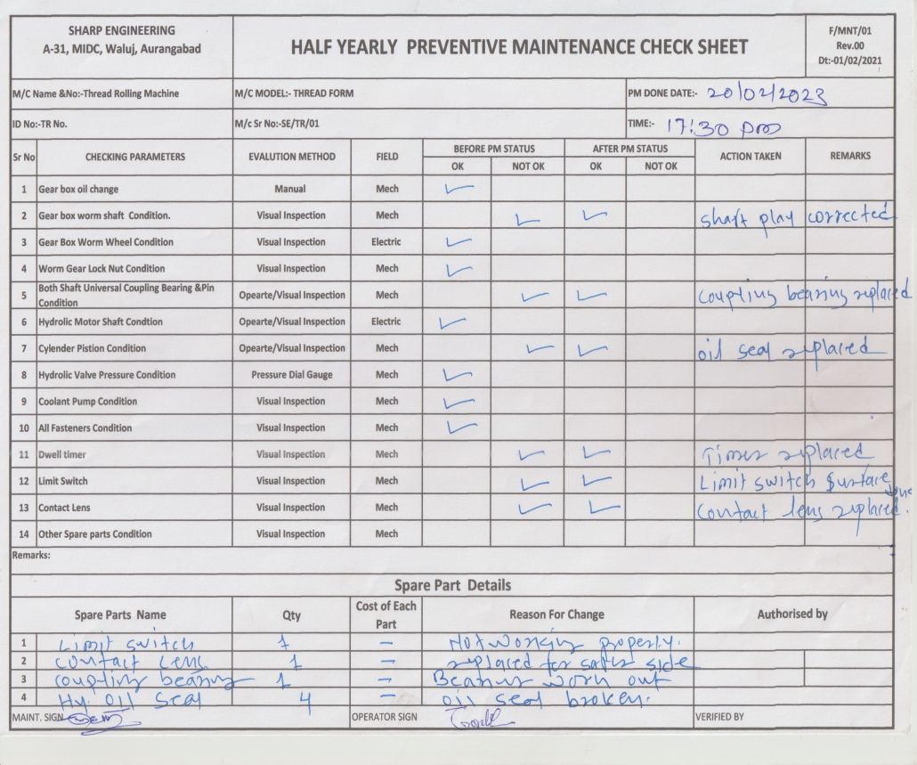
Sustenance action: FORK BOLT K-2
DRILL MACHINE :- SE/TR/01 Date: 22/02/2023
BEFORE
AFTER
Problem/Present Status:
Check point not added in preventive maintenance check sheet.
Countermeasure:
Check point added in preventive maintenance check sheet. Maintenance person will verify on Half yearly basis.
Benefits :- Monitoring…..

Slide 6
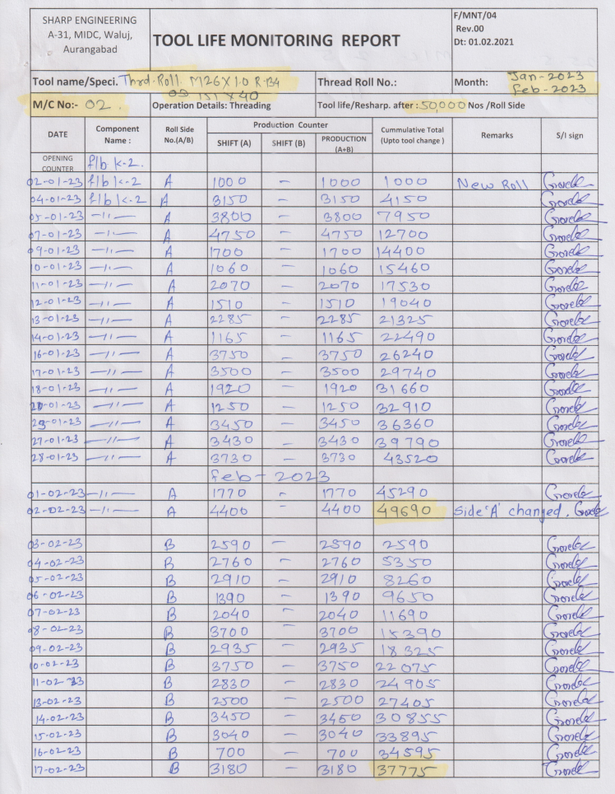
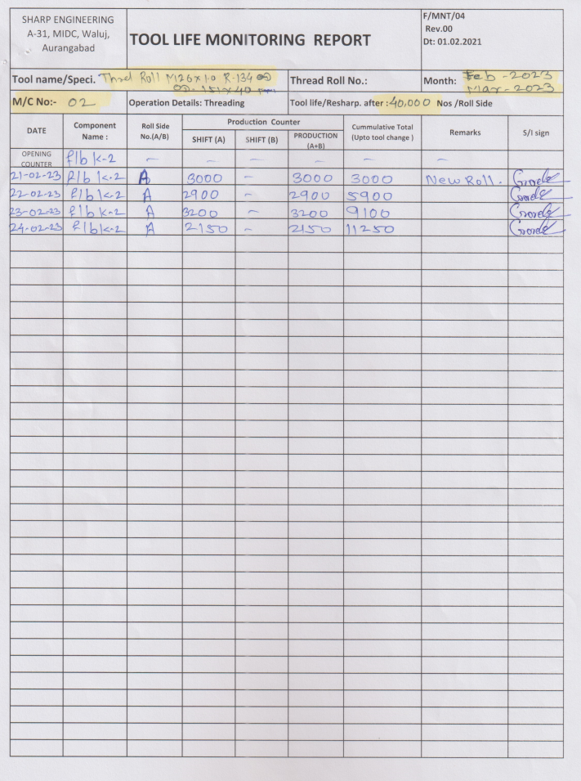
Sustenance action: FORK BOLT K-2
DRILL MACHINE :- SE/TR/01 Date: 22/02/2023
BEFORE
AFTER
Problem/Present Status:
Thread role life defined for 50000/side.
Countermeasure:
Thread role life reduced from 50000/side to 40000/side.
Benefits :- Monitoring…..

Slide 7
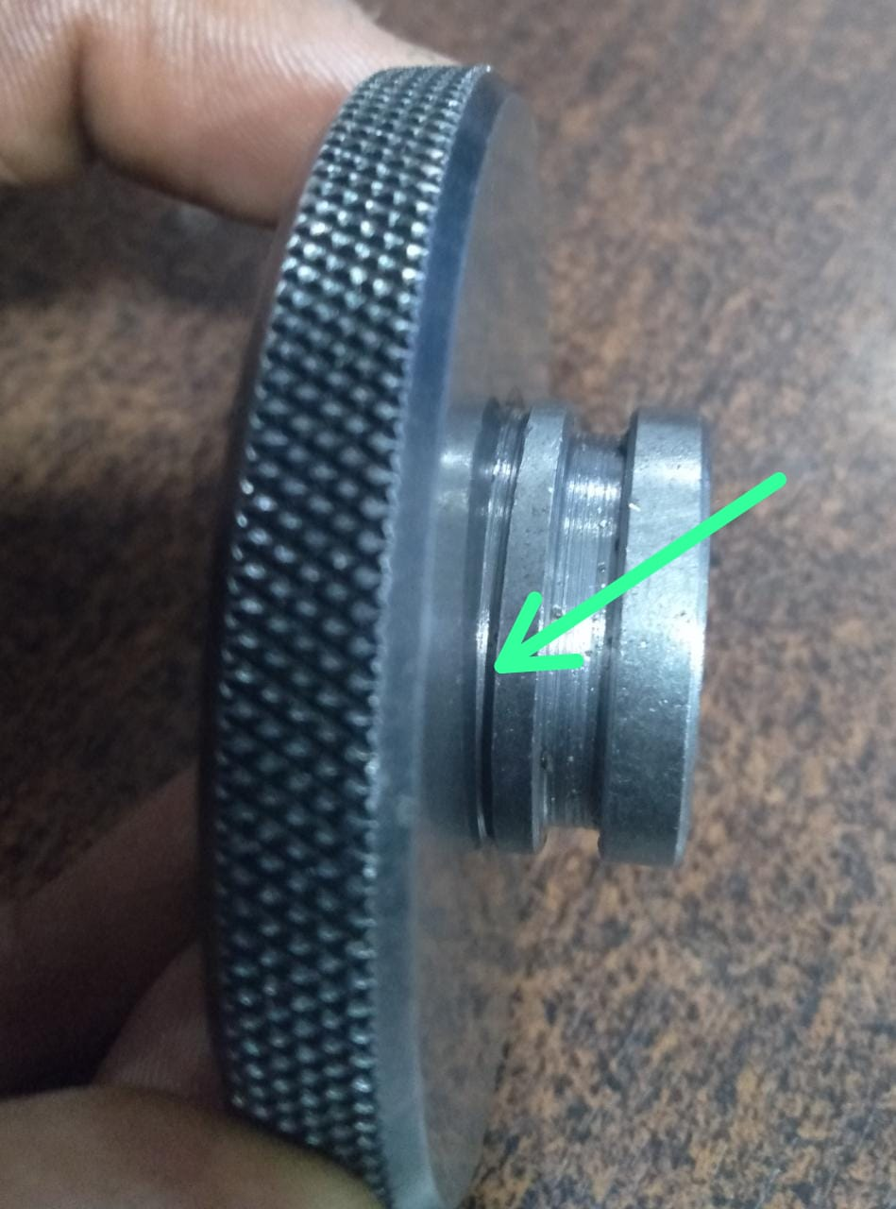
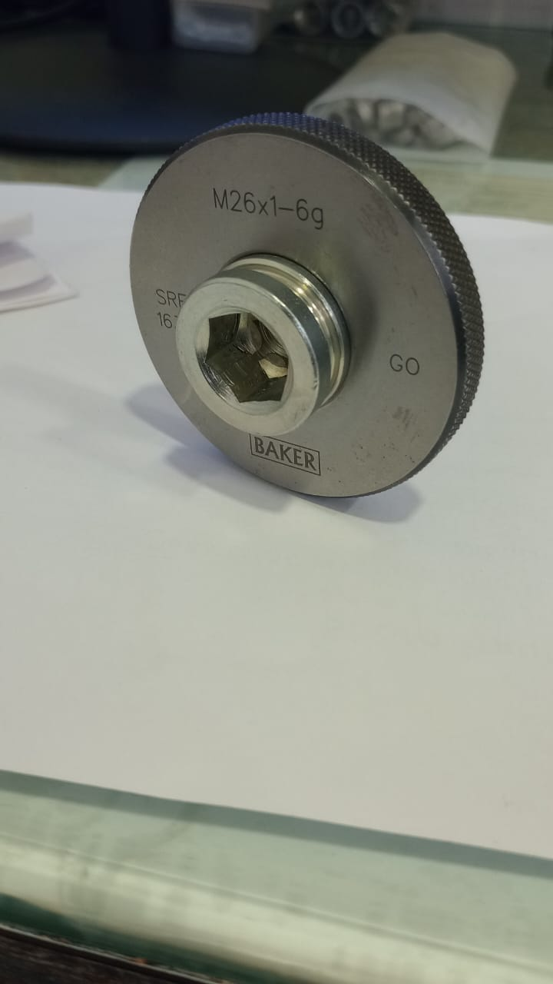
ONE POINT LESSON
Shop :- (SHARP ENGINEERS- G29) |  | Dept. :- Machine Shop (SE/MS-01) |  |  | F/QA/27 01.11.16 00
Class |  |  |  | Lesson no |  | 21
 |  |  |  | Date of preparation |  | 18/02/2023
 | Basic knowledge | Improvement class | Trouble shooting class | Production Head |  | Mr. Ingole
 |  |  |  | Quality Head |  | Mr. Jadhav
Topic:- FORK BOLT K-2 :- रोलिंग आऊट / क्रॉस थ्रेडींग पार्टस फाउंड ऑन कस्टमर एंड
Key Points:- थ्रेड रोलिंग रिंग गेज चेक करते समय गेज कॉलर पर पुरी तरह से रेस्ट हो रहा है इसकी पुष्टी करले, किसी एक तरफ से गॅप नही होणा चाहिये II क्रॉस बैठने वाले पार्ट को रिजेक्ट करे और प्रॉब्लेम आणे पर तुरंत सुपरवायजर को सूचित करे
Know Why:- To supply defect free part at customer end.
Not OK
OK
Date | 20.02.2023 | 20.02.2023 | 20.02.2023 | 20.02.2023 | 21.02.2023 | 21.02.2023 | 21.02.2023 | 21.02.2023
Teacher | Mr.Ingole | Mr.Ingole | Mr. Krishna | Mr. Shivanand | Mr. Jadhav | Mr. Jadhav | Mr. Jadhav | Mr. Jadhav
Learner | Mr. Krishna | Mr. Shivanand | Mr. Gupta | Mr. Mukesh | Mr. Vinod | Mr. Chandan | Mr.Sagar | Mr. Shaikh

Slide 8
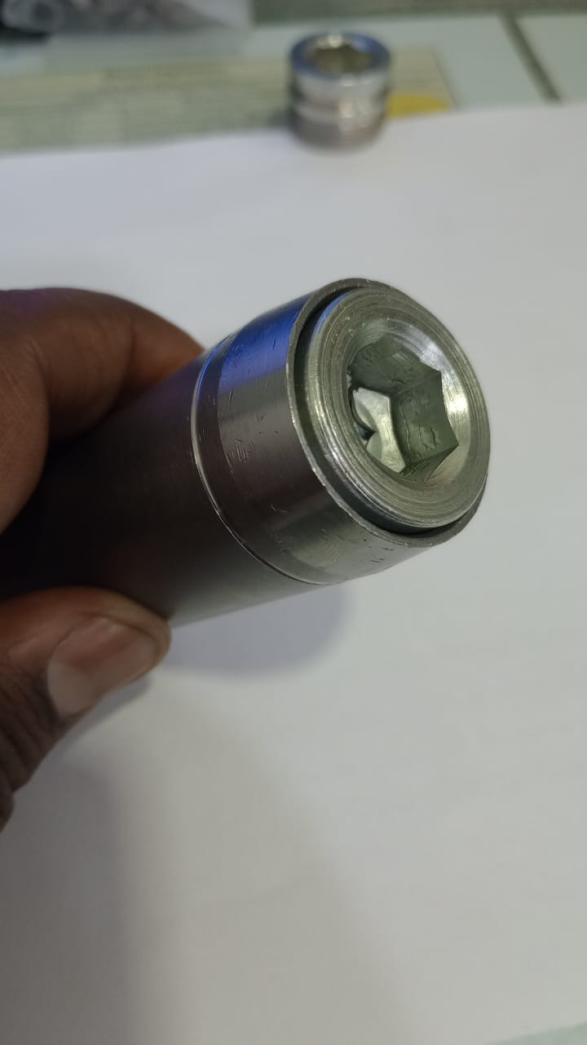
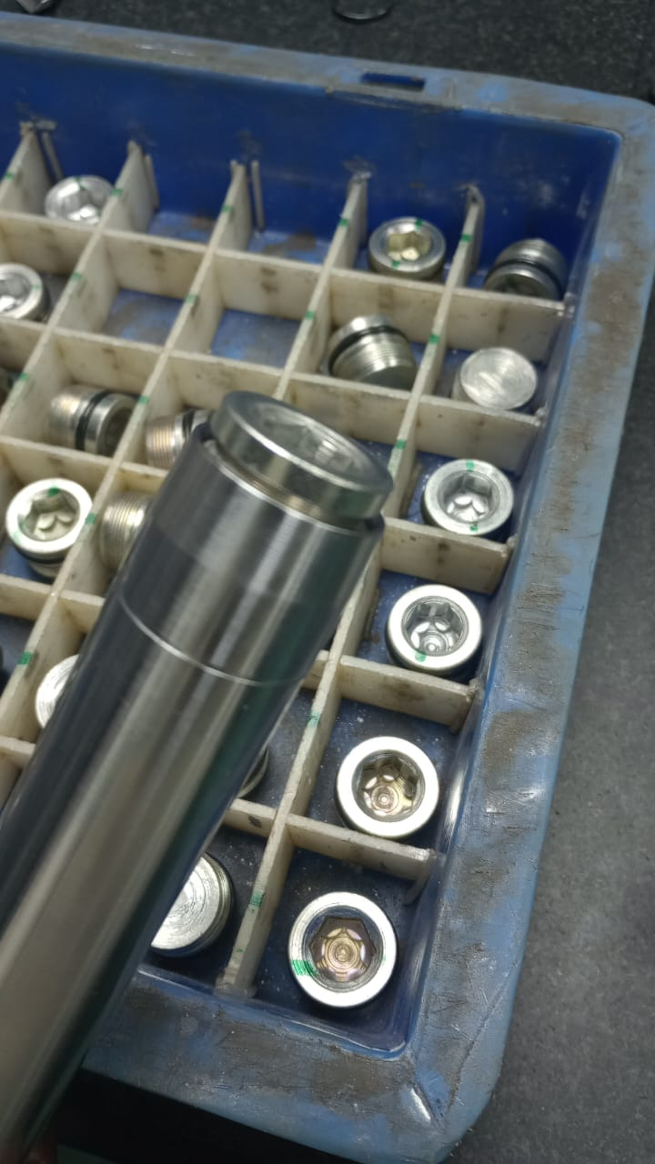
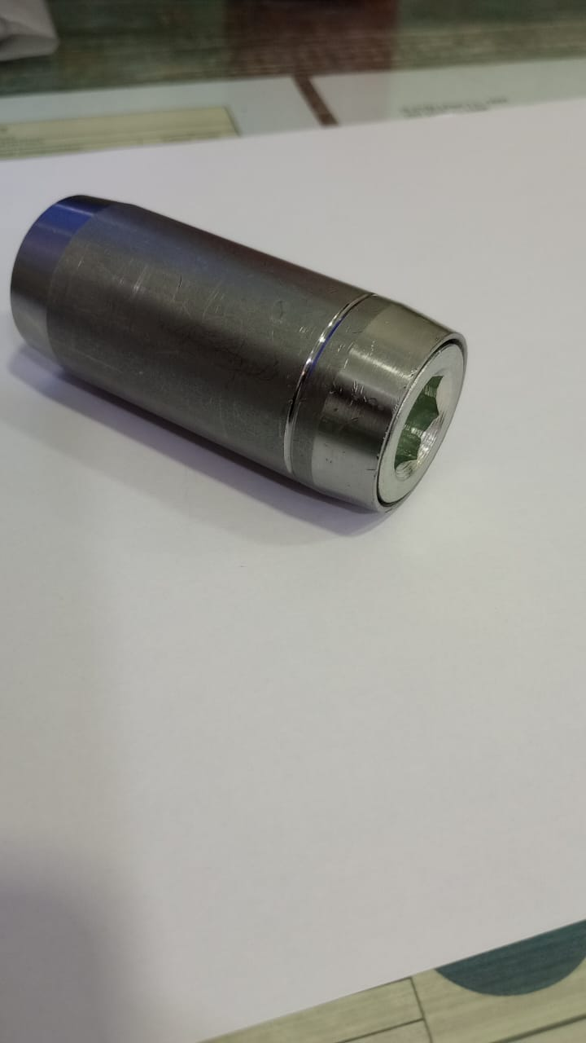
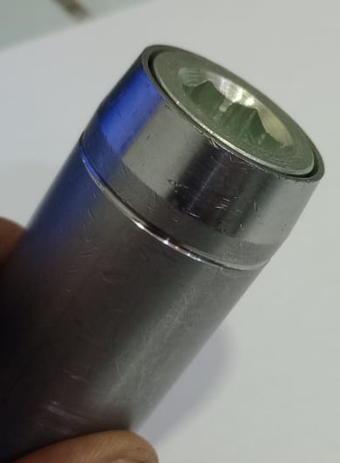
ONE POINT LESSON
Shop :- (SHARP ENGINEERS- G29) |  | Dept. :- Final Inspection(SE/MS-01) |  |  | F/QA/27 01.11.16 00
Class |  |  |  | Lesson no |  | 22
 |  |  |  | Date of preparation |  | 25/02/2023
 | Basic knowledge | Improvement class | Trouble shooting class | Production Head |  | Mr. Ingole
 |  |  |  | Quality Head |  | Mr. Jadhav
Topic:- रोलिंग आऊट / क्रॉस थ्रेडींग पार्टस फाउंड ऑन कस्टमर एंड
Key Points:- फाइनल इंस्पेक्टर पार्ट चेक करने के बाद ओके पार्ट के उपर ग्रिन मार्किंग और नॉट ओके पार्ट पर रेड मार्किंग करेंगे. सुपरवाइजर इसकी जांच करने के बाद ही ओके पार्ट को आगे बढ़ायेंगे. रेड मार्किंग या बिना मार्किंग वाले ससपेक्टेड पार्ट को अलग रखे.
Know Why:- To supply defect free part at customer end.
Not OK
OK
Date | 27.02.2023 | 27.02.2023 | 27.02.2023 | 27.02.2023 | 27.02.2023 | 27.02.2023 | 27.02.2023 | 27.02.2023
Teacher | Mr.Ingole | Mr.Ingole | Mr. Krishna | Mr. Shivanand | Mr. Jadhav | Mr. Jadhav | Mr. Jadhav | Mr. Jadhav
Learner | Mr. Krishna | Mr. Shivanand | Mr. Gupta | Mr. Mukesh | Mr. Vinod | Mr. Chandan | Mr.Sagar | Mr. Shaikh

Slide 9
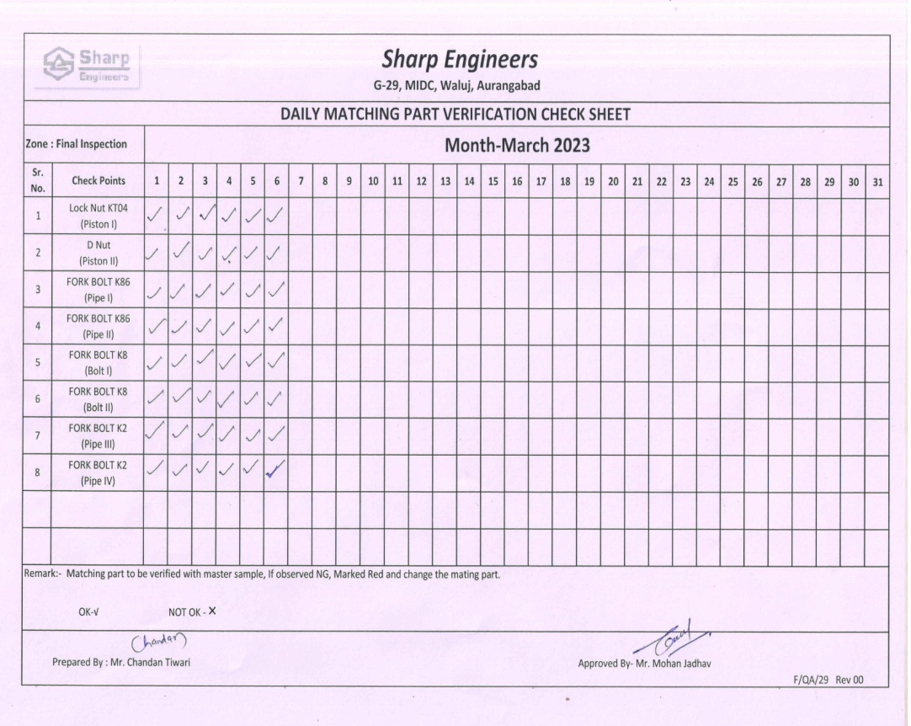
Outflow Action: FORK BOLT K-2
FINAL INSPECTION MATING PART VERIFICATION CHECK SHEET Date: 27/02/2023
BEFORE
AFTER
Problem/Present Status:
Mating Part change frequency not defined
Countermeasure:
Daily Verification of mating parts used for 100% Inspection.
Benefits :- Monitoring…..

Slide 10
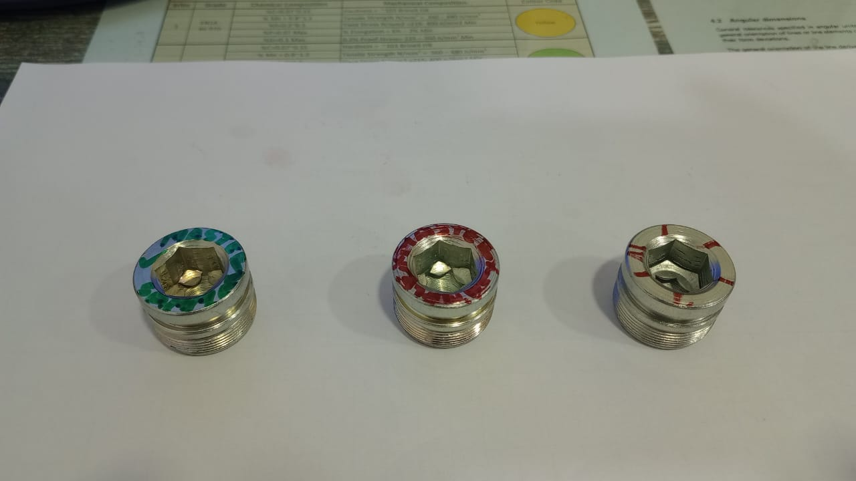
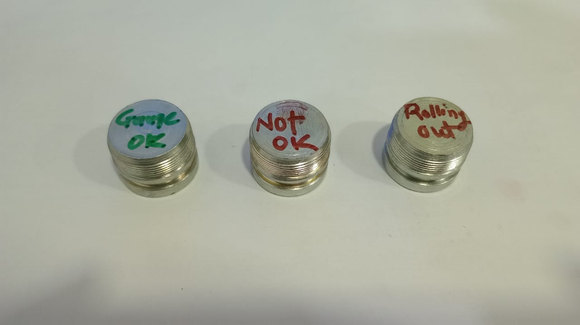
Outflow Action: FORK BOLT K-2
FINAL INSPECTION MATING PART VERIFICATION MASTER SAMPLE Date: 27/02/2023
BEFORE
AFTER
Problem/Present Status:
Master Samples Not Available to check mating parts
Countermeasure: Master Samples Identified to check mating parts.
1. Gauge OK, 2. Gauge Not OK, 3. Cross Threading
Benefits :- Monitoring…..

Slide 11
THANK YOU

