Slide 1
TUBE PRODUCTS OF INDIA
SHIRWAL
30x28-Saptagiri Engineering-Crack sample analysis.
Complaint 10/02/23
24th Feb- 2023

Slide 2
Customer :- Saptagiri Engineering.
Complaint :- Weld Crack.
Size :- 30x28.

Slide 3
Suspected lot details
Dispatches from Shirwal to PWH & from PWH to Saptagiri Engineering
Customer Name | PWH Invoice No. | PWH Invoice Date | OD | ID | Length | Qty Nos | Qty Mtrs | Qty Tons | Plant Invoice No. | Vehicle No. | Plant Invoice Date | LotQty
SAPTAGIRI | 3015010053327 | 27-Jan-23 | 30 | 28 | 4650 | 508 | 2540.4 | 1.78336 | PSH-LST-16302 | MH12MV1629 | 22-Dec-22 | 2651.8
SAPTAGIRI | 3015010053327 | 27-Jan-23 | 30 | 28 | 4650 | 22 | 111.4 | 0.0782 | PSH-LST-16302 | MH12MV1629 | 22-Dec-22 | 2651.8
SAPTAGIRI | 3015010053189 | 22-Jan-23 | 30 | 28 | 4650 | 343 | 1716 | 1.20463 | PSH-LST-16294 | MH12HD6776 | 20-Dec-22 | 8457
SAPTAGIRI | 3015010053189 | 22-Jan-23 | 30 | 28 | 4650 | 1348 | 6741 | 4.73218 | PSH-LST-16294 | MH12HD6776 | 20-Dec-22 | 8457

Slide 4
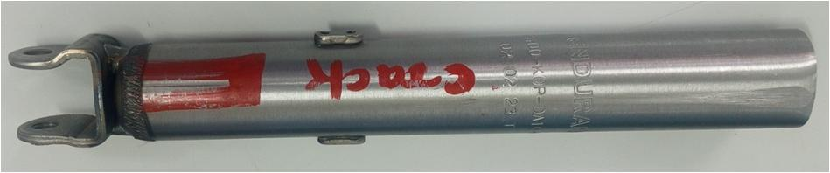
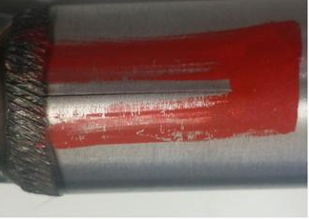
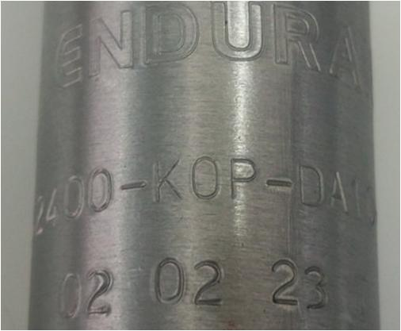
Sample photos & dimensions
Total Length-195 mm
Sr. No | Parameter | Specification (mm) | Actual (mm)
1 | OD | 30± 0.10 | 30.00/30.02
2 | ID | 28.0+0.075 | 28.04/28.08
3 | Crack length |  | 26.20
4 | Total length |  | 195
5 | Batch code |  | 02.02.23
Crack length- 26.20 mm
Crack Area

Slide 5
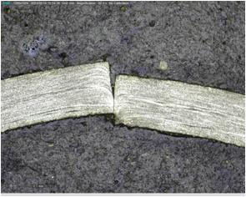
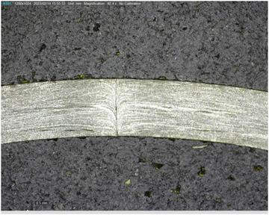
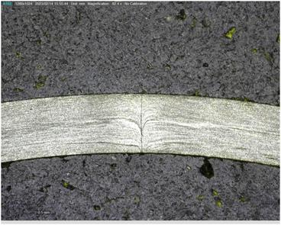
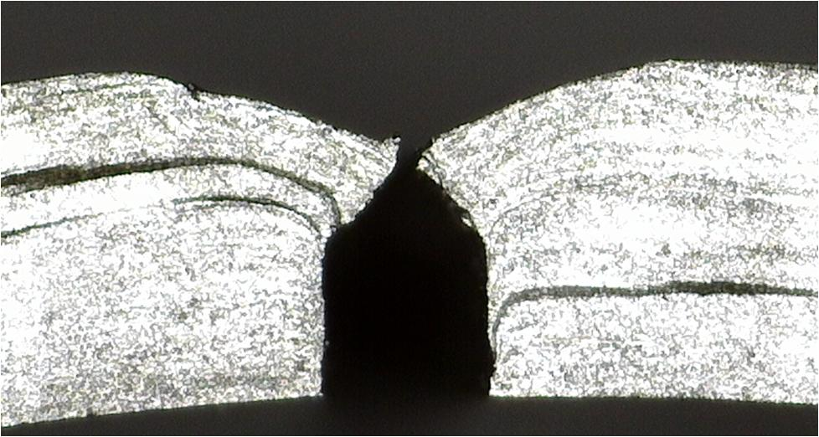
Failed Sample Analysis
A
B
C
Observation:-
Crack observed on the weld line.
Weak weld bond at defective area.

Slide 6
Chemical Analysis
Chemical Composition
%Element | C | Mn | Si | S | P | Al | Remarks
Spec | 0.12 Max | 0.60 Max | - | 0.04Max | 0.04Max | -
Actual | 0.0975 | 0.3613 | 0.0059 | 0.0135 | 0.0175 | 0.0563 | OK
Remark:- Chemical Analysis by spectro Method does Confirms to IS 3074/2005 CEW 1

Slide 7
Process Flow
CDW Tube Process Flow
Slitting
Tube Rolling
Annealing
Push Pointing/Swaging
Start
Weld Crack defect occurs in this area
Straightening
Drawing
Wet Process
ECT
Cutting
Inspection
Packing
End
Dispatch

Slide 8
Root cause Analysis
Root Cause Analysis:-
Man
Machine
Wrong Tool used
Strip buckling due to speed mismatch in accumulator
Side pressure clamp loose
Jerk during Rolling
Un Skilled operator
Bearing failure
End weld strip off set
Coolant contamination
Weld Crack
Speed and Power not as
per spec.
Impeder Position not OK
Fin blade broken
Fin cutting head
Fin blade diameter
Slit edge damage
Slit edge offset during end weld joining
Impeder damage
Slit edge burr
Mill alignment not ok
Roll profile not okay
Slit coil Camber
Method
Tooling
Material

Slide 9
Verification of Causes
# | 4M | PROBABLE CAUSES | FACTS VERIFICATION | Remark
1 | MAN | Wrong Tool used | Verified the tool issue process no abnormality observed | OK
 |  | Un Skilled operator | Operators are skilled no new operators on Machine | OK
2 | TOOLING | Roll profile not okay | Checked roll profile found ok | OK
 |  | Fin cutting head. | Fin Cutting head checked and observed top roll mounting pin worn out and damage .( Tube mill stoppage was there) | Not ok
 |  | Impeder damage | Impeder condition was ok | OK
 |  | Fin blade broken | No abnormality observed in Fin blade | OK
 |  | Fin blade diameter | Fin blade diameter is inadequate when end weld is offset | ok
3 | MATERIAL | Slit edge damage | Wooden plank on slit storage rack found | OK
 |  | Slit edge burr | No burr observed on slit | OK
 |  | Slit coil thickness variation in initial lap | No Thickness variation in initial lap of slit coil | OK

Slide 10
Verification of Causes
# | 4M | PROBABLE CAUSES | FACTS VERIFICATION | Remark
4 | METHOD | Mill alignment not ok | Mill alignment checked during setting found in place. | OK
 |  | Speed and power as per specification | Speed and power checked as per speck and found ok. | OK
 |  | Slit edge offset during end weld joining | Parallel Slit edges are verified by visually | OK
 |  | Impeder Position not OK | Fin cutting bar length is standardized and it is OK | OK
5 | MACHINE | Strip buckling due to speed mismatch in accumulator | Tube mill accumulator potentiometer found OK | OK
 |  | Bearing failure | No bearing failure found | OK
 |  | Coolant contamination | Filter checked found OK | OK
 |  | End weld strip off set | The operation of Strip joining was carried out by hydraulic system | OK
 |  | Side pressure clamp got loose. | No strip shifting observed. | OK
 |  | Jerk during Rolling | Verified the Tube mill report no Mill jerk observed | OK

Slide 11
(WHY-WHY ANALYSIS)
● Root cause establishment (Why-Why Analysis) - Occurrence
WHY – 1 | WHY- 2 | WHY -3 | WHY-4 | Why-5
Weld Crack. | Weak weld bond | Improper squeezing during welding at localized area due to Fin cutting disturbance | Fin Cutting head top roll momentary blockage | Fin Cutting head top roll mounting pin worn out and damage
● Root cause establishment (Why-Why Analysis) - Detection
WHY – 1 | WHY- 2 | WHY -3 | WHY-4 | Why-5
Weld crack | Tube got opened in sub sequent operation | Less bonding strength | Not detected in ECT | Weld intact.

Slide 12
Action Plan
Occurrence Side Action
Sr. No | Cause | Countermeasure | Target. Date | Status
1 | Improper squeezing during welding at localized area due to Fin cutting disturbance | 1.In every rolling of final30x28 size Fin cutting head top roll pin will be replaced with new pin. 2) Pin change point added in Fin cutting tool issue check sheet. | 1) 05/03/23 2) Added on 22/02/23 | 2) Completed
Detection side Action
1 | Detection | As per Stoppage Matrix one extra tube will be removed. | Implemented by Jan-23 | Started.
2 |  | On line ECT at TM 2 Planned. | May-2023

Slide 13
Thank You !

