Slide 1
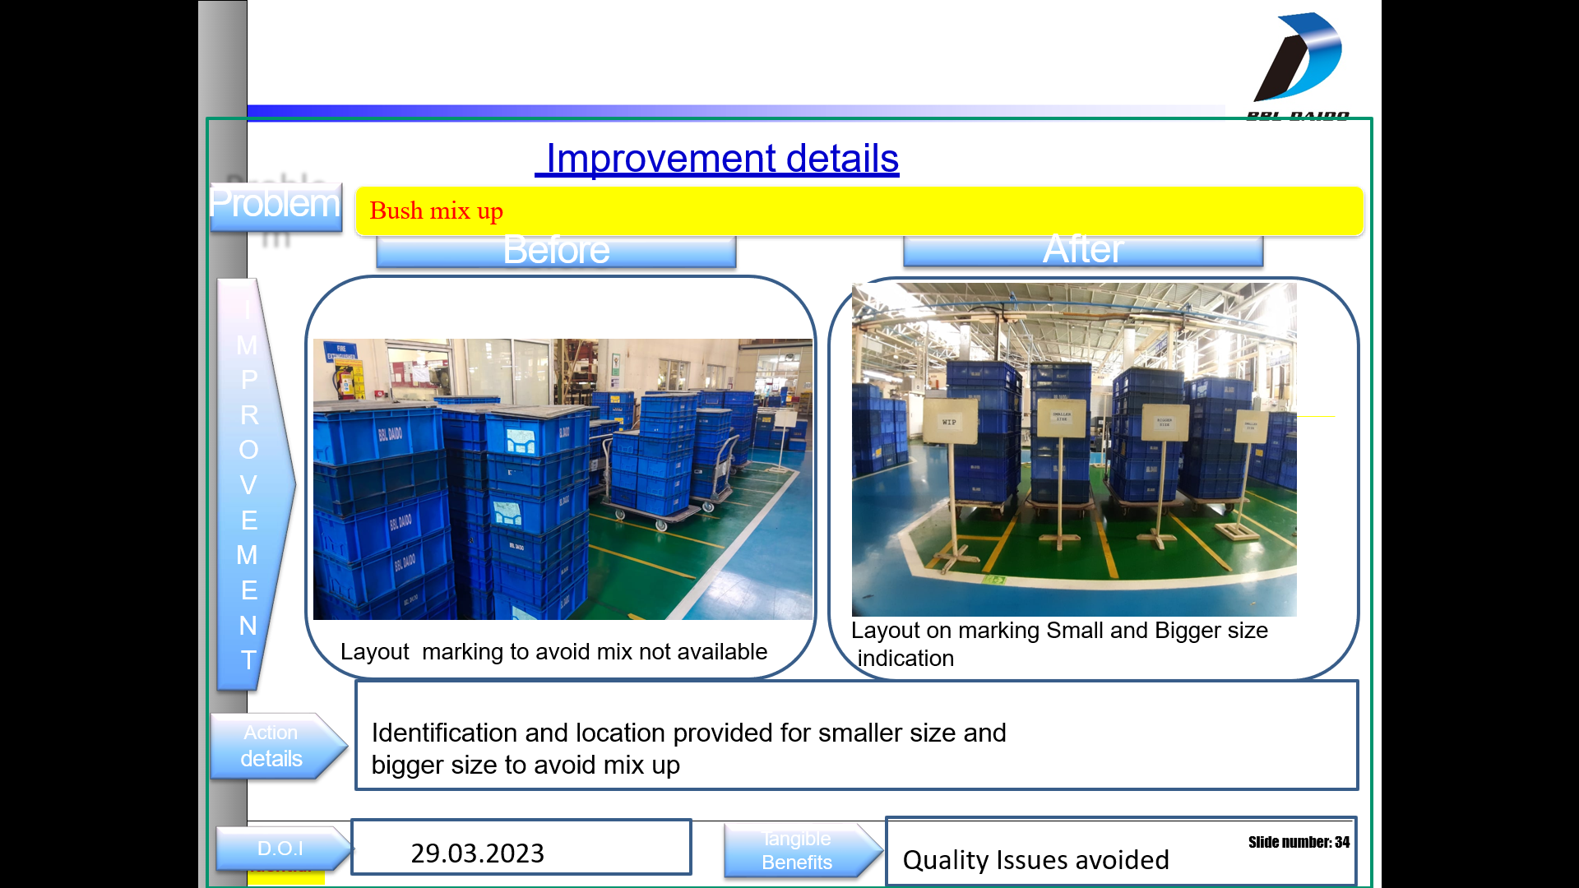
WIP Area – No proper marking to avoid mix up

Slide 2
WIP Area – No proper marking to avoid mix up

