Slide 1
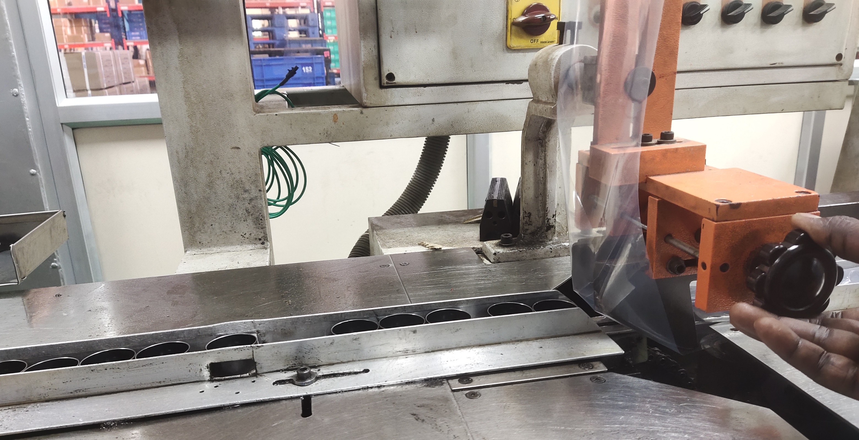
Detection Poka yoke
Chute entry controller provided

