Slide 1
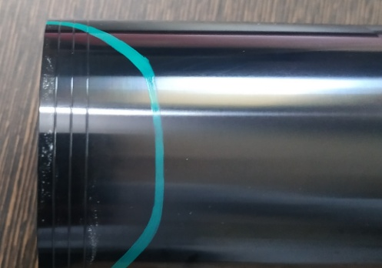
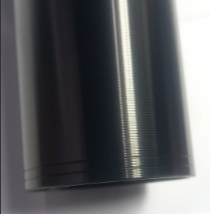
One Point Lesson
Process loction: Sizing Process one point Lesson for Adventure post muffler (Shell)
Class |  |  |  | Lesson no |  | 07
 |  |  |  | Date of preparation |  | 03.04.23
 | Basic knowledge | Improvement class | Trouble shooting class
 |  |  |  | Section leader |  | Sadashiv Satpute
Date | 03.04.23
Teacher | B S Lokhande
Learner | Inspection Inspector
Shade variation
Shade variation at Corner not Allowed .
X
NOT OK
No Shade variation .
OK

