Slide 1
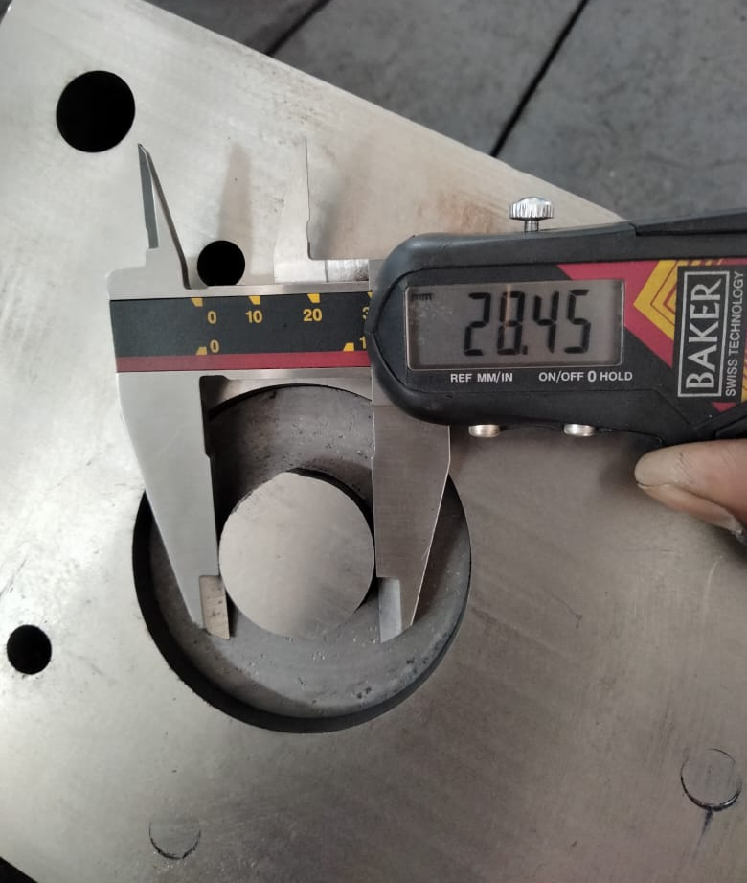
1- Daily verification started of tool condition during setup approval
2- New ID punch provided 28.45mm and part ID observation 28.18~28.25mm after P/C

