Slide 1
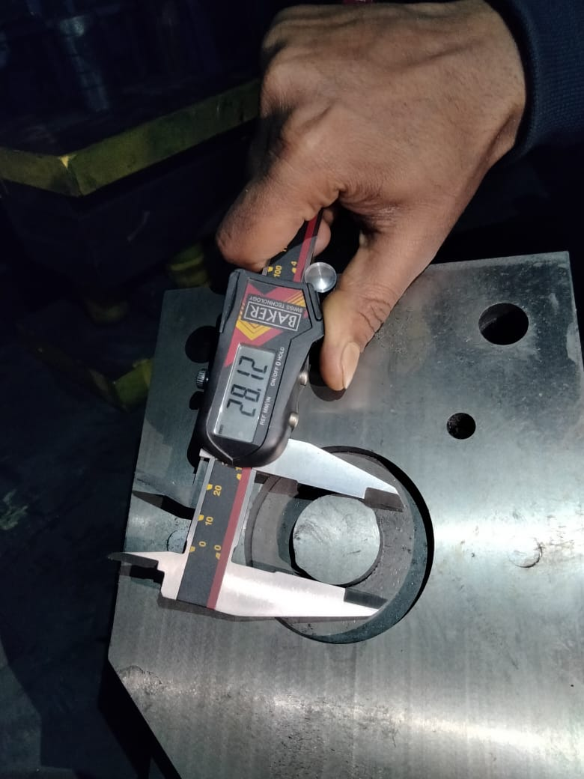
1-NO daily verification of tool condition during setup approval
2- Punch ID under Size as per Required 0.35mm

