Slide 1
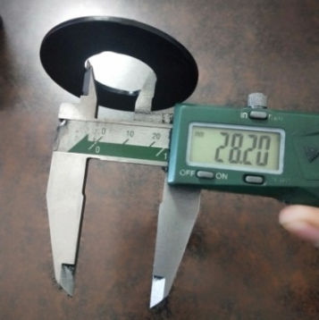
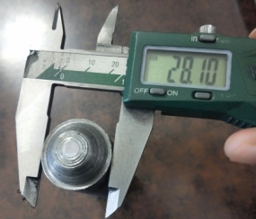
ID gauge od Dimenater 28.10mm
1- 100% Inspection done with ID checking gauge and after Inspection dot marking done on part with white paint marker

