Slide 1
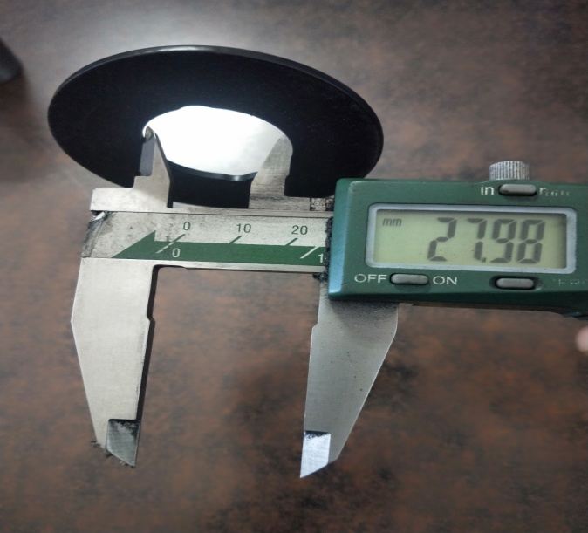
Sampling Inspection done by instruments (DVC)

