Slide 1
Manoj Industries
Action plan on Ather front Holder Bracket slot distance 19.32 +/-0.10 mm observed oversize.

Slide 2
Action plan
Sr.No. | Non- conformance observed | Action Taken /planned | Status
01 | 19.32 +/-0.1 mm distance observed oversize. | Q-Alert displayed near work station & at final inspection area.
02 |  | 19.32mm Slotting operation planned on VMC machine with proper clamping fixture.
03 |  | New hydraulic clamping fixture made on VMC
04 |  | Training provided to operator
05 |  | Planned to introduce attribute gauge to check 100%

Slide 3
. Q-Alert
Q-Alert
Date: 05.03.2023
Ather Front Holder Bracket
19.32 +/-0.1mm Not OK
19.32+/-0.1 found oversize.19.46 ~ 19.52mm

Slide 4
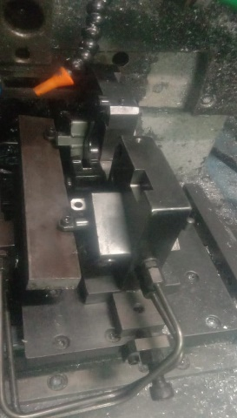
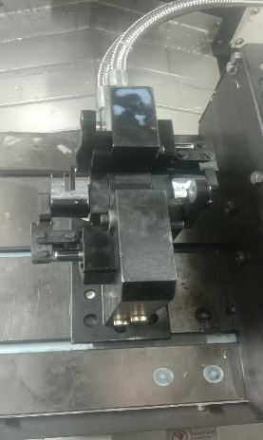
. Modification in machining fixture.
Before
After
Old SPM fixture .
New VMC machining fixture with hydraulic clamping.

Slide 5
Attribute gauge .
Action Taken :- We have planned to introduce new attribute type gauge to check 100% dimension of 19.32 +/-0.1 mm.

Slide 6
Thank You

