Slide 1
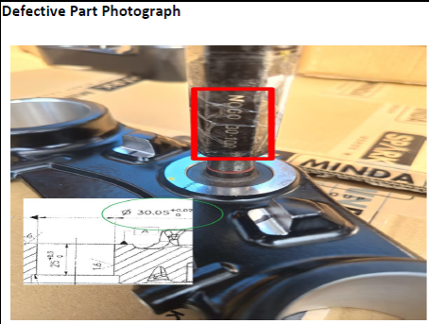
OPL FOR RC200 under Bkt
Customer Complaint of UG / RC200 under Bkt ID 30.05 +0.02 over size
NOK Part Dia 30.05 + 0.02 No Go pass:-
✓
RC200 under Bkt ID 30.05 +0.02 check every bin 5 nos if single part over size found inform to supervisor & hold all lot don’t dispatch to customer.

