Slide 1
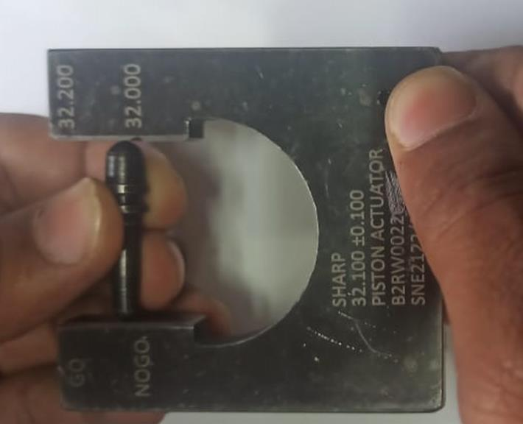
Improvement in Inspection
Before
After
Standard SESG provided for inspection in place of digital vernier and 100% inspection.

