Slide 1
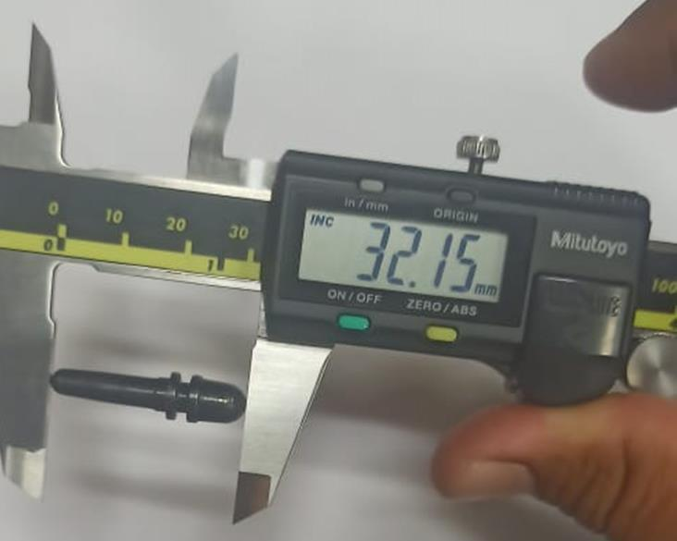
Improvement in Inspection
Before
After
Sampling basis inspection as per IS:2500 and checking done by vernier caliper.

