Slide 1
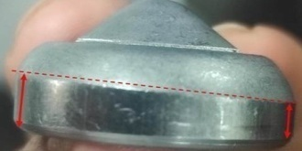
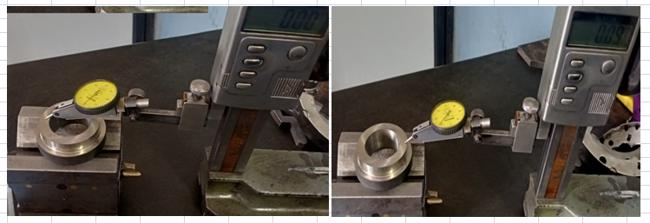
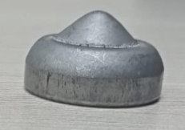
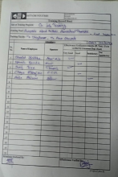
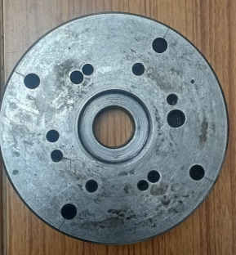
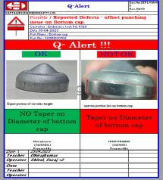
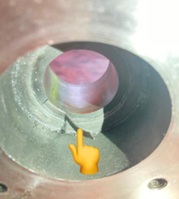

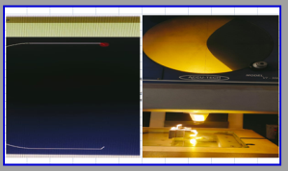
ACTIONS FOR BOTTOM CAP OFFSET PUNCHING
Supplier: Saptagiri Industries.
Operation: Bottom cap Offset punching
Implementation Date: 18.04.2023
Forming at one side , As installed new carbide bush into mounting bottom block , It has tapper up to 1.0 mm | Carbide bush verified for parallelism . Observed parallelism up to 1.0 mm its rework grinding operation. After rework Carbide bush verified and its observed 0.12 mm Made a SOP for carbide bush installation. At stored location, All carbide bush verified. While production , First part of the shift its’ verify by Profile projector. Awareness training provided to final inspector
BEFORE
AFTER
Problem/Present Status: Bottom cap. Offset Punching
Carbide bush verified for parallelism
Forming at one side , As installed new carbide bush into mounting bottom block , It has tapper up to 1.0 mm
Material flow
Observed parallelism up to 1.0 mm its rework grinding operation
Material flow
RM inspection
RM inspection
After rework Carbide bush verified and its observed 0.12 mm
Sheet shearing
Sheet shearing
Blanking
Made a SOP for carbide bush installation
Blanking
Forming
While production , First part of the shift its’ verify by Profile projector.
Forming
Face Turning
Face Turning
Final Inspection
Final Inspection
Packing
Packing

