Slide 1
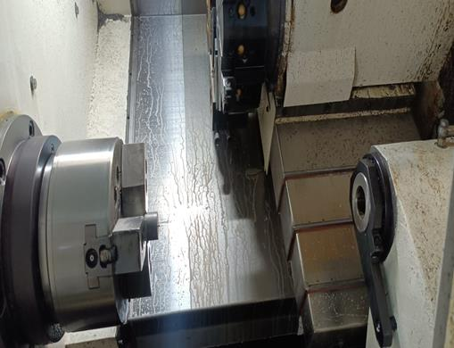
Countermeasure:- Machining stage
DRILL MACHINE :- SE/CNC/02 Date: 25/05/2023
BEFORE
AFTER
Problem/Present Status:
Countermeasure:
Machining operation method changed from conventional machine to CNC machining.
Benefits :- Customer complaint eliminated permanently.

