Slide 1
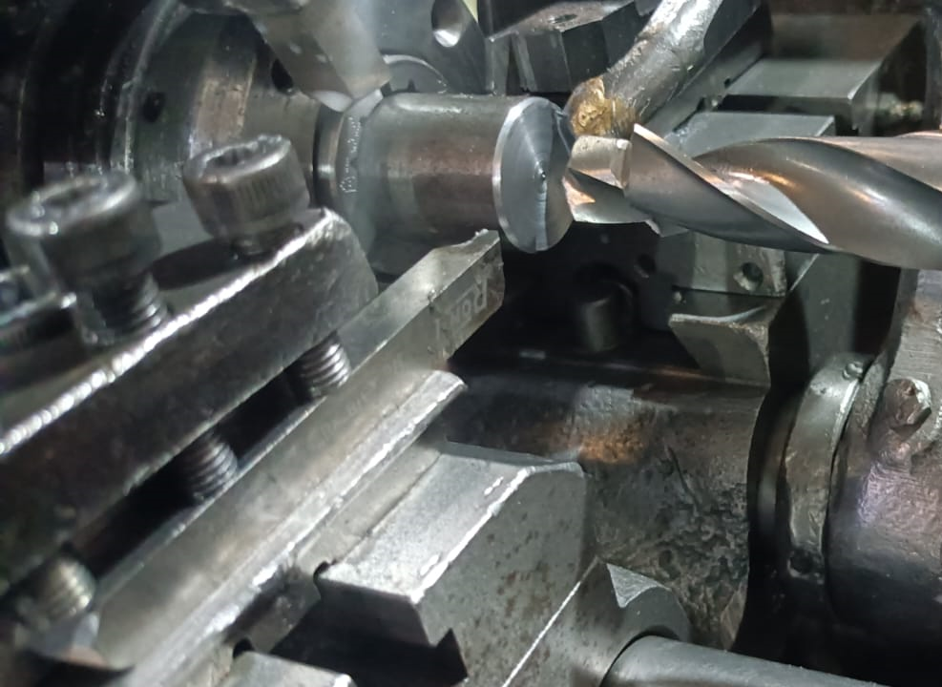
Countermeasure:- Machining stage
DRILL MACHINE :- SE/SSAL/01 Date: 25/05/2023
BEFORE
AFTER
Problem/Present Status:
Traub machining (conventional machine ) are being used for turning, grooving and facing operation in place of CNC machining operation.
Countermeasure:
Benefits :- NA

