Slide 1
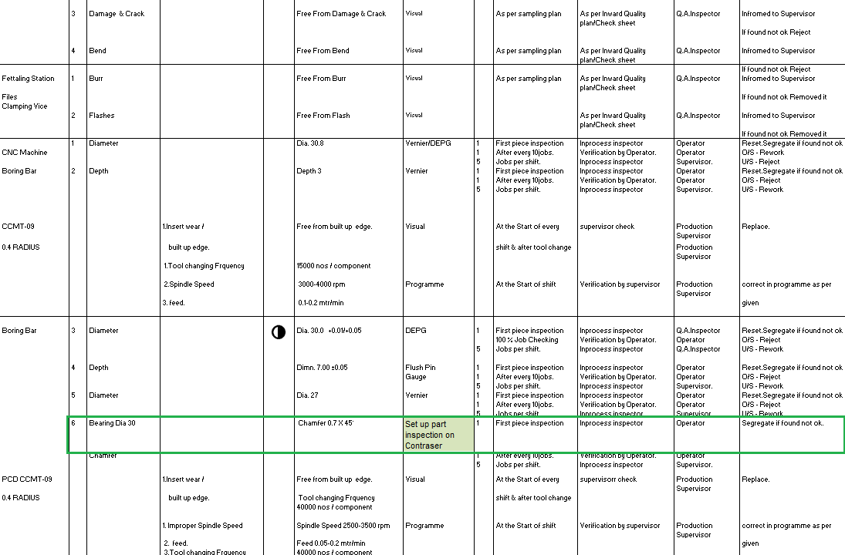
ADVANTECH ENGINEERING COMPANY
After
Machine set up parts chamfer inspection by contraser control plan revised

