Slide 1
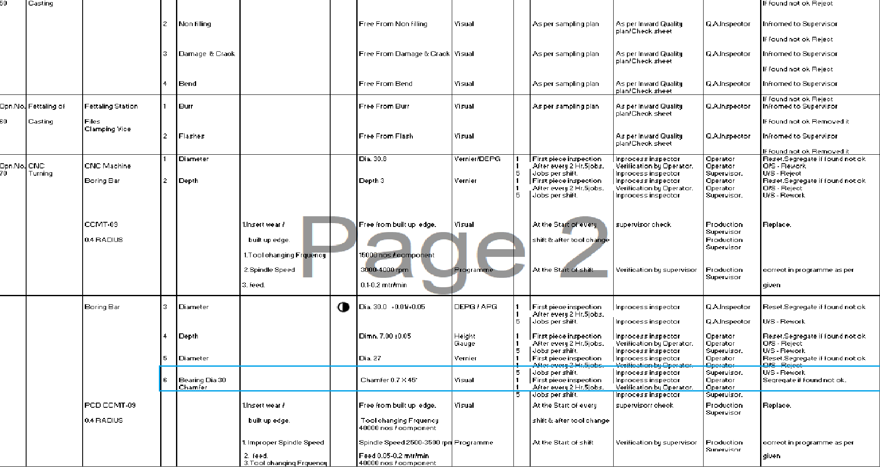
ADVANTECH ENGINEERING COMPANY
Before
Chamfer inspection by visual

