Slide 1
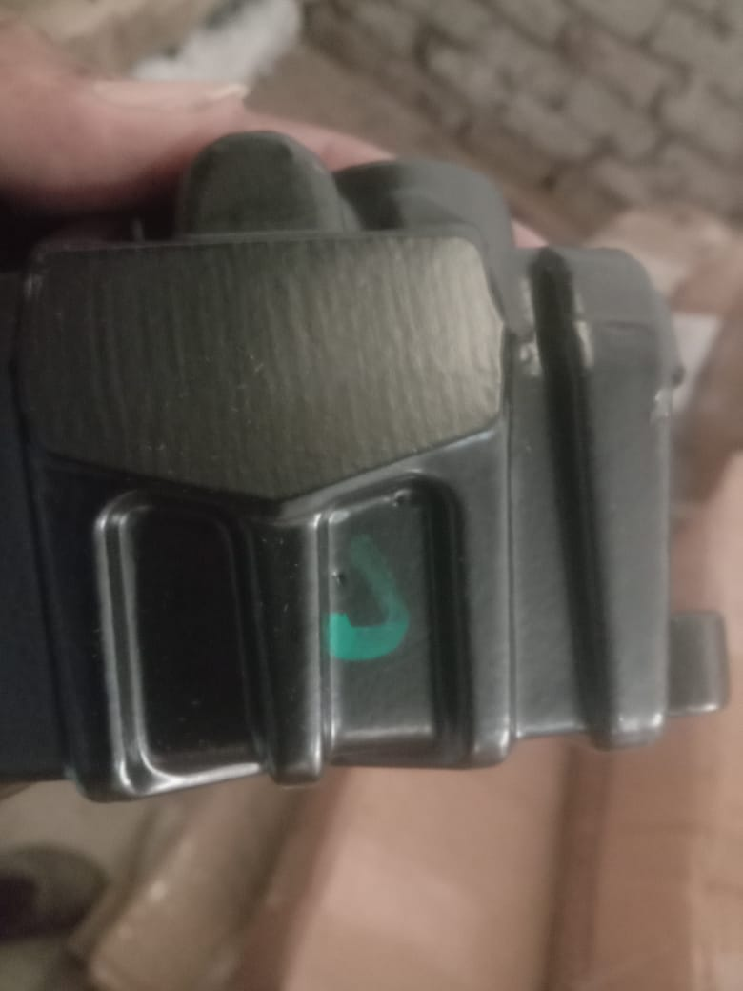
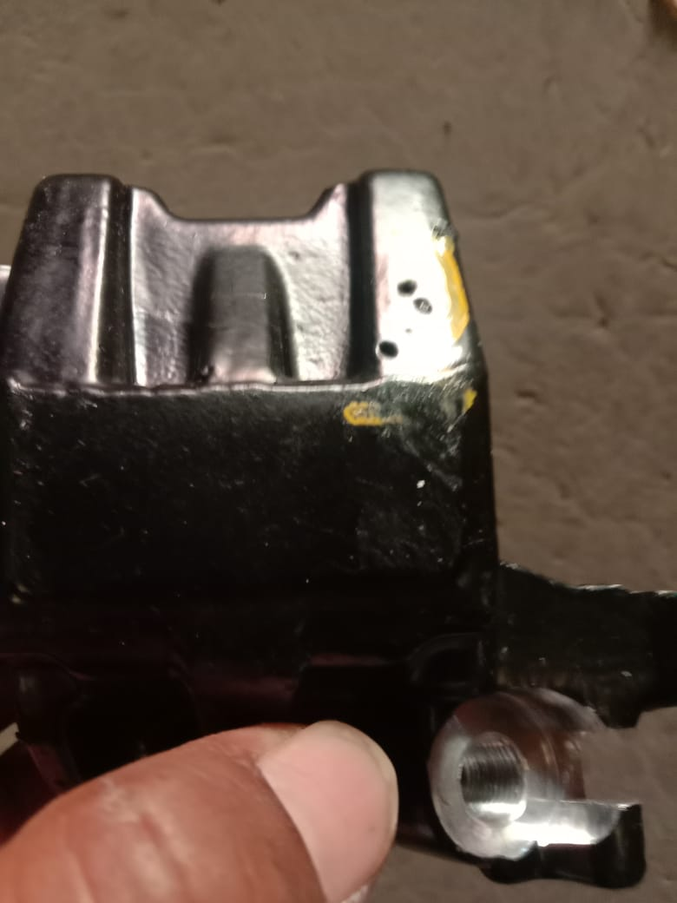
QSR Issues – Corrective actions
Part name & Part no. Integral & K2 rear caliper body Model- Customer complaint :
Physical Phenomenon : Blow hole & pin hole
Part Snap

Slide 2
Corrective Action Details
Before
After
BH & PH on integral & K2 caliper body casting surface
No BH & PH on integral & K2 caliper body casting surface
Part Name | Model | Vendor | Defect | Actions | T. Date | Status
Integral & K2 rear caliper body |  | VE | Customer complaint – BH and PH on integral & K2 caliper body Physical Phenomenon –Integral & K2 BH and PH observed on caliper body Why 1; BH,ph caliper body reach to ETL Why 2: BH,ph observed on caliper body. Why 3: Sand drop during production . Why 4 : Sand core not curing properly. Why5: Root Cause:1. Sand core not curing properly. | Containment Action :- 1. ETL End – Qty rejected by ETL 2. Available stock at Supplier end verified for BH and PH Inspection side action Supplier End:- 1. 100% parts checked and permanent marker dot mark provide on parts 2. Check point added in hourly in-process inspection. Cause Side Action:- 1. Sand core curing time will increase. 2. After sand core making proper pasting will be done on surface to avoid sand drop. 3. Sand core will be cleaned with air before using. | 06.06.2023 06.06.2023 06.06.2023 | Completed Completed Completed
HORIZONTAL DEPLOYMENT : H105
SUSTENANCE (PREVENTIVE) ACTIONS 3 Layer Audit , FFPA,JH,Fixture PM
SYSTEM ACTIONS :-In process Inspection, Process Audit & Product Audit

Slide 3
THANKS….

