Slide 1

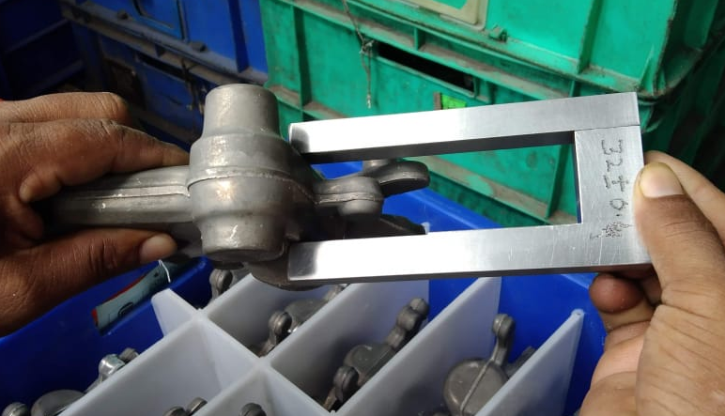
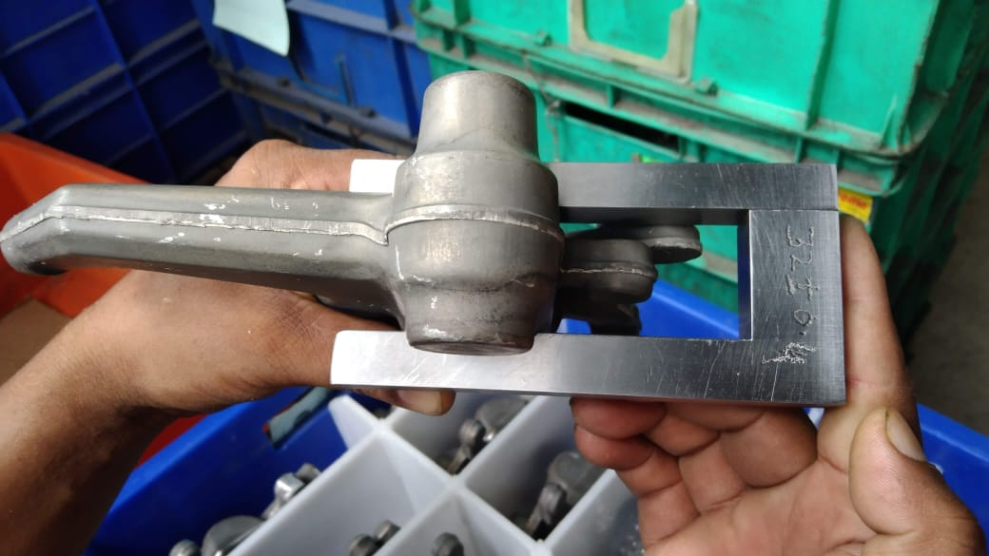
Before/ After Improvement
Defect description- M/CING SHIFT.-SHIFT OBSERVED.
Before | After
Before- Inspection done on sampling basis , / attribute gauge not available | After- Snap gauge made to check 100%
N/A

