Slide 1
Analysis –Cause & Effect Diagram
Man
Machine/Tool
Process Flow
Trimming machine not proper working
Unskilled/semi skilled manpower used
Air Pressure insufficient
Trimming tool blunt
Lug Width Oversize
Improper checking method
EFFECT
Improper tool setting
Part stucked in trimming tool
Improper method used for part remove from machine
Method
Material

Slide 2
Probable Cause
Sr. No. | Category | Probable Cause | Verification | Jud (O/X)
1 | Man | Unskilled/semi skilled manpower used | Gaurav & moti was aware about the process (WI/PRM/002, Skill matrix(F15/P&A(SKM, Limit Sample | O
2 | Machine/Tool | Insufficient air pressure | Observed pressure was 4 kg/cm2 found ok (WI/PRM/002) | O
3 |  | Trimming machine not working properly | As per machine check sheet found ok | O
 |  | Trimming tool blunt | Checked reshaping frequency proper adhered found ok | O
4
5 | Method | Improper checking method | At trimming process Part checked by vernier caliper during set-up & in-process inspection , but Possibility is there to bypass . F31/QAD(HIR-TRIM) | x
6 |  | Part Stucked in trimming tool | Observed part no chance of stucking in tool(WI/PRM/002) | O
7 |  | Improper tool setting | Observed setting done properly by tool setter(WI/PRM/002) F31/QAD(HIR-TRIM) | O
8 |  | Improper method used for part remove from machine | When parts are stored at near trimming tool, a part gets stuck in the tool, so that when trimming another part with same condition, the width of the claw increases over of stuck part. | x

Slide 3
Root Cause Analysis
Occur / Outf. | Problem | Why-1 | Why-2 | Why-3 | Why-4
Occurrence | Trimming part stucked in tool ,chance of claw width over | Sometime parts get stuck up in Die after trimming and does not fly even puff of air. Operator keep running the machine continue, then core plate lug pressed by punch and claw width size become over. | There is narrow space for the trimming tool to come off when the part is stuck | No provision in tool to avoid such type issue | Claw width oversize possibility not considered as an failure mode in PFMEA during trimming
Outflow | Checking method not sufficient to detect claw width over size on one claw at trimming & PDI | Claw width checked by vernier caliper ,during set-up, houlry & PDI, which does not ensure of whole lot /parts | Claw width oversized (One claw) possibility not considered while defined in control plan | No criteria for defining the inspection method in control plan | Procedure not available for control plan & inspection standard

Slide 4
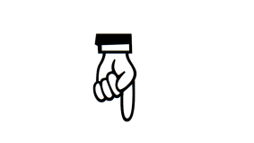
Countermeasure & Standardization

Slide 5
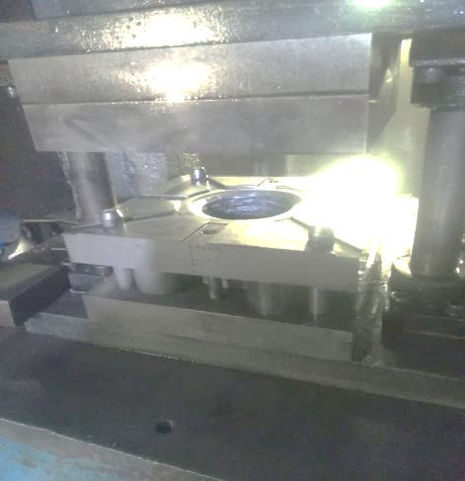
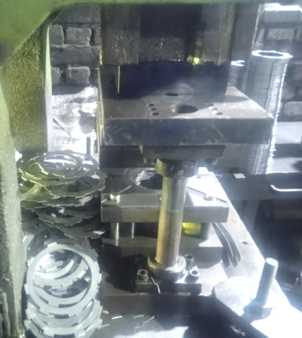
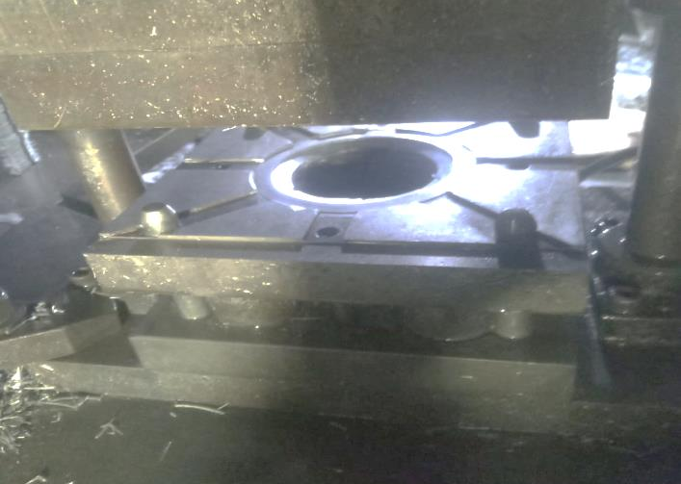
Occurrence Countermeasure
Occurrence Countermeasure | Illustration
Part ejection system to be made in trimming tool to avoid stuck issue . Done 2.11.2023
Before
After
Part stucked in tool
3.0 mm slot provided in tool to avoid claw width over size ,No chance of oversize
Part stucked in tool due to there is 0.50 mm draft in tool chance of claw width over size
Benefit : No chance of lug width over size during trimming process

Slide 6
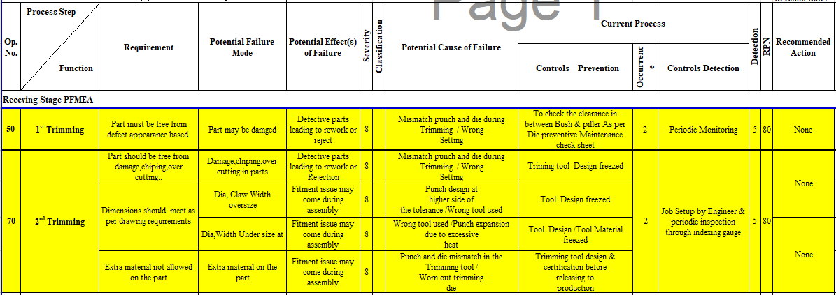
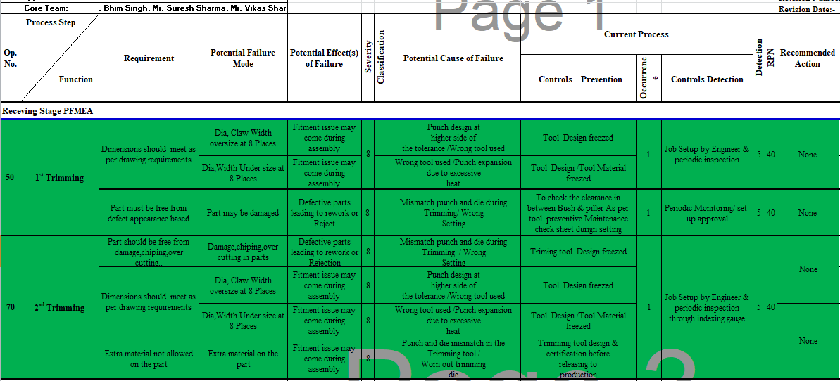
Occurrence Countermeasure
Occurrence Countermeasure | Illustration
PFMEA updated for claw width oversize at one claw .Done 2.11.2023
Before
Claw width oversize possibility not covered in PFMEA and adhered
After
Claw width at 8 places oversize possibility covered in PFMEA at Trimming 1& 2 and adhered(RPN reduced)
Benefit : RPN reduced from 80 to 40

Slide 7
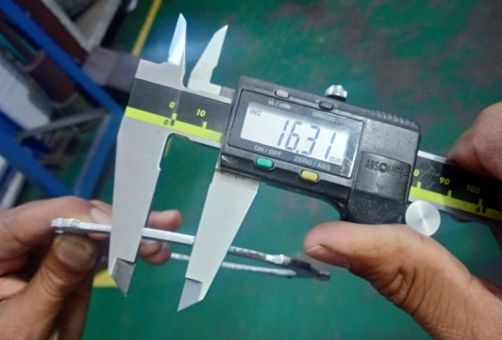
Out Flow Countermeasure
Outflow Countermeasure | Illustration
Inspection method to be improved –Done(2.11.2023)
Before
After
Lug width checked by vernier caliper 1 pc after 2 hrs ,chance of defected parts bypass
Indexing Gauge made and adhered to detect lug width oversize .
Inspection started by indexing gauge 20 nos/hr
Benefit : Claw width issue easy to detect during inspection

Slide 8
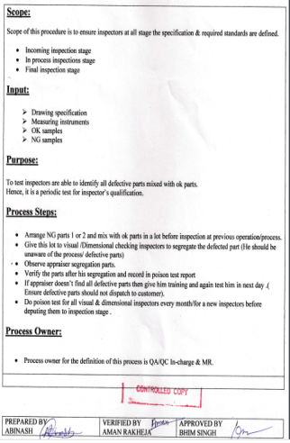
Out Flow Countermeasure
Outflow Countermeasure | Illustration
Poison test to be done to verify the effectiveness of inspection- Done(2.11.2023)
Before
After
Not Available
Poison test mechanism not available
Procedure made and adhered for poison test
Benefit : Effectiveness improve of inspection

