Slide 1
Defect Analysis Report
W/O- 967/0 (K19)
Part Name: Plate Clutch
Part Number: C2JT042020
Issue detail: Teeth ID not OK- Fitment Issue

Slide 2

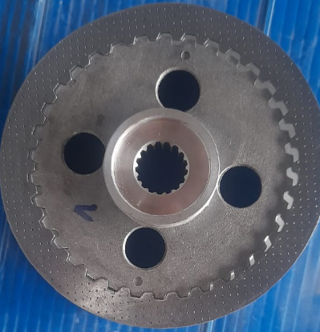
Detail of defect
Fitment issue

Slide 3
Process Flow Chart
RM Inspection
Fine Blanking
Linishing
Barelling
Straightning
Sandering
Straightning
Transport to IFB-GRP plant in Metal Bin
Oil Cleaning
Gap Gauge checking
Visual Checking
Packing

Slide 4
Containment Action detail
 | Component Name | Total checking | Fitment issue
 | PLATE CLUTCH K19 | 4000 | 1
 | PLATE CLUTCH K19 | 3800 | 0
 | PLATE CLUTCH K19 | 4000 | 1
 | PLATE CLUTCH K19 | 5700 | 0
 | PLATE CLUTCH K19 | 6000 | 0
 | PLATE CLUTCH K19 | 6000 | 0
 | PLATE CLUTCH K19 | 6000 | 0
Total Ware house stock and transit stock inspection running as per fitment part

Slide 5
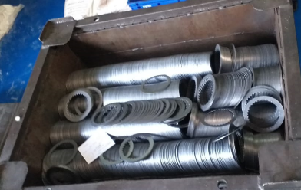
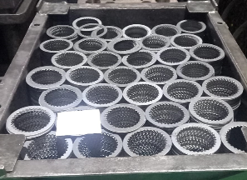
Cause of Generation
Inter plant Material movement in bin
Possibility of material bend during transportation→ After getting bend same material getting straight in next straightening operation but ovality will generate at ID and OD
Action plan:- Material will be stack in bin and loose material should not be kept over.
Possibility of material bend during transportation→ Eliminated

Slide 6
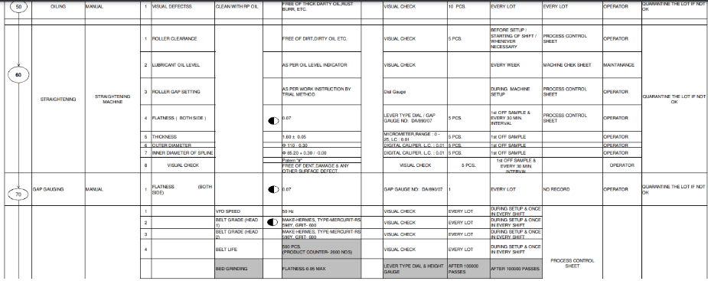
Cause of Outflow
NO control given in control plan for bend component

Slide 7
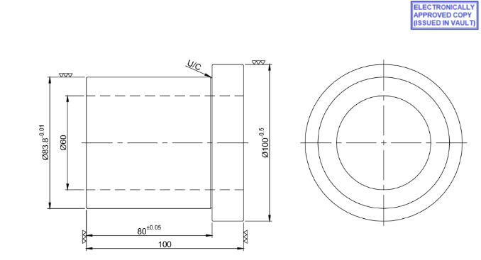
Cause of Outflow
New type gauge design made and 100 % inspection started in next lot production

Slide 8
Why-Why Analysis- Generation
Why? Component not qualify at corresponding fitment part
Why? Component found oval
Why? Component storage by OD resting
Why? No standard defined for storage of material in bin
Action- OPL made and displayed over machine. Status- Done

Slide 9
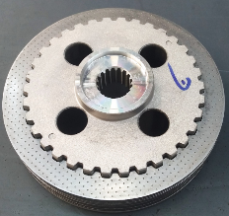
Why-Why Analysis- Outflow
Why? Bend component found at customer end
Why? No inspection system defined in Control plan
Action Plan:- New type gauge need to be design and made for detection at final stage→ Status- Under process and will be implement by 8-7-2023
Temporary Action plan→ 100 % inspection by mating part started at Warehouse for in transit and warehouse stock and 100% inspection started at IFB end at final stage.

Slide 10
Action Plan
1> 100 % ID checking gauge to be made for Ovality checking in component→ Under process→ T.Date- 7-07-2023
2> Component stacking system to be change from rolling to stacking→ OPL to be made→ Done

Slide 11
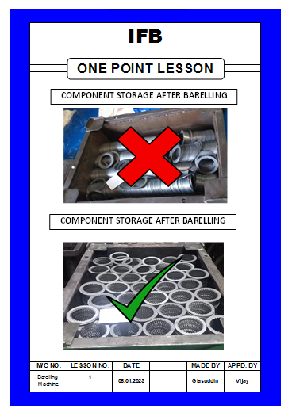
Action Plan

Slide 12
Thank you

