Slide 1
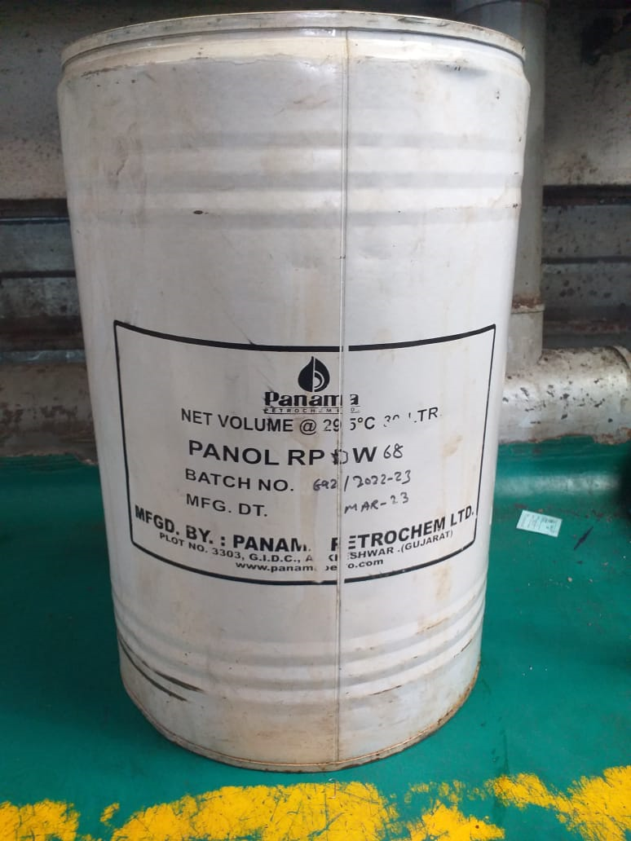
Countermeasure:- Machining stage
FINAL INSPECTION :- Q GATE Date: 04/07/2023
BEFORE
AFTER
Problem/Present Status:
Rust preventive oil PANOL RP DW 68 being used, less life of rust preventive oil(Only 15 days after oil application)
Countermeasure:
Benefits :- NA

