Slide 1
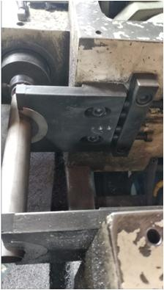
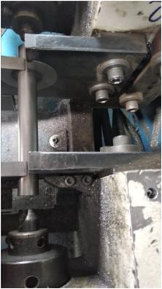
Implementation & Action for Less chamfer
ETL Plant :-Sanand Suspension
Supplier Name:- M/s Saptagiri Industries
Defect Phenomenon :- Less Chamfer
Part Name:- INNER TUBE CHAMFERED K0LA (S1GD01726B)
Date of occurrence:- 20.06.2023(No. of occurrences – 01 ) Qty rej. : 90 Nos
Name of Customer (In case of CC / EFR) :-M/s ETL ( Sanand )
No. of occurrences / No.of Rej Qty /PPM :- 90 No’s
Area of concern :- CC/EFR/Warranty/Major Rej./Rework at ETL
Effectiveness Monitoring (PPM/Rej. Qty/CC)
Baseline 20.06.2023
90 No’s
Why-Why Analysis:-
Occurrence Side :- Less Chamfer -
Chamfer Uneven →W1- W.r.t. center outer tube clamping alignment disturb
W2- O/t Clamping plate loosed . →W3 Capsule slot given for bolt locking of the clamping plate
Escape Side:-W1. Skip from final inspection→W2 Inspector Not aware about defect. →W3.
Evidence of action
Before | After
Root Causes:-
Occurrence cause :-
Capsule slot given for bolt locking of the clamping plate
Escape Cause:- Inspector Not aware about defect
Corrective Action/ Implementation Dates/Status:-
Occurrence Action :-
1) Rigid bolt engage with clamping plate including spring tension washer to avoided clamping plate loosed issue Date: 22.06.2023
2) For verification of O/t clamping plate point has added in daily machine check sheet Date:22.06.2023
Escape action:-
1) 100 % visul inspection started as per one point lesson and Q alert Display at work place Date:22.06.2023
2) Awareness training given to inspector Date:22.06.2023
Capsul slot given for bolt locking of the clamping plate
Rigid bolt enegae with claming plate inculding spring tention washer to avoide clampning plate loosed issue
Preventive / Sustenance Action
Future/HD Action if any :- All type of I/T

