Slide 1
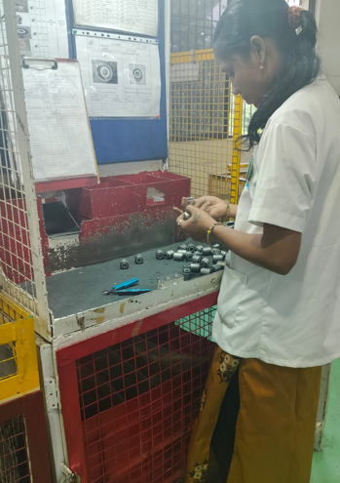
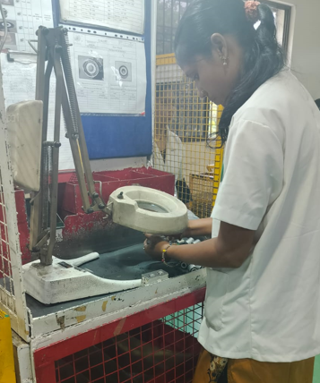
Before & after inspection method
Before
After
Visual inspection done by as shown in photograph .
Now , Visual inspection done with help of magnified glass.

