Slide 1
Improvement in Cause side
NOT OK DRILL
OK DRILL
TIN (Titanium Nitride )Coated drill are being used for drill machining ,SPC done for coated and non coated drill after process validation TIN coated drill defined and added in the control plan.
Benefits: TiN is a hard ceramic coating that is often used on steel drill bits and other machine tooling, and it provides several benefits, mainly longer edge retention and reduced friction Tin-coated drill bits should last longer than uncoated bits

Slide 2
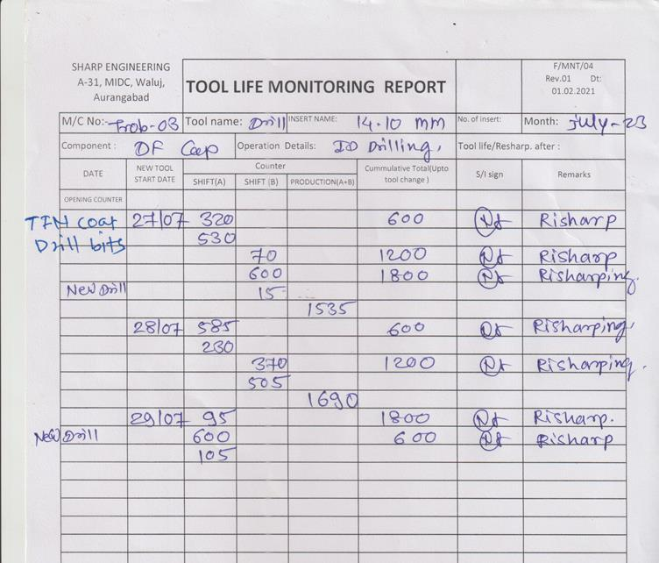
Improvement in Cause side (Tool Life)
Before
After

