Slide 1
Improvement in Cause side
NOT OK DRILL
OK DRILL
Tool worn out on 600/sharpening earlier than defined frequency , non coated drill worn out sometimes at end of the tool life near @500 Nos.

Slide 2
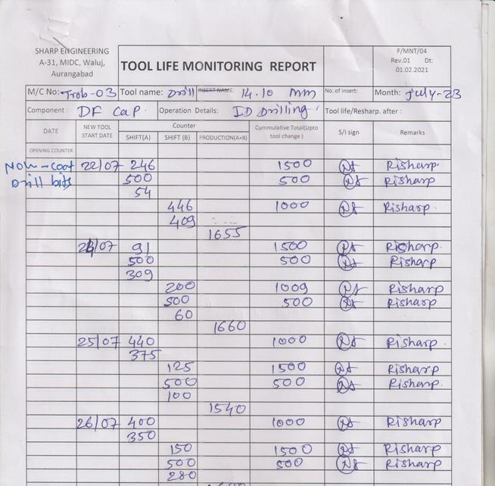
Improvement in Cause side (Tool Life)
Before
After

