Slide 1
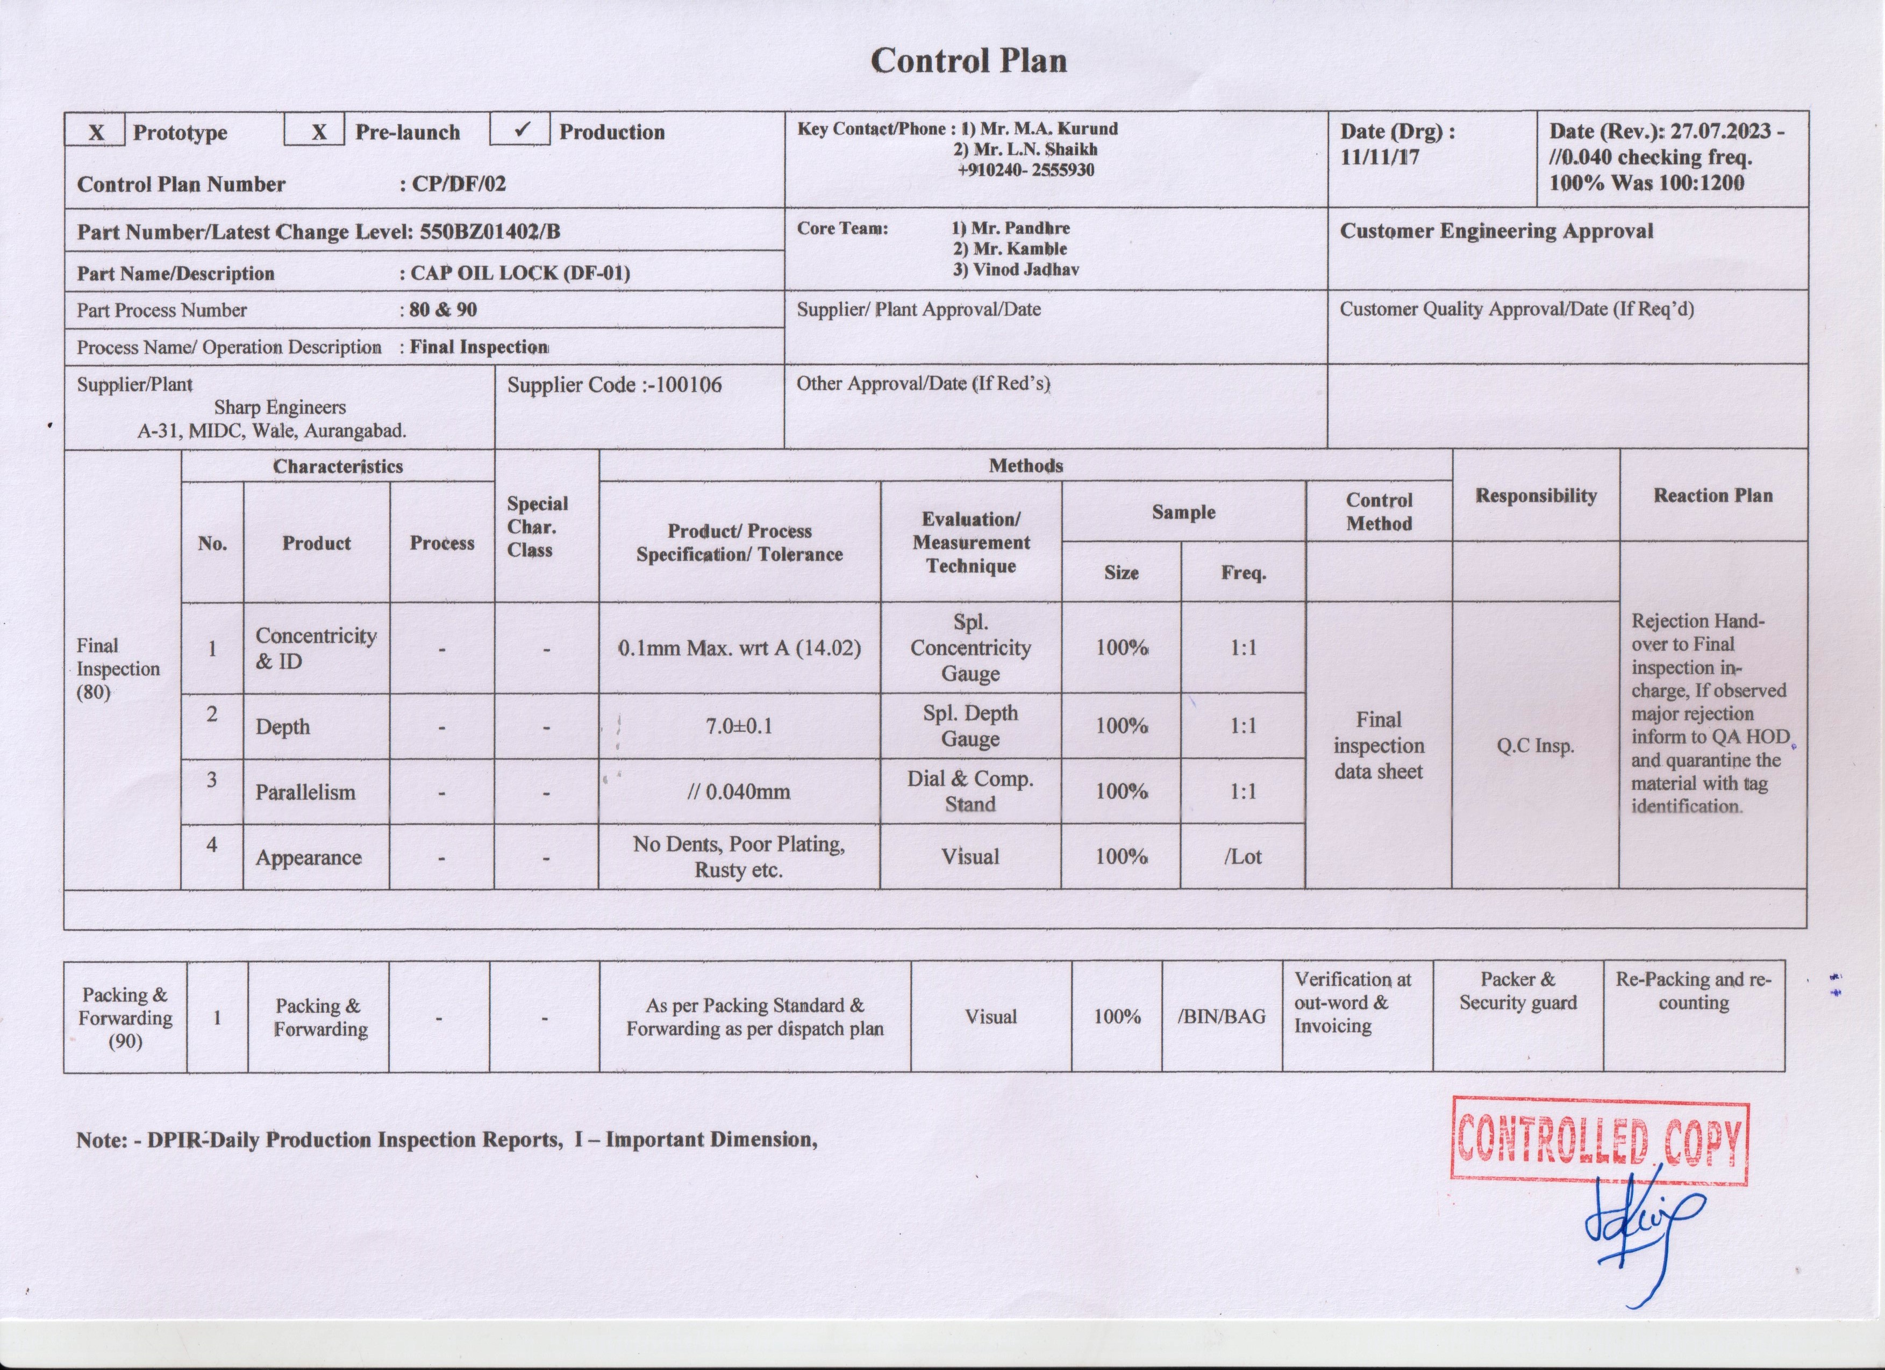
Improvement in Inspection
Before
After

Slide 2
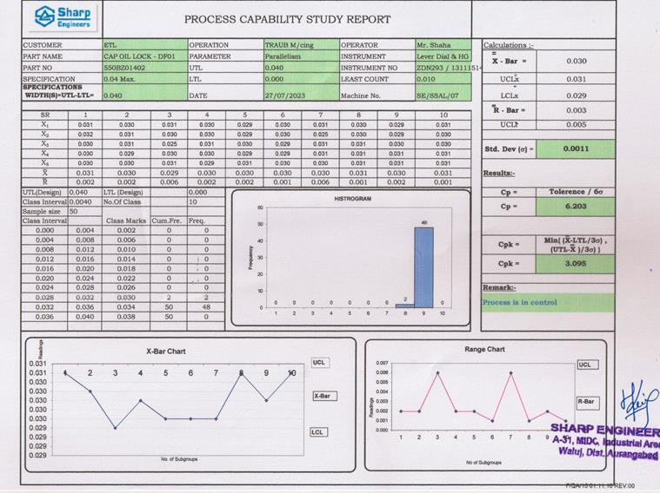
Improvement in Inspection
Before
After

