Slide 1
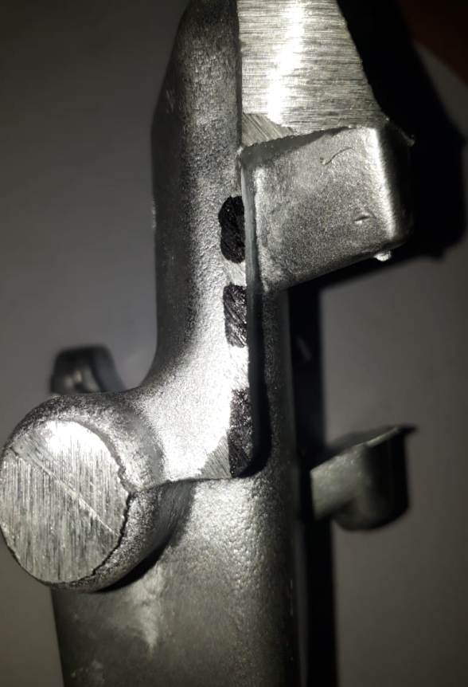
ACTION TAKEN ON-
To remove air from die slots are provided in die as shown bellow.

