Slide 1
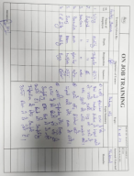
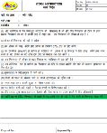
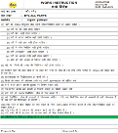
Machine
Probable Causes
3
1
Problem :-
Fishbone
2
Man
Sr. No. | Probable Cause | Verification | Jud (O/X)
1 | Negligency Done by Inspector | Training record available for same | O
2 | Heating parameter disturb | Heating Parameter Observed 261˚C against 270±20˚C | O
3 | Improper Lug Matching Sequence | Lug Matching Sequence was Disturb | x
4 | Un-even Holding Time | Holding Time Found ok (40 Minutes) | o
5 | Improper Inspection | Sample Collected from One Box | x
Flatness Obs. 0.30mm Against & Nov’23 0.20mm in LML core Plate & 3W4S
Negligency Done by Inspector
Improper lug Matching Sequence
Heating Parameter Disturb
Un-Even Holding Time
Improper Inspection
Material
Method
4
Occur / Outf. | Problem | Why-1 | Why-2 | Why-3 | Why-4
Occurrence | Flatness Obs. 0.30mm Against 0.20mm | Improper Lug Matching Sequence | Lug Matching Sequence was Found Disturbed | Due to improper material handling during heating | Possibilities was not Considered in Heating W.I
Outflow | Flatness Obs. 0.30mm Against 0.20mm | Improper Inspection | Defected Parts was Not Detected During Sampling Inspection | Sample Collected From one Box | Check Point was not Available for Sample Collected from Multiple Boxes.
Occurrence Countermeasure | Illustration
Check has been Added in Heating W.I . OPL Has been made for Lug Matching Sequence.. PFMEA Has been updated for lug Matching Training Provided to the Operator.
All actions horizontal development in all Core Plate
Outflow Countermeasure | Illustration
Final Inspection W.I has been Updated. Training to be given to the concerned persons. Sampling inspection has been started to collect the sample from multiple Boxes. 100% marking has been Implemented on Outside of the Bunch SOP made and adhere for flatness checking
5
6
OPL
Heating Work Instruction
Training
Final Inspection W.I
Note : All countermeasure will be implemented-Done

Slide 2
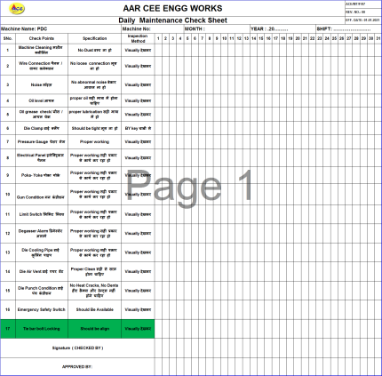
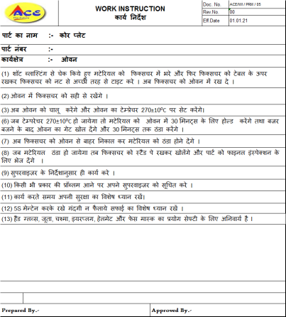
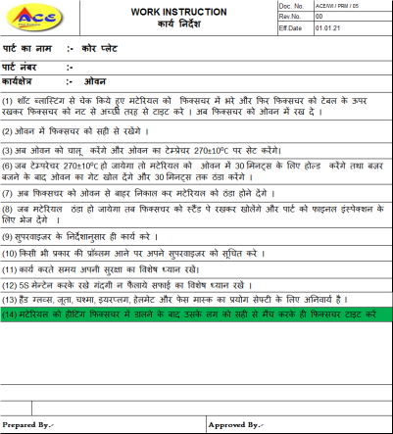
Actions Taken- Before/After
Actions Taken (Cause Side)
BEFORE
AFTER
W.I
W.I
Problem
Possibilities was not considered in Heating W.I
Improvement
Check Point has been added in heating W.I

Slide 3
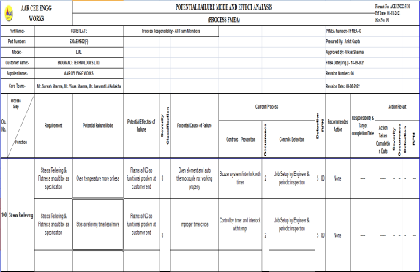
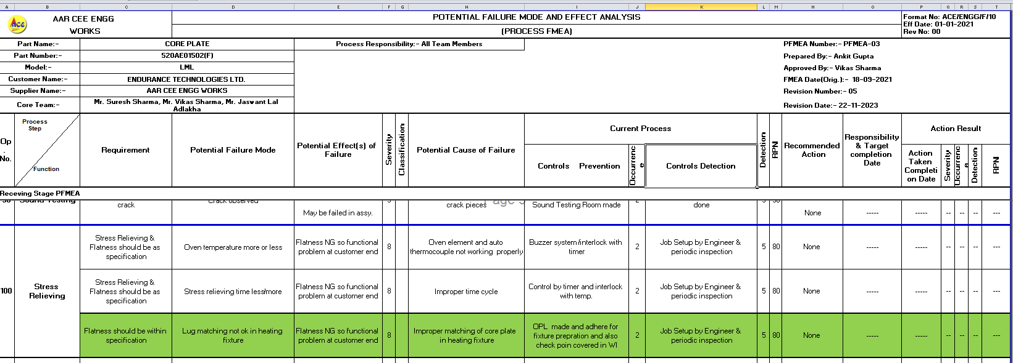
Actions Taken- Before/After
Actions Taken -Cause Side
BEFORE
AFTER
Problem
Possibilities was not considered in PFMEA
Improvement
Lug matching issue covered in PFMEA and adhered

Slide 4
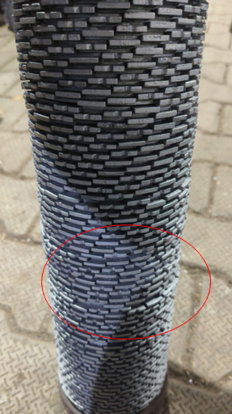
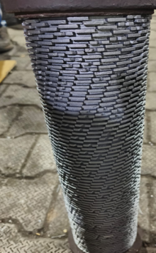
Actions Taken- Before/After
Actions Taken -Cause Side
BEFORE
AFTER
Problem
Lug Matching was Disturbed During Heating Process
Improvement
#Training provided for Proper Lug matching Sequence to Avoid Flatness Issues
#OPL made and adhere

Slide 5
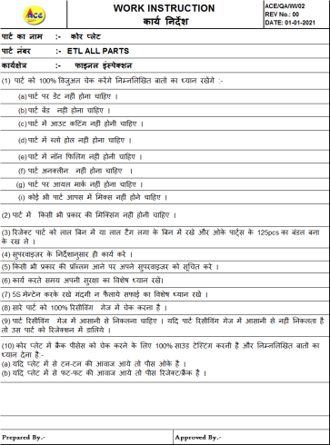
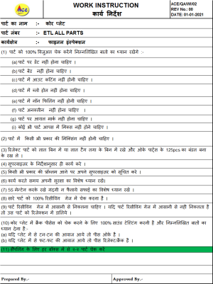
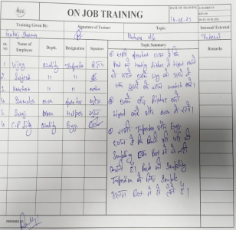
Actions Taken- Before/After
Actions Taken -Cause Side
BEFORE
AFTER
Problem
Check Point not Covered in Final Inspection W.I
Improvement
Check Point Covered in Final Inspection W.I.
Training provided

Slide 6
Actions Taken- Before/After
Actions Taken -Cause Side
BEFORE
AFTER
NA
Problem
Improvement
OPL has been Made and Displayed at Concern Department

Slide 7
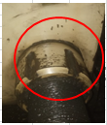
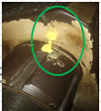
Actions Taken- Before/After
Actions Taken -Cause Side
BEFORE
AFTER
Problem
Tie bar bolt locking mechanism was not available
Improvement
Tie bar bolt locking mechanism has been Made and adhered.

Slide 8
Actions Taken- Before/After
Actions Taken -Cause Side
BEFORE
AFTER
NA
Problem
Improvement
SOP made and adhere for flatness inspection & Gauging

Slide 9
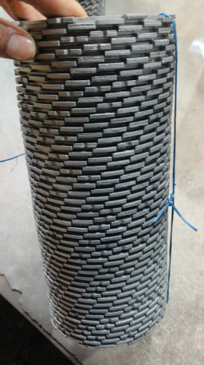
Actions Taken- Before/After
Actions Taken (Inspection Side)
BEFORE
AFTER
Problem
Marking was not available on parts
Improvement
100% marking has been Implemented on Outside of the Core Plate Bunch

Slide 10
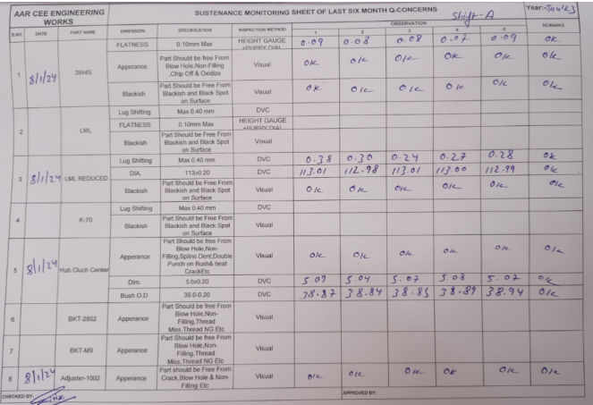
Actions Taken- Before/After
Actions Taken (Inspection Side)
BEFORE
AFTER
N/A
Problem
Improvement
Q-Sustenance Monitoring Sheet Has been Started

Slide 11
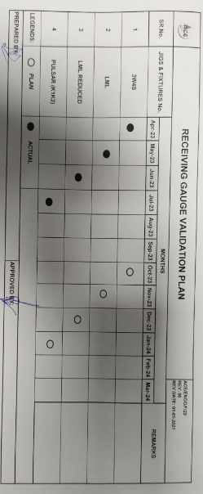
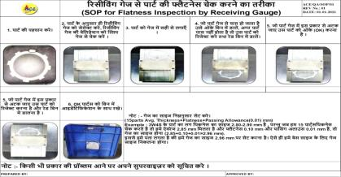
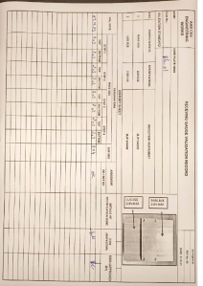
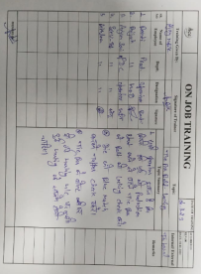
Actions Taken- Before/After
Actions Taken -Inspection Side
BEFORE
AFTER
Problem
Receiving Gauge Validation Plan was not adhered
Improvement
# Gauge verification started on daily basis from 6 months
# SOP made for inspection and verification –Done
# Training Provided

Slide 12
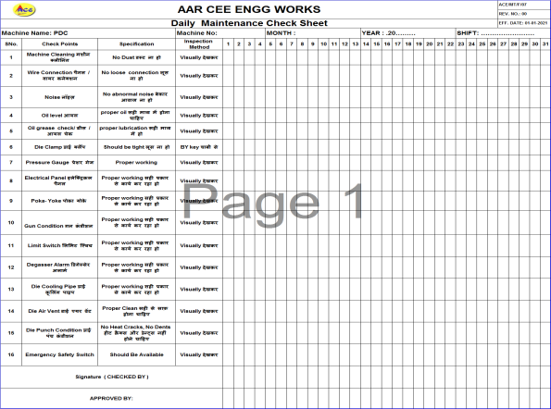
Actions Taken- Before/After
Actions Taken (Cause Side)
BEFORE
AFTER
Daily PM Check Sheet
Daily PM Check Sheet
Problem
Possibilities was not considered in Machine Check Sheet
Improvement
Check Point has been added in Daily PM Check sheet

Slide 13
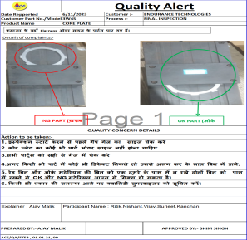
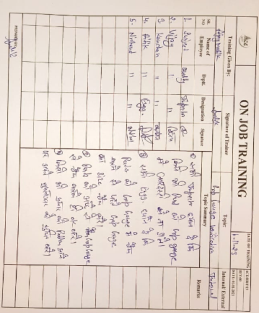
Actions Taken- Before/After
Actions Taken (Inspection Side)
BEFORE
AFTER
N/A
Problem
Improvement
OPL made for inspection by snap gauge & training given for the same.

Slide 14
Actions Taken- Before/After
Actions Taken (Inspection Side)
BEFORE
AFTER
N/A
Problem
Improvement
Q-Sustenance Monitoring Sheet Has been Started and adhered.

