Slide 1
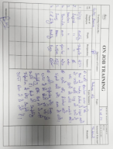
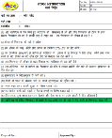
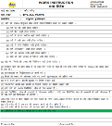
Machine
Probable Causes
3
1
Problem :-
Fishbone
2
Man
Sr. No. | Probable Cause | Verification | Jud (O/X)
1 | Negligency Done by Inspector | Training record available for same | O
2 | Heating parameter disturb | Heating Parameter Observed 261˚C against 270±20˚C | O
3 | Improper Lug Matching Sequence | Lug Matching Sequence was Disturb | x
4 | Un-even Holding Time | Holding Time Found ok (40 Minutes) | o
5 | Improper Inspection | Sample Collected from One Box | x
Flatness Obs. 0.30mm Against & Nov’23 0.10mm in core Plate 3W4S
Negligency Done by Inspector
Improper lug Matching Sequence
Heating Parameter Disturb
Un-Even Holding Time
Improper Inspection
Material
Method
4
Occur / Outf. | Problem | Why-1 | Why-2 | Why-3 | Why-4
Occurrence | Flatness Obs. 0.30mm Against 0.20mm | Improper Lug Matching Sequence | Lug Matching Sequence was Found Disturbed | Due to improper material handling during heating | Possibilities was not Considered in Heating W.I
Outflow | Flatness Obs. 0.30mm Against 0.20mm | Improper Inspection | Defected Parts was Not Detected During Sampling Inspection | Sample Collected From one Box | Check Point was not Available for Sample Collected from Multiple Boxes.
Occurrence Countermeasure | Illustration
Check has been Added in Heating W.I . OPL Has been made for Lug Matching Sequence.. PFMEA Has been updated for lug Matching Training Provided to the Operator.
All actions horizontal development in all Core Plate
Outflow Countermeasure | Illustration
Final Inspection W.I has been Updated. Training to be given to the concerned persons. Sampling inspection has been started to collect the sample from multiple Boxes. 100% marking has been Implemented on Outside of the Bunch SOP made and adhere for flatness checking
5
6
OPL
Heating Work Instruction
Training
Final Inspection W.I
Note : All countermeasure will be implemented-Done

Slide 2
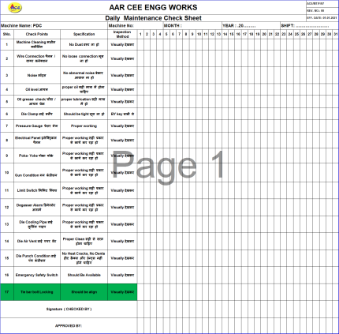
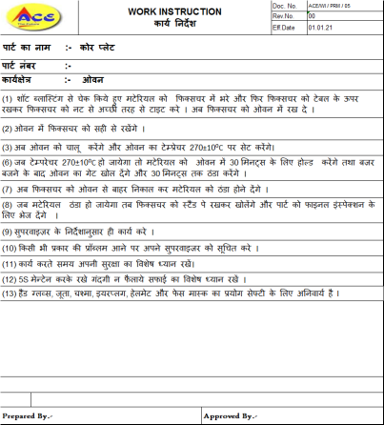
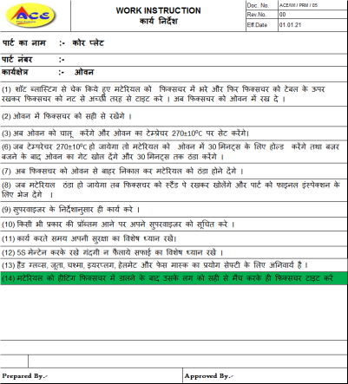
Actions Taken- Before/After
Actions Taken (Cause Side)
BEFORE
AFTER
W.I
W.I
Problem
Possibilities was not considered in Heating W.I
Improvement
Check Point has been added in heating W.I

Slide 3
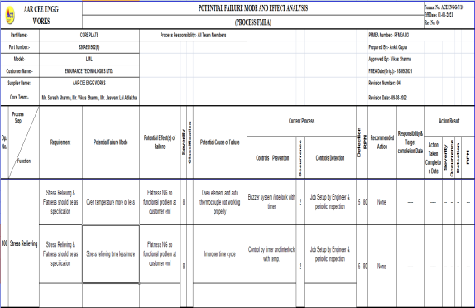
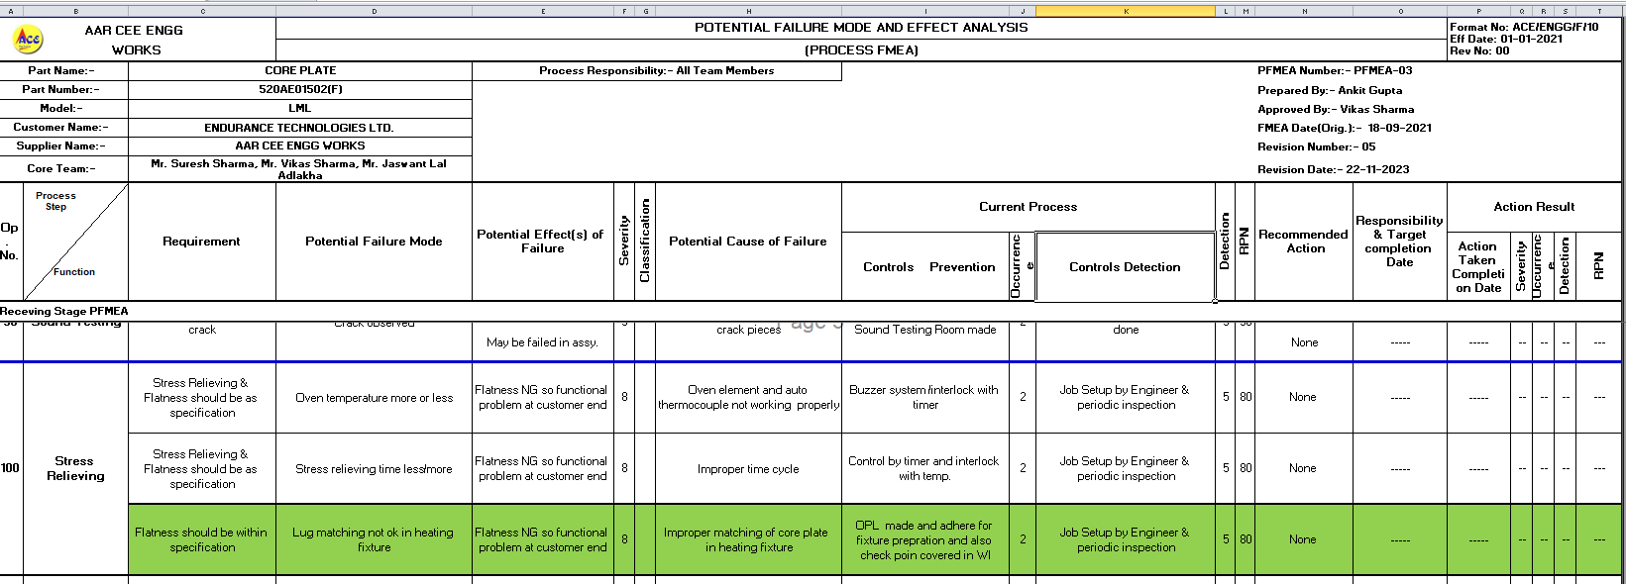
Actions Taken- Before/After
Actions Taken -Cause Side
BEFORE
AFTER
Problem
Possibilities was not considered in PFMEA
Improvement
Lug matching issue covered in PFMEA and adhered

Slide 4
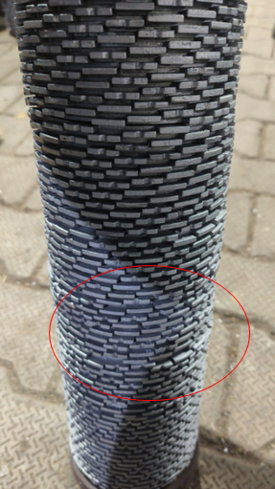
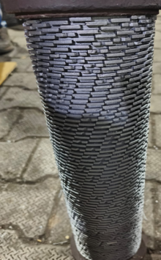
Actions Taken- Before/After
Actions Taken -Cause Side
BEFORE
AFTER
Problem
Lug Matching was Disturbed During Heating Process
Improvement
#Training provided for Proper Lug matching Sequence to Avoid Flatness Issues
#OPL made and adhere

Slide 5
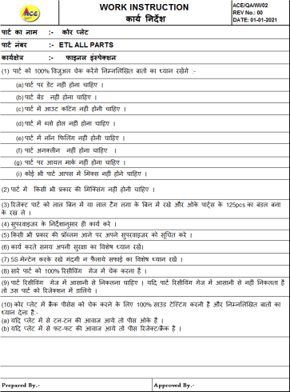
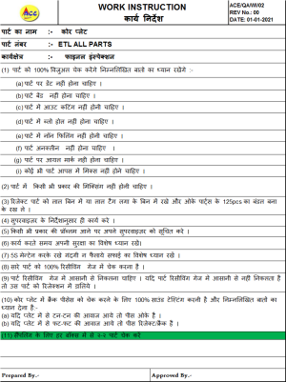
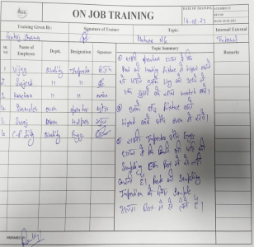
Actions Taken- Before/After
Actions Taken -Cause Side
BEFORE
AFTER
Problem
Check Point not Covered in Final Inspection W.I
Improvement
Check Point Covered in Final Inspection W.I.
Training provided

Slide 6
Actions Taken- Before/After
Actions Taken -Cause Side
BEFORE
AFTER
NA
Problem
Improvement
OPL has been Made and Displayed at Concern Department

Slide 7
Actions Taken- Before/After
Actions Taken -Cause Side
BEFORE
AFTER
NA
Problem
Improvement
SOP made and adhere for flatness inspection & Gauging

Slide 8
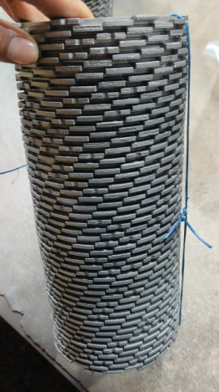
Actions Taken- Before/After
Actions Taken (Inspection Side)
BEFORE
AFTER
Problem
Marking was not available on parts
Improvement
100% marking has been Implemented on Outside of the Core Plate Bunch

Slide 9
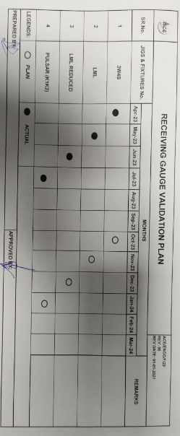
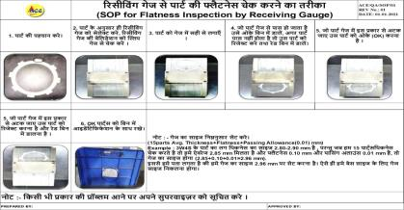
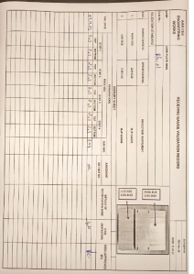
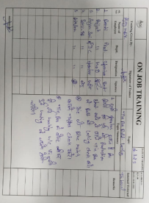
Actions Taken- Before/After
Actions Taken -Inspection Side
BEFORE
AFTER
Problem
Receiving Gauge Validation Plan was not adhered
Improvement
# Gauge verification started on daily basis from 6 months
# SOP made for inspection and verification –Done
# Training Provided

Slide 10
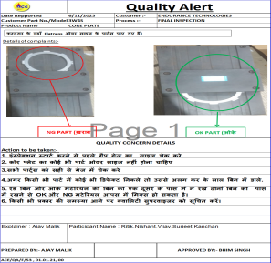
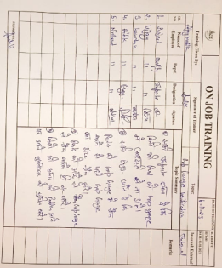
Actions Taken- Before/After
Actions Taken (Inspection Side)
BEFORE
AFTER
N/A
Problem
Improvement
OPL made for inspection by snap gauge & training given for the same.

Slide 11
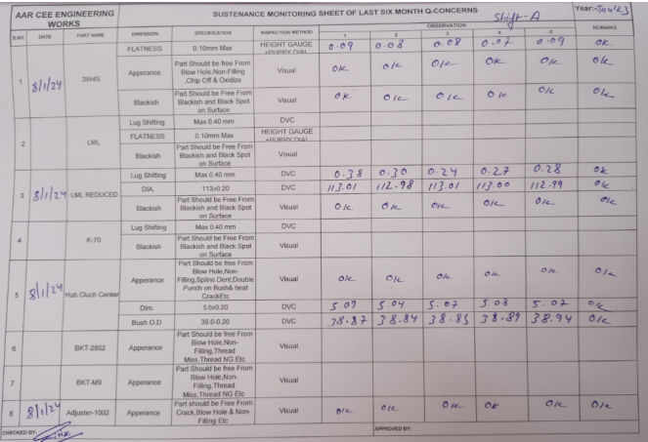
Actions Taken- Before/After
Actions Taken (Inspection Side)
BEFORE
AFTER
N/A
Problem
Improvement
Q-Sustenance Monitoring Sheet Has been Started and adhered.

