Slide 1
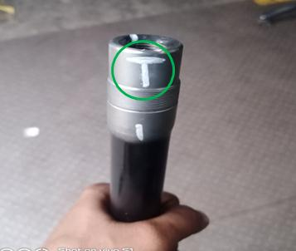
Outflow Side Action
100% inspection started with identification check mark for confirmation.
Awareness given to operator and inspector & OPL Displayed.
For ok parts provide 100 % Verification identification marking on 22mm dimension.

