Slide 1
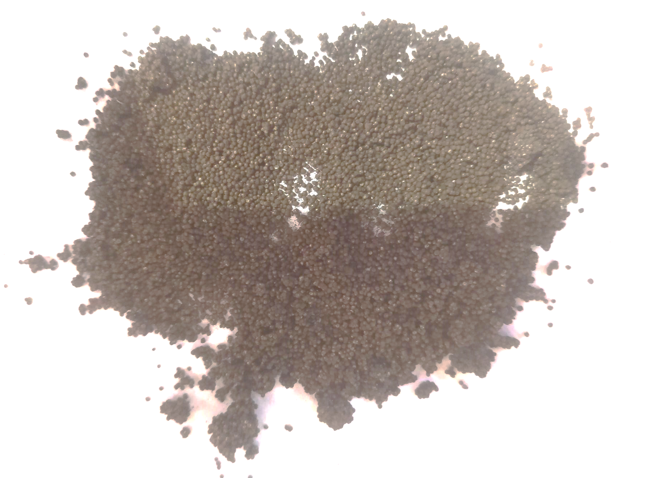
Before
Shots with moisture & Dust

