Slide 1
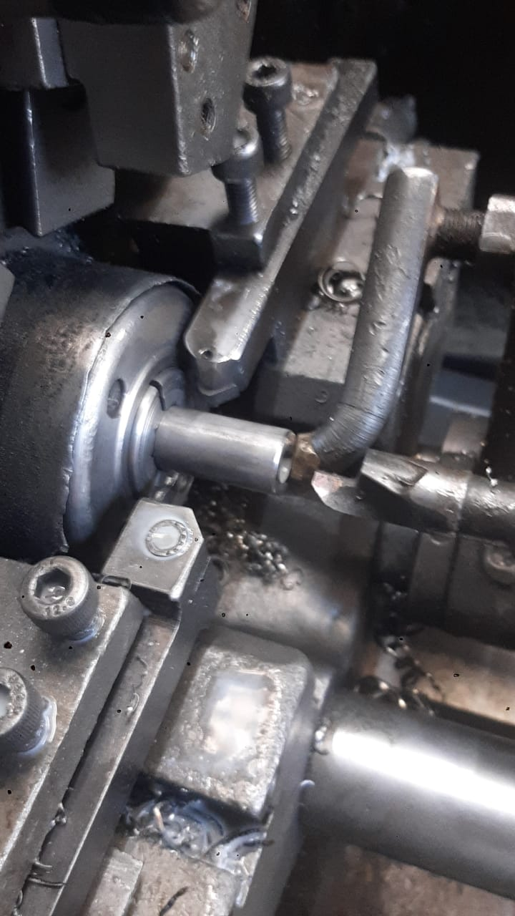
OCURANCE SIDE CORRECTIVE ACTION
AFTER
2
1 | On Traub Machine Length Rest Pipe STOPPER adjust as per Required Specification

