Slide 1
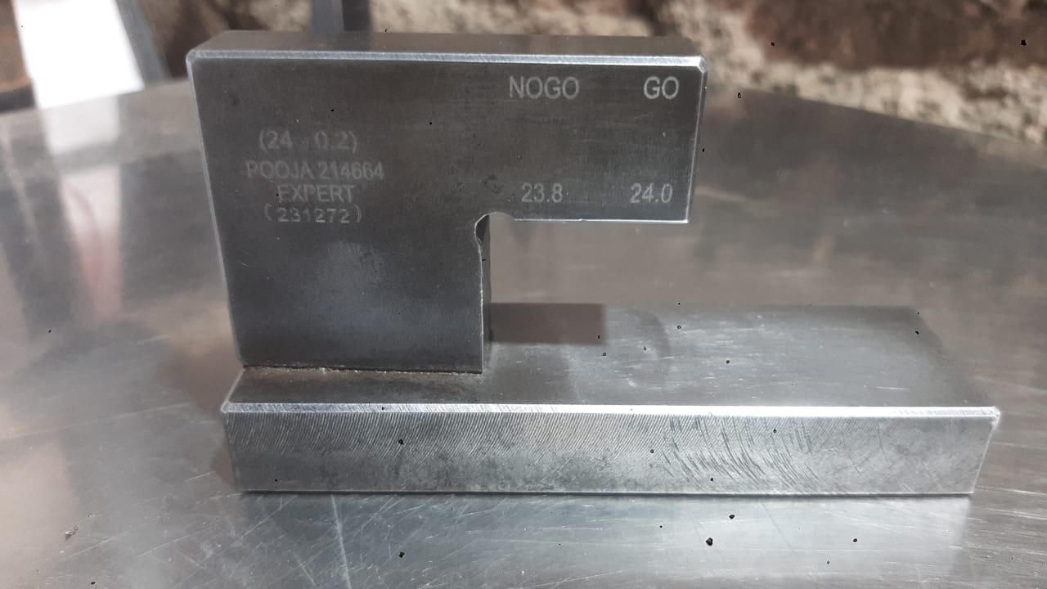
DETECTION SIDE CORRECTIVE ACTION
1 | Height Gauge Size Reduce By 0.02mm .
2

