Slide 1
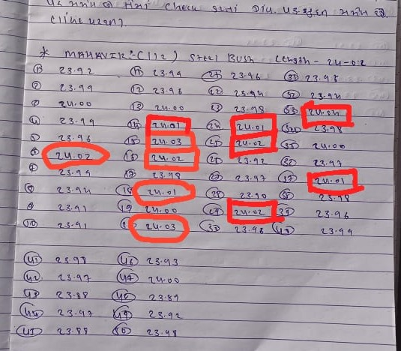
OCURANCE SIDE CORRECTIVE ACTION
BEFORE
2
1 | During Length oversize observed Than Required Drawing Spec at Customer End

