Slide 1
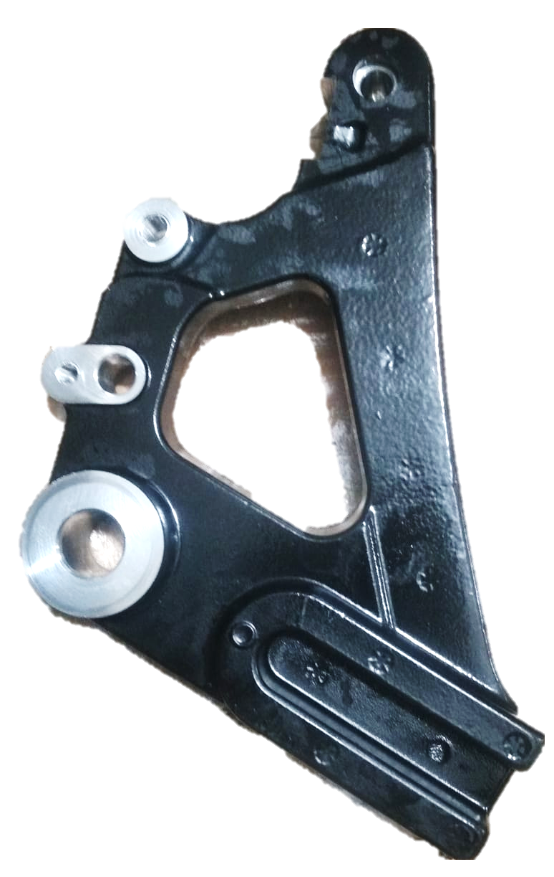
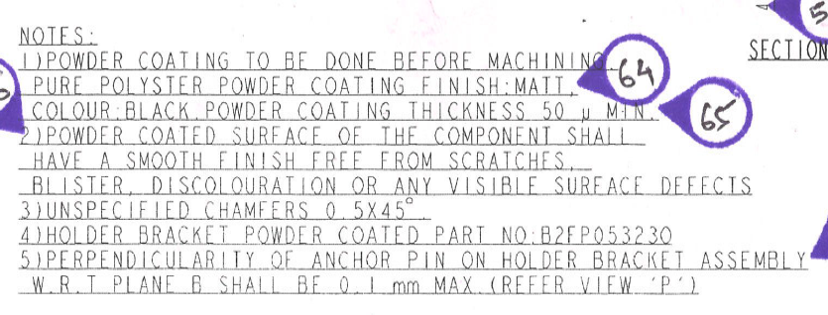
QSR Issues – Corrective actions
Part name & Part no. Holder Bracket RE J1 Rear B2FP05613O
Model- Customer complaint : Royal Enfield
Physical Phenomenon : DUST, UNCOVER,ORANGE PEEL
Part Snap
Drawing Snap

Slide 2
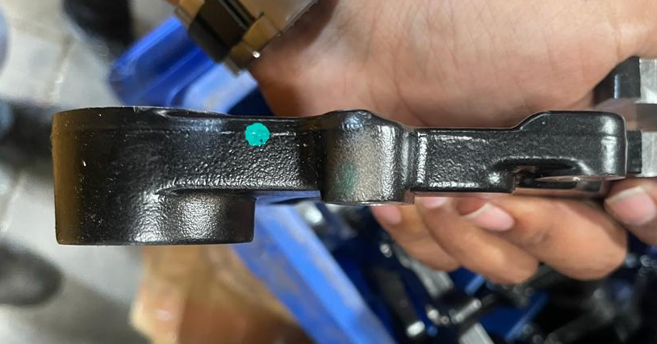
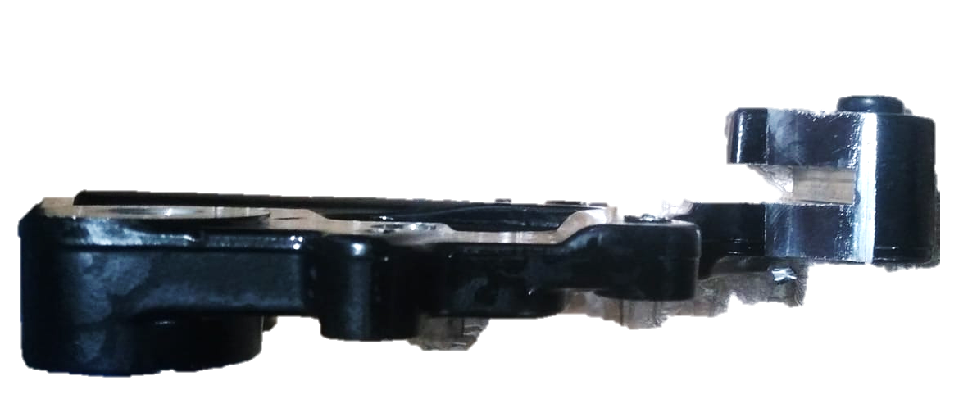
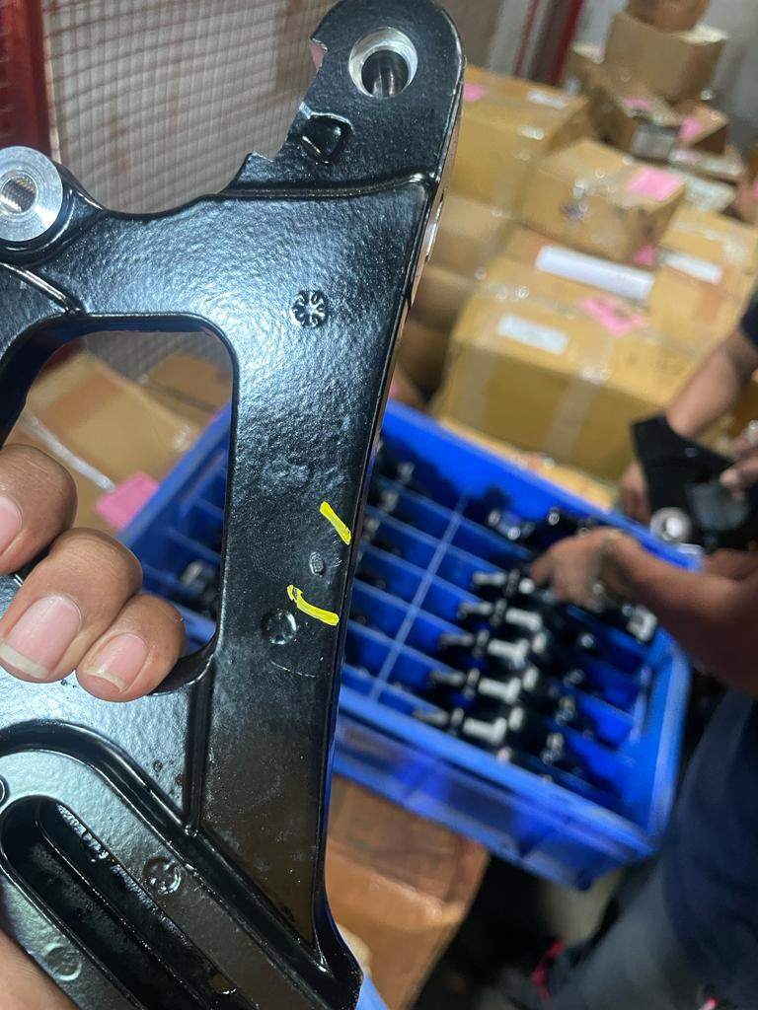
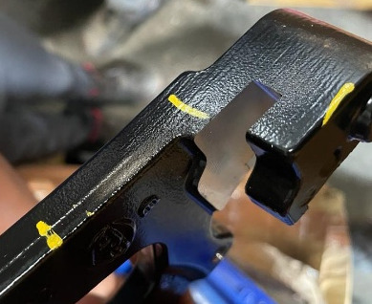
Corrective Action Details
Before
After
DUST, UNCOVER,ORANGE PEEL ON PARTS
NO DUST , UNCOVER , ORANGE PEEL ON PART
Part Name | Model | Vendor | Defect | Actions | T. Date | Status
1. HOLDER BRACKET FINISHED-RE J1 REAR | Royal Enfield | Praneel Industries | Customer complaint – DUST, UNCOVER,ORANGE PEEL ON PARTS Physical Phenomenon – DUST, UNCOVER,ORANGE PEEL ON PARTS Why 1; Uncover issue observed in Holder bracket Why 2: Defective ventury observed in Powder coating Gun Why 3:Powder coating Gun not proper checked before powder coating process Why 4 :Powder coating Operator has not gained sufficient knowledge for powder coating process Root Cause: New Manpower | Containment Action :- 1. .ETL End – 30 Qty rejected by ETL 2. . Available stock at Supplier end verified for this issue Inspection side action Supplier End:- 1. Training & Awareness Given to powder coating operator & final inspector 2.. Q-Alert Displayed at workstations. Inspection side action ETL End:- 1-Q Alert displayed Cause Side Action:- Immediate new ventury install in Powder coating Gun Training provided to Powder coating operator for powder coating gun checking and Cleaning PM check Sheet provided at Powder coating booth for coating gun checking and Cleaning | 16.10.23 16.10.23 16.10.23 16.10.23 16.10.23 16.10.23 16.10.23 25.10.23 | Completed Completed Completed Completed Completed Completed Completed
HORIZONTAL DEPLOYMENT : All line
SUSTENANCE (PREVENTIVE) ACTIONS : PM Checksheet
SYSTEM ACTIONS :-PM Check sheet & process audit

Slide 3
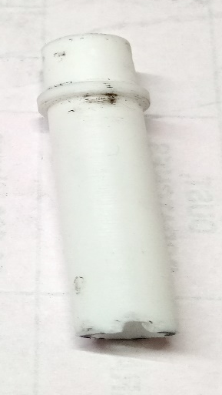

Corrective Action Details
Pic 1
Defective Ventury
Replaced & New Ventury

Slide 4
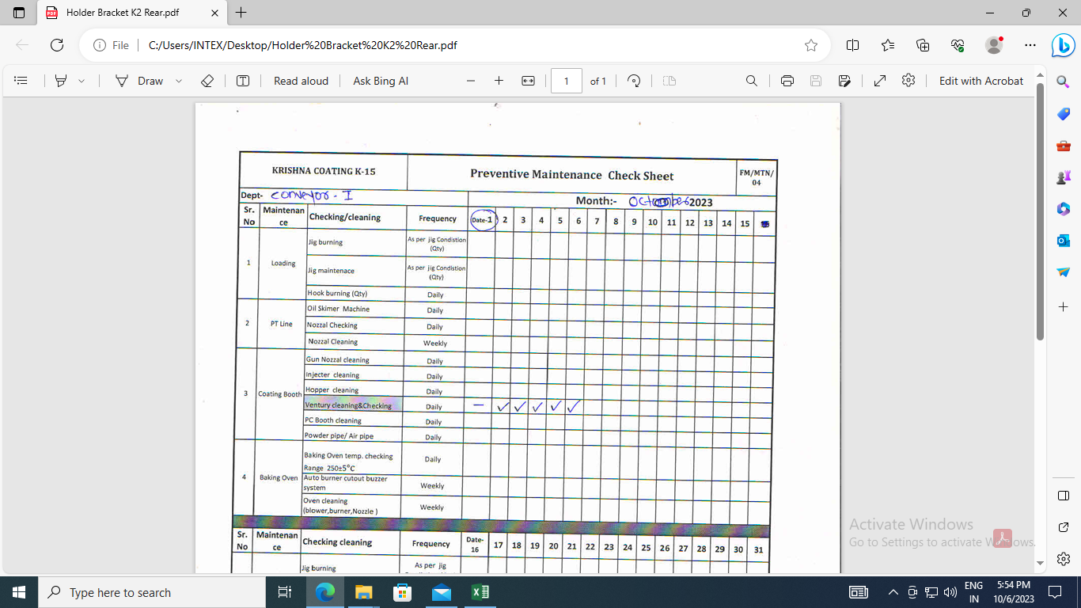
Corrective Action Details
Pic 2
PM Check sheet Implemented at powder coating booth & Checkpoint added for gun checking & Cleaning

Slide 5
Evidences
Q-Alert Displayed at Workstation.

