Slide 1
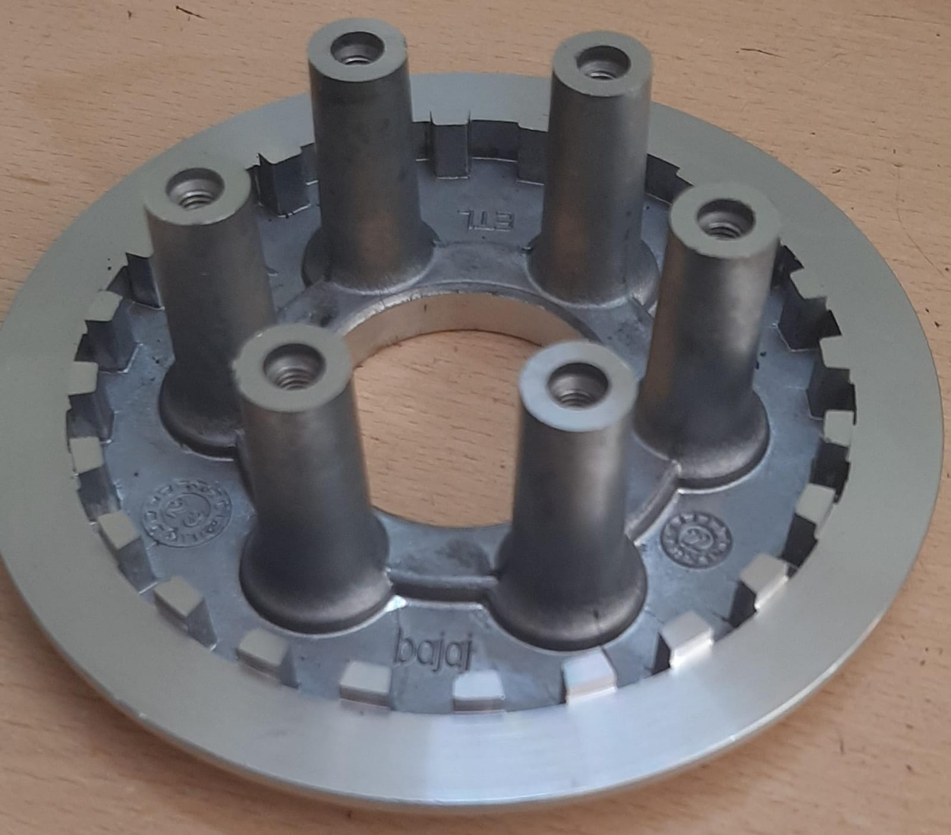
Part name & Part no. : WHEEL CLUTCH FINISHED UPGRADE (520PP01902). Model : 3W4S
Customer complaint :. Fitment issue due to teeth run out found up to 1.15 mm against 0.2 mm
Physical Phenomenon : Problem in Fitment
1. Rejection Quantity – month wise
Mfg. Month | Jan.23 | Feb.23 | Mar.23 | Apr.23 | May.23 | Jun.23 | Jul.23 | Aug.23 | Sept. 23 | Oct.23 | Nov.23 | Dec.23
Rejected qty. in nos. | 0 | 0 | 0 | 0 | 0 | 0 | 0 | 0 | 0 | 2
2. Photograph – failure phenomenon
3. Whether the defect is detectable at part manufacturing line – Yes
Check and confirm whether the defective pieces pass the detection stage of the manufacturing line – Yes

Slide 2
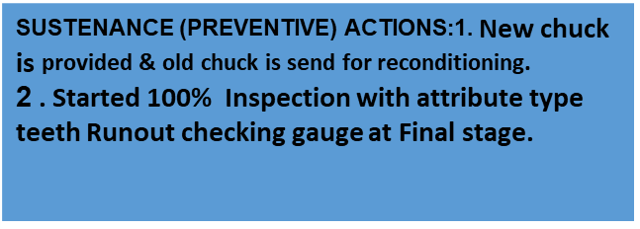
Part Name | Model | Vendor | Defect | Actions | T.Date | Status
WHEEL CLUTCH FINISHED UPGRADE (520PP01902) | 3W4S | Madhura Die Cast Pvt. Ltd. | Customer complaint –Fitment issue due to teeth run out found up to 1.15 mm against 0.2 mm Physical Phenomenon –Problem in Fitment Why 1: Fitment issue due to teeth run out found up to 1.15 mm against 0.2 mm Why 2:.- CNC machine chuck Jaw abnormal clamping Why 3:- Out of three one jaw got play during clamping Why 4:- Jaw clamping pad area in CNC chuck got wear Why5:- Jaw clamping area play found upto 0.15 mm. Root Cause::Jaw clamping pad area in CNC chuck got wear. | Cause Side Action: New chuck is provided & old chuck is send for reconditioning . Started Jaw Clamping (Working condition ) Verification on daily JH Activity . PM Plan revised Mentioned specific dimension of chuck guide area 14 mm tolerance upto, +H7(0.025mm). Started Chuck Inspection by using master Ring & dial stand point verified in daily JH activity. Jaw Boring frequency is define in PM Check sheet & its monitoring started. Clamping pressure validation started interlock given to chuck clamping pressure. New attribute Relation gauge manufacturing is started . Mgf .Target Date – 05.11.2023 Customer complain action sustenance verification register maintain. Inspection side action: 1. Started 100% Inspection with attribute type teeth runout Checking gauge at Final stage. 2. Also Fitment checking parameter with meeting part 3W4S hub added in final inspection check sheet. 3. Inspection Agreement & PDIR is revised for 100% inspection with attribute type teeth runout gauge. 4. Started doc audit daily basis & data maintained . | 16.10.2023
HORIZONTAL DEPLOYMENT : YES IMPL. STATUS & DATE : Under progress 15.10.2023

Slide 3
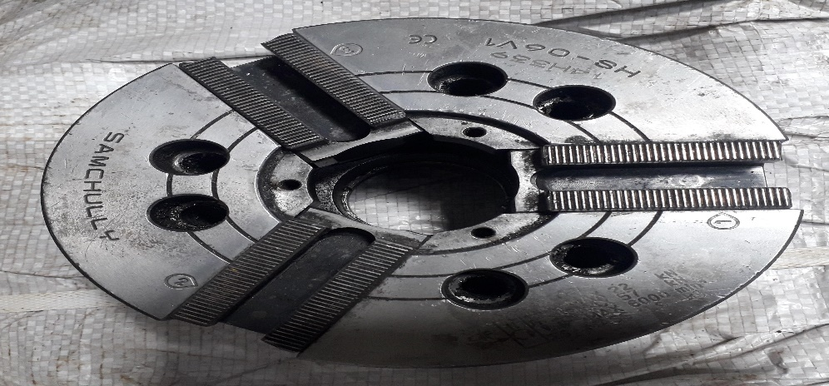
Corrective Action Details
Cause Side Action:
New chuck is provided & old chuck is send for reconditioning .
Started Jaw Clamping (Working condition ) Verification on daily JH Activity .
PM Plan revised Mentioned specific dimension of chuck guide area 14 mm tolerance upto, +H7(0.025mm).
Started Chuck Inspection by using master Ring & dial stand point verified in daily JH activity.
Jaw Boring frequency is define in PM Check sheet & its monitoring started.
Clamping pressure validation started interlock given to chuck clamping pressure.
New attribute Relation gauge manufacturing is started . Mgf .Target Date – 05.11.2023
Customer complain action sustenance verification register maintain.
Inspection side action:
1. Started 100% Inspection with attribute type teeth runout Checking gauge at Final stage.
2. Also Fitment checking parameter with meeting part 3W4S hub added in final inspection check sheet.
3. Inspection Agreement & PDIR is revised for 100% inspection with attribute type teeth runout gauge.
4. Started doc audit daily basis & data maintained .
Jaw clamping pad area in CNC chuck got wear

