Slide 1
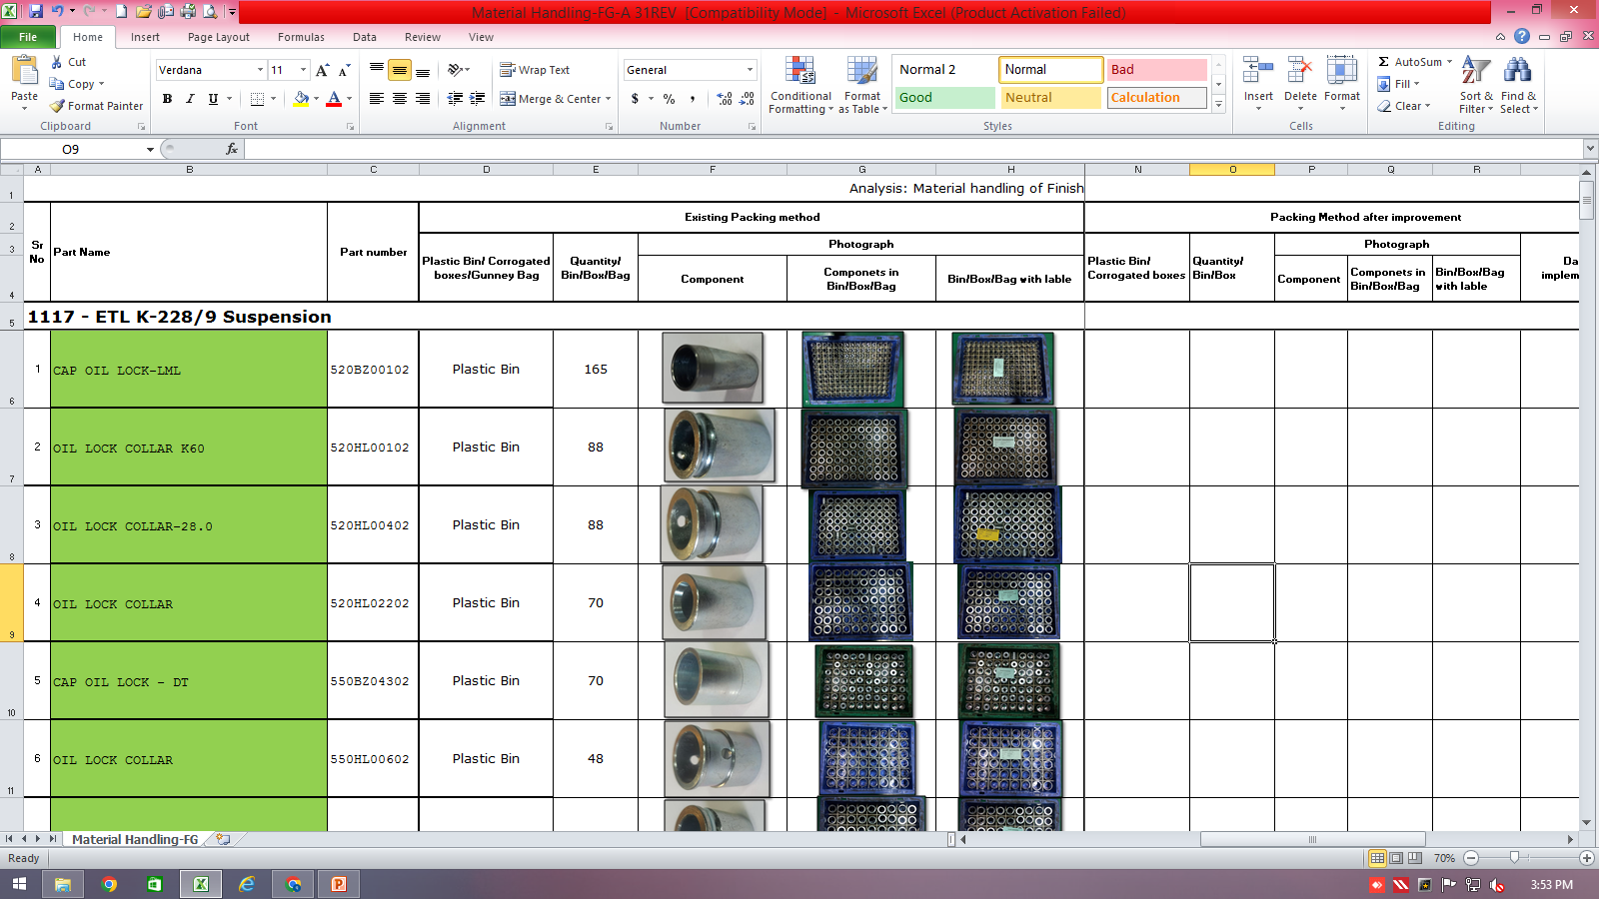
Countermeasure:- PACKING STAGE
EVIDENSES
FINAL INSPECTION: ‘Q’ GATE
BEFORE
AFTER
Transparent poly bag are being used at BSR stage
Countermeasure: SOP & Analysis: Material handling of Finish Product being supplied to Endurance displayed at BSR.

